Slide 1



Orientation to the Self-Assessment Process in Head Start

Slide 2


Welcome!
Thank you for joining our self-assessment team.

Slide 3

Overview of Head Start and Early Head Start
In 1965, Head Start began as a summer program for preschoolers as part of the War on Poverty.
In 1995, Head Start expanded to include Early Head Start, serving pregnant women and children ages 0–3.
In 2014, Early Head Start was again expanded through the funding of Early Head Start-Child Care Partnerships.
Head Start and Early Head Start programs support comprehensive services, including those that address
the cognitive, social, and emotional development of children from birth to age 5.
Family engagement has always been a cornerstone of the Head Start program.

Slide 4

What Is Head Start?
A program focused on helping young children prepare for and be successful in school. This is done by providing comprehensive services that are responsive to each child and family's ethnic, cultural, and
linguistic heritage.

Slide 5

Head Start Today

Slide 6

About Our Program
Our history
Locations, size, and demographics
Program design and services
Our partners
Growing, changing, and learning

Slide 7

Our Program Goals
Add your program goals
. . . . . . . . . . . . . . . . . . . . . . . . . . . . . . . . . . . . . . . . . . . .
. . . . . . . . . . . . . . . . . . . . . . . . . . . . . . . . . . . . . . . . . . . .
. . . . . . . . . . . . . . . . . . . . . . . . . . . . . . . . . . . . . . . . . . . .

Slide 8




The Head Start Act and the HSPPS

Slide 9





Recommended Practices for Self-Assessment
A process for reviewing progress on goals and objectives, being accountable for what you proposed in your application, and determining if resources are used effectively
What?
To leverage strengths and look for areas of improvement and innovation
Program staff, parents, Policy Council and governing body/Tribal Council members,
Why?
Who?
community leaders, content experts, and other interested people
When?
Annually
How?
Follow the five-phase self-assessment process

Slide 10

Role of a Self-Assessment Team Member
Remain open-minded and strength-based
Analyze data
Engage in dialogue with team
Value the opinions of others
Recommend
Ensure parents have a voice at the table to share their unique perspectives

Slide 11

Role of a Team Leader
Assist team members as they review data
Use a strength-based process and encourage dialogue about information presented
Support team members who may be reluctant to share their thoughts or ideas
Build team consensus around recommendations
Prepare a summary recommendation report to be shared with the full self-assessment team
11

Slide 12






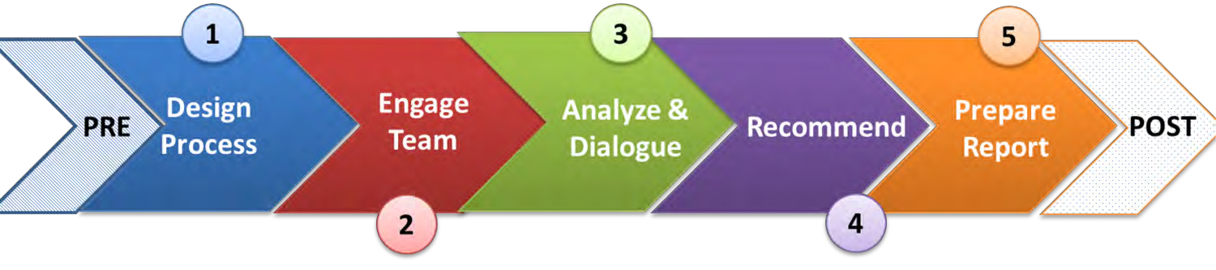


Phases of Self-Assessment

Slide 13

Our Plan for This Year's Self-Assessment
Add your plan and timeline for self-assessment
. . . . . . . . . . . . . . . . . . . . . . . . . . . . . . . . . . . . . . . . . . . .
. . . . . . . . . . . . . . . . . . . . . . . . . . . . . . . . . . . . . . . . . . . .
. . . . . . . . . . . . . . . . . . . . . . . . . . . . . . . . . . . . . . . . . . . .

Slide 14

Why Start with Strengths?
Learn from what is going well
Appreciate the progress made on goals and objectives
Investigate systemic issues
Move toward innovations
Improve outcomes for children and families

Slide 15

Topics and Questions for This Year's Self-Assessment
Add your topics and questions
. . . . . . . . . . . . . . . . . . . . . . . . . . . . . . . . . . . . . . . . . . . .
. . . . . . . . . . . . . . . . . . . . . . . . . . . . . . . . . . . . . . . . . . . .
. . . . . . . . . . . . . . . . . . . . . . . . . . . . . . . . . . . . . . . . . . . .

Slide 16

Analyzing the Data
What do we know?
What is the data telling us?
What don't we know?
Is there a way to find out with additional data?
What questions does the data pose?
What patterns and trends do we notice when we compare year-to-year data?
What do we learn from looking at multiple sources of data regarding one topic or issue?

Slide 17

Data We Will Examine in This Year's Self-Assessment
Add the program data you will bring into self-assessment
. . . . . . . . . . . . . . . . . . . . . . . . . . . . . . . . . . . . . . . . . . . .
. . . . . . . . . . . . . . . . . . . . . . . . . . . . . . . . . . . . . . . . . . . .
. . . . . . . . . . . . . . . . . . . . . . . . . . . . . . . . . . . . . . . . . . . .

Slide 18

Dialoguing with the Team
Establish ground rules
Hear everyone's voice
Stay focused on the "big picture"
Work together to get "unstuck"
Value the group process over individual opinions

Slide 19

Making Recommendations
Look at all the discoveries together
Stay focused on systems versus details
Categorize based on:
  Progress on goals and objectives
  Systemic issues
  Innovations and new resources

Slide 20

How Is the Self-Assessment Used?
Director creates final report from the recommendations
Policy Council and governing body/Tribal Council approve the final report
Director submits report to Regional Office
Self-assessment report and recommendations are used in future planning and goal-setting

Slide 21
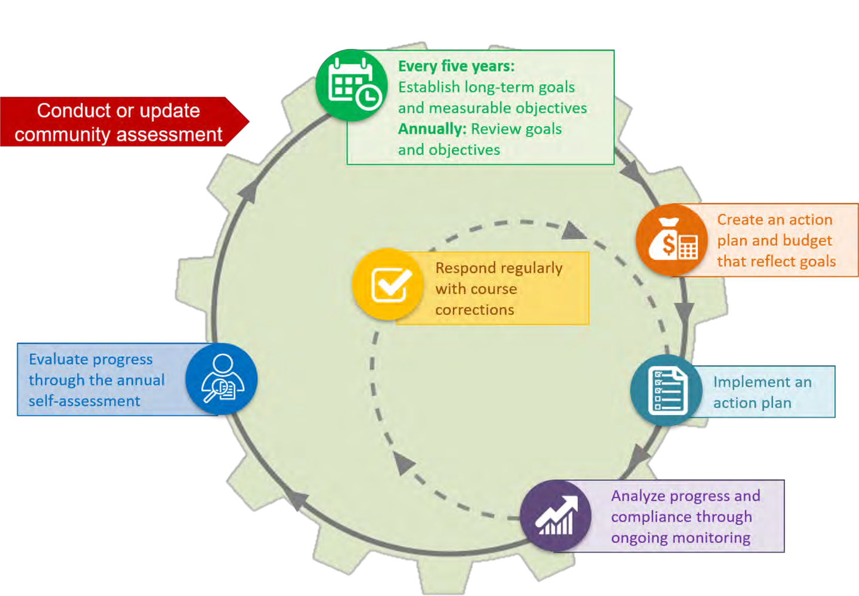
Program Planning for Continuous Improvement

Slide 22

Benefits of Self-Assessment
See the big picture
Bring fresh perspective
Understand the possibilities and challenges the program faces
Cultivate new ideas
Build stronger community partnerships
Maximize use of existing resources

Slide 23

Thank you!
Only with your help can we make this process a success.
Our children, their families, and the community-at-large will benefit from our high-quality services and the achievement of our goals!
23

Slide 24






Contact PMFO
pmfo@ecetta.info
https://eclkc.ohs.acf.hhs.gov/ncpmfo Call us: 888.874.5469

