Slide 1
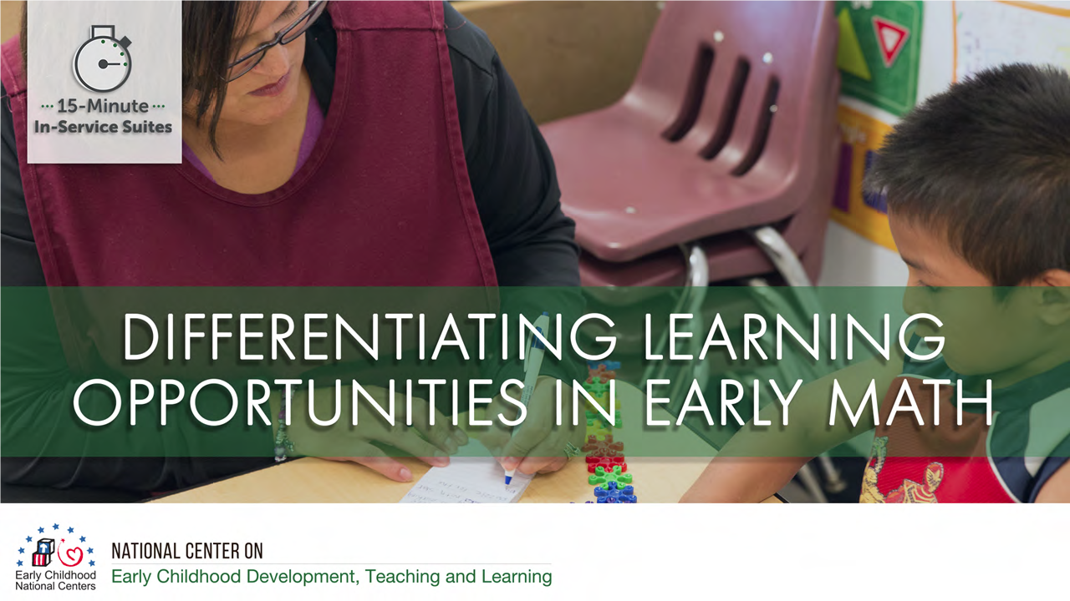

Slide 2
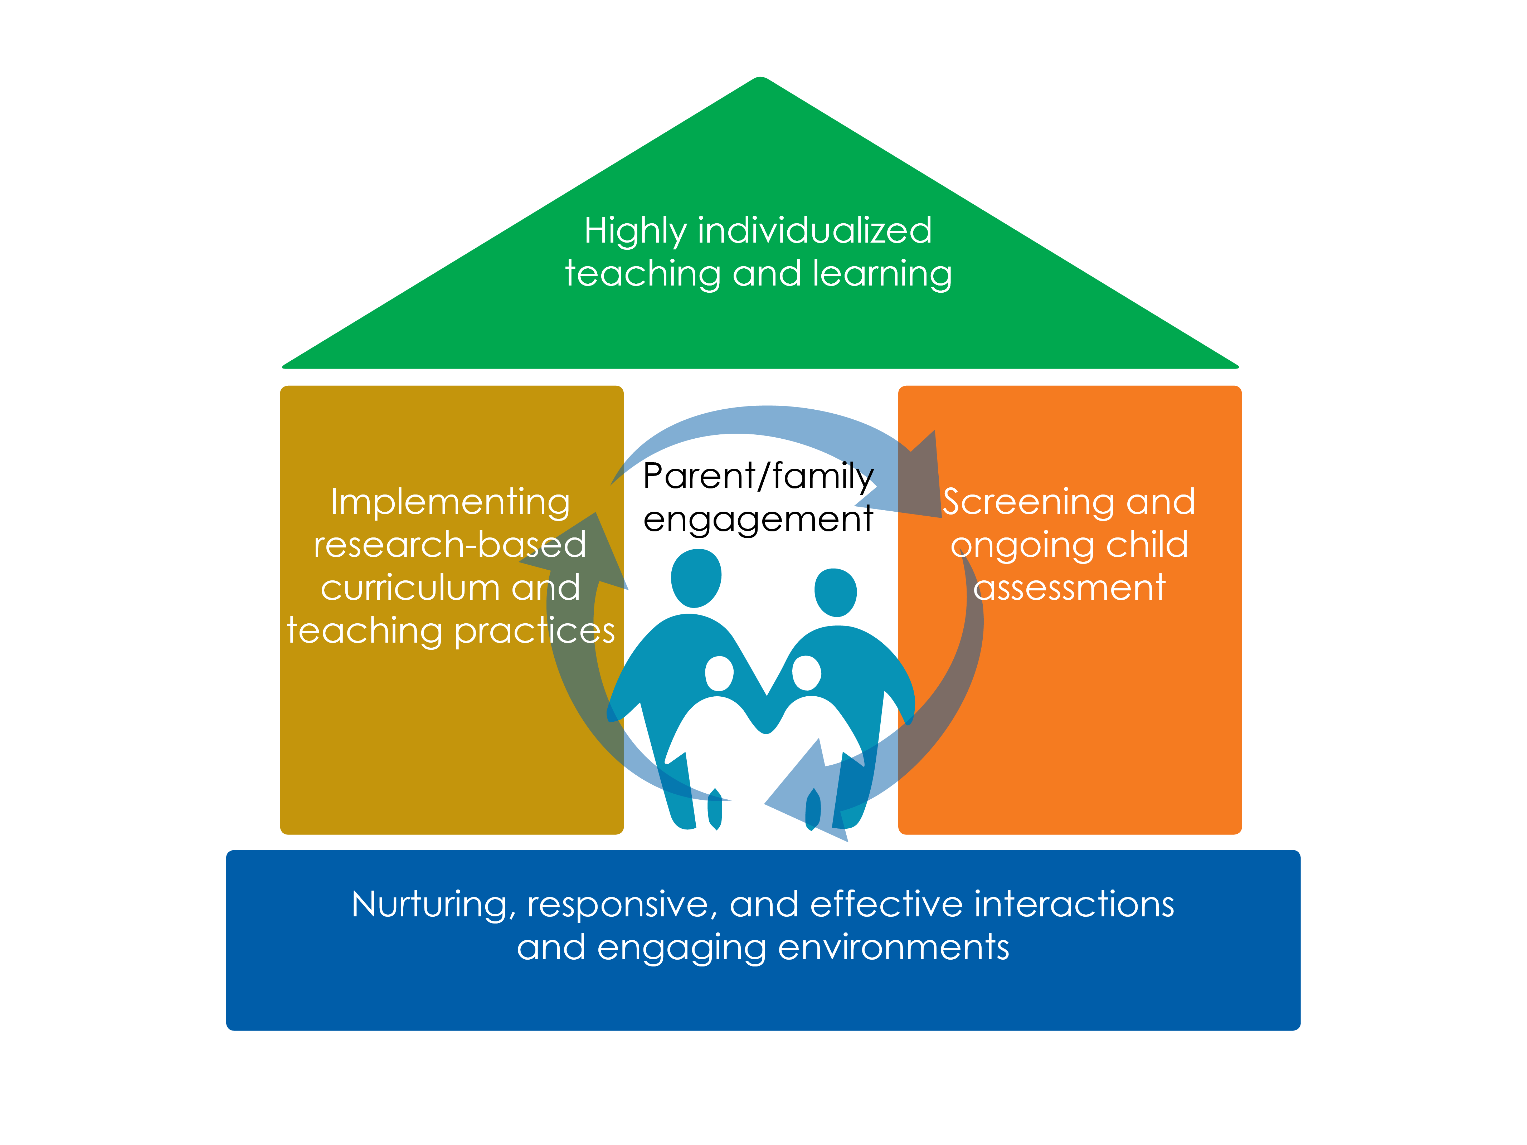
Framework for Effective Practice

Slide 3
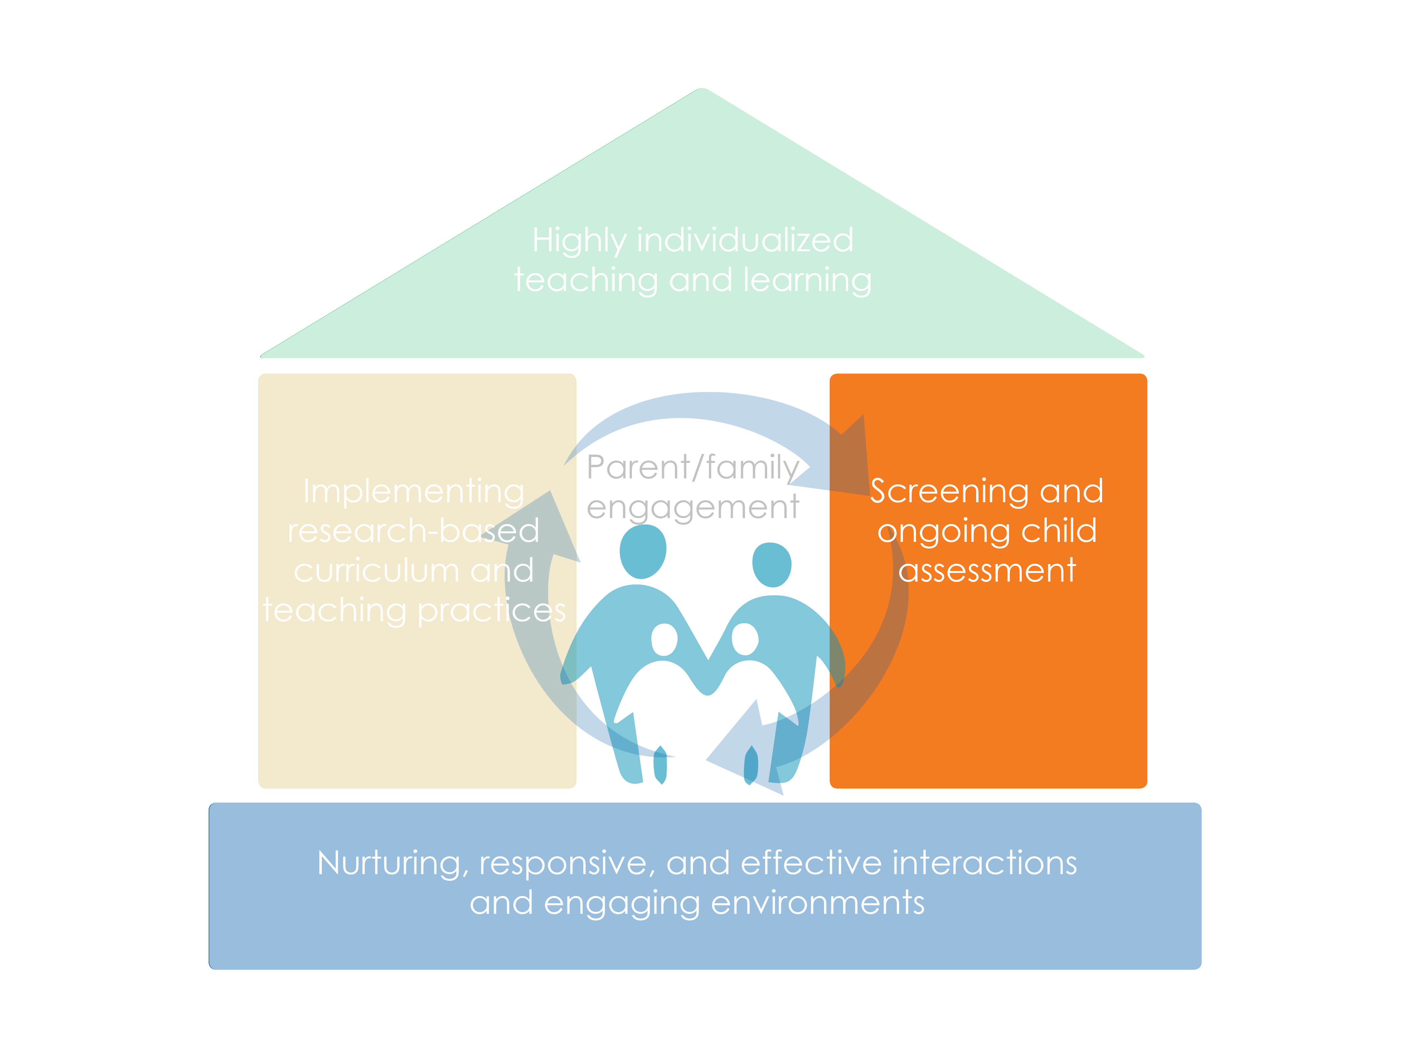
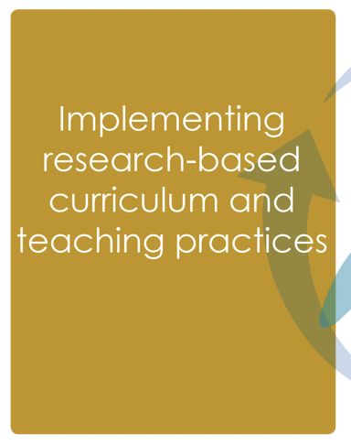
Framework for Effective Practice

Slide 4
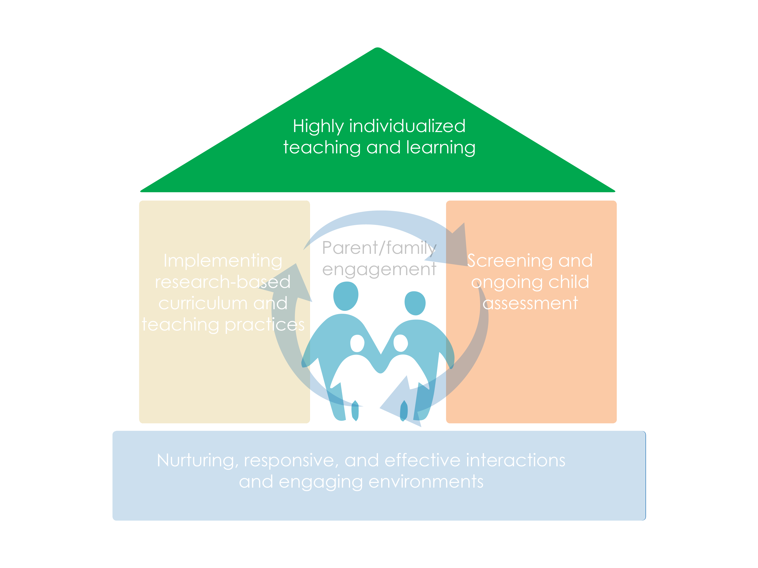
Framework for Effective Practice

Slide 5
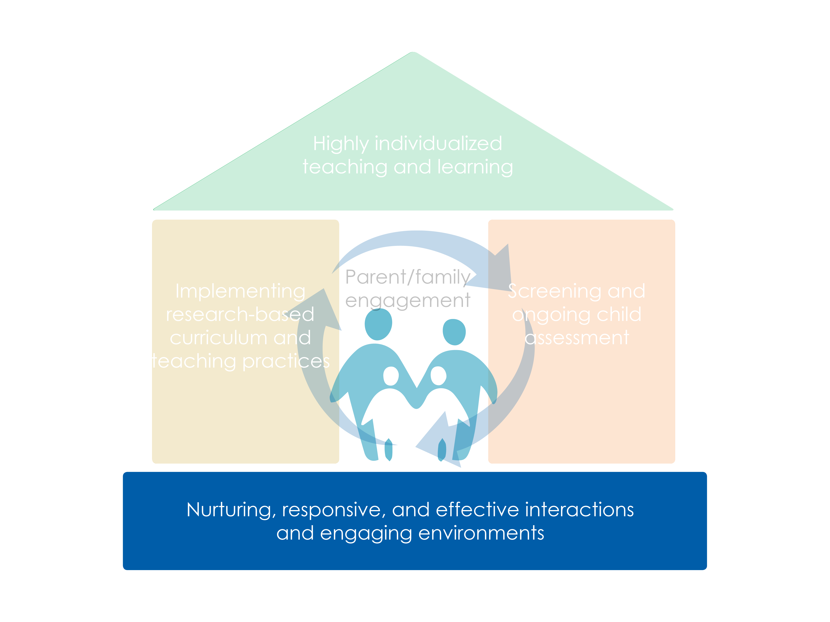
Framework for Effective Practice

Slide 6
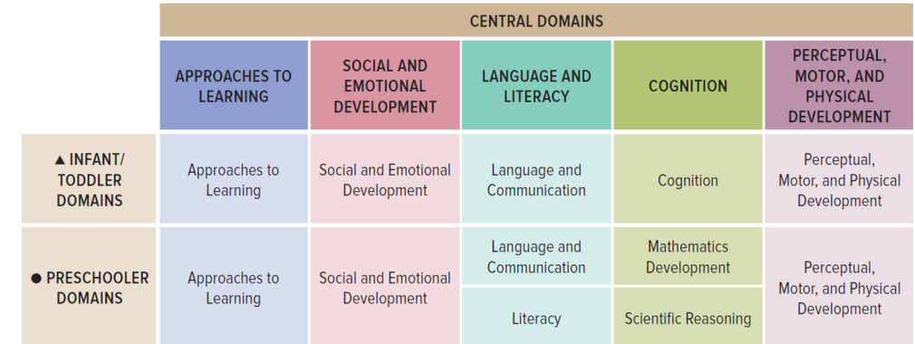
Early Math Found in the ELOF

Slide 7
Objectives
Describe the importance of differentiating learning opportunities in early math.
Provide ways to use differentiation along a developmental progression to inform teaching.
Give examples of differentiated learning opportunities based on developmental progressions.

Slide 8
What Is Differentiation?
Differentiation is the ongoing assessment of children’s learning to design beneficial learning opportunities.
Differentiation involves evaluating children’s learning in the moment it occurs—in informal discussions, in observations of natural play, or in small group activities.
And then creating learning opportunities based on what staff learn.

Slide 9
Differentiating in Early Math
Differentiating requires staff learn about children’s thinking, then create or modify the environment and interactions based on what they have learned.
Differentiating learning opportunities are key to effective early math education at all ages.
For mathematics, learning new concepts depends on learning previous ones well.

Slide 10
Why Differentiate?
Teachers underestimated “high attainers” 41% of the time.
  These children only got repetitious practice.
  They did not learn new concepts and skills.
Teachers overestimated “low attainers” 44% of the time.
  Teachers didn’t “move back” to develop ideas and skills students had not yet learned.
  Most of the time, teachers just moved to next set of tasks.
The most successful teacher spent the most time with small groups, assessing children's level of thinking through discussion.

Slide 11
How Well Are Education Staff
Supported?
When we hear the results of that and other studies, we wonder:
  How many teachers received professional development in math?
  How do teachers learn about the different developmental levels of thinking?

Slide 12
Differentiation Develops Multiple Abilities
Children who enter school with fewer math skills benefit the most from differentiated learning opportunities.
  Differentiation helps children develop self-regulation skills.

Slide 13
Differentiation Starts Early
How about infants and toddlers?
  Although interactions are different, a developmental perspective is key.
Equity concerns start early!

Slide 14
Differentiation: A Deeper Dive
Remember, differentiation is the use of ongoing assessment information about children’s learning to design learning opportunities.
Differentiation involves identifying what a child knows as it occurs—in informal discussions, in observation of natural play, or in small groups.
Education staff assess children's learning for the whole class and individual children.
Education staff build feedback loops to adjust their interactions and activities. They build on what a child knows, including everyday environments, routines, activities, and intentional instruction.

Slide 15

Learning Trajectories
We need a path.
Adults who help children progress toward their math goals don’t see themselves as “doing math” or “covering a curriculum,” but as helping children move through a learning trajectory….

Slide 16
Learning Trajectory’s 3 Parts
Goal
Developmental progression
Teaching practices: Environments, routines, and intentional activities

Slide 17
Differentiation’s Key Questions
Where are we trying to go?
Where are we now?
How can we get there?
LT goal
  LT’s developmental progression—where are children now and what are next levels?
  LT teaching practices—environment, routines, and intentional activities

Slide 18
LT Goal: Where Are We Trying to Go?
Beyond “rote” counting.
Goal is accurate, fluent, confident:
  verbal counting
  object counting
  counting strategies
Counting is the key to all future number knowledge as well as the first and most basic mathematical algorithm.

Slide 19
Developmental Progression and Assessment:
Where Are We Now?
Ongoing assessment is best conducted during interactions intended to improve teaching and learning.
This is sometimes called “curriculum-embedded assessment” or simply teacher observation and documentation during interactions with children.
Its usefulness depends on knowing the developmental progression—the path of learning and teaching.

Slide 20
Counting: A Brief Example
A little girl holds four crayons in her right hand. With her left hand, she randomly touches crayons, touching some twice, as she counts “one, two, three, four, five, six.”
Think-pair-share:
  What competencies do you see?
  What might this child’s next level of thinking include?

Slide 21
Developmental Progression: Where Are We Now?
Where are we now?
  This child is a “Reciter.”
  She knows verbal counting, at least up to “six.”
Where do we go next?
  She needs to develop the ability to keep one-to-one correspondence.
Now that we know her present and next (immediate goal) levels, we turn to teaching practices.

Slide 22
LT’s Teaching Practices: How Do We Get There?
Several research-based teaching practices help children learn and use one-to-one correspondence, such as the following:
  Ask the child to count slowly and carefully, counting each item once
  If necessary, touch the child’s hand gently and count with them
Home visitors can help parents understand and notice the various developmental trajectories and encourage and support them as they use the teaching practices.

Slide 23
Improving Feedback
What is the key error?
What do I think is the reason for this child’s error?
How can I help the child to avoid this error in the future?

Slide 24
Feedback for Specific Errors
Example: Correspondence errors in counting
Emphasize accuracy—encourage counting slowly, carefully to “count each object exactly once.”
Explain keeping-track strategies for scattered collections.
  If moving objects is possible and desirable in the activity, suggest different pile.
  Explain making a verbal plan, such as “Go from top to bottom. Start from the top and count every one”—then do so.
For children with visual impairments, guide their hands and count together.

Slide 25
Should We Always Correct Errors?
Not always.
  What does the error tell us? What purpose would the correction serve?
What type of error is it?
  Example: Nita, Jen, and a counting mistake.
Focus on mathematical structure and children’s strategies—not on correct answers.

Slide 26
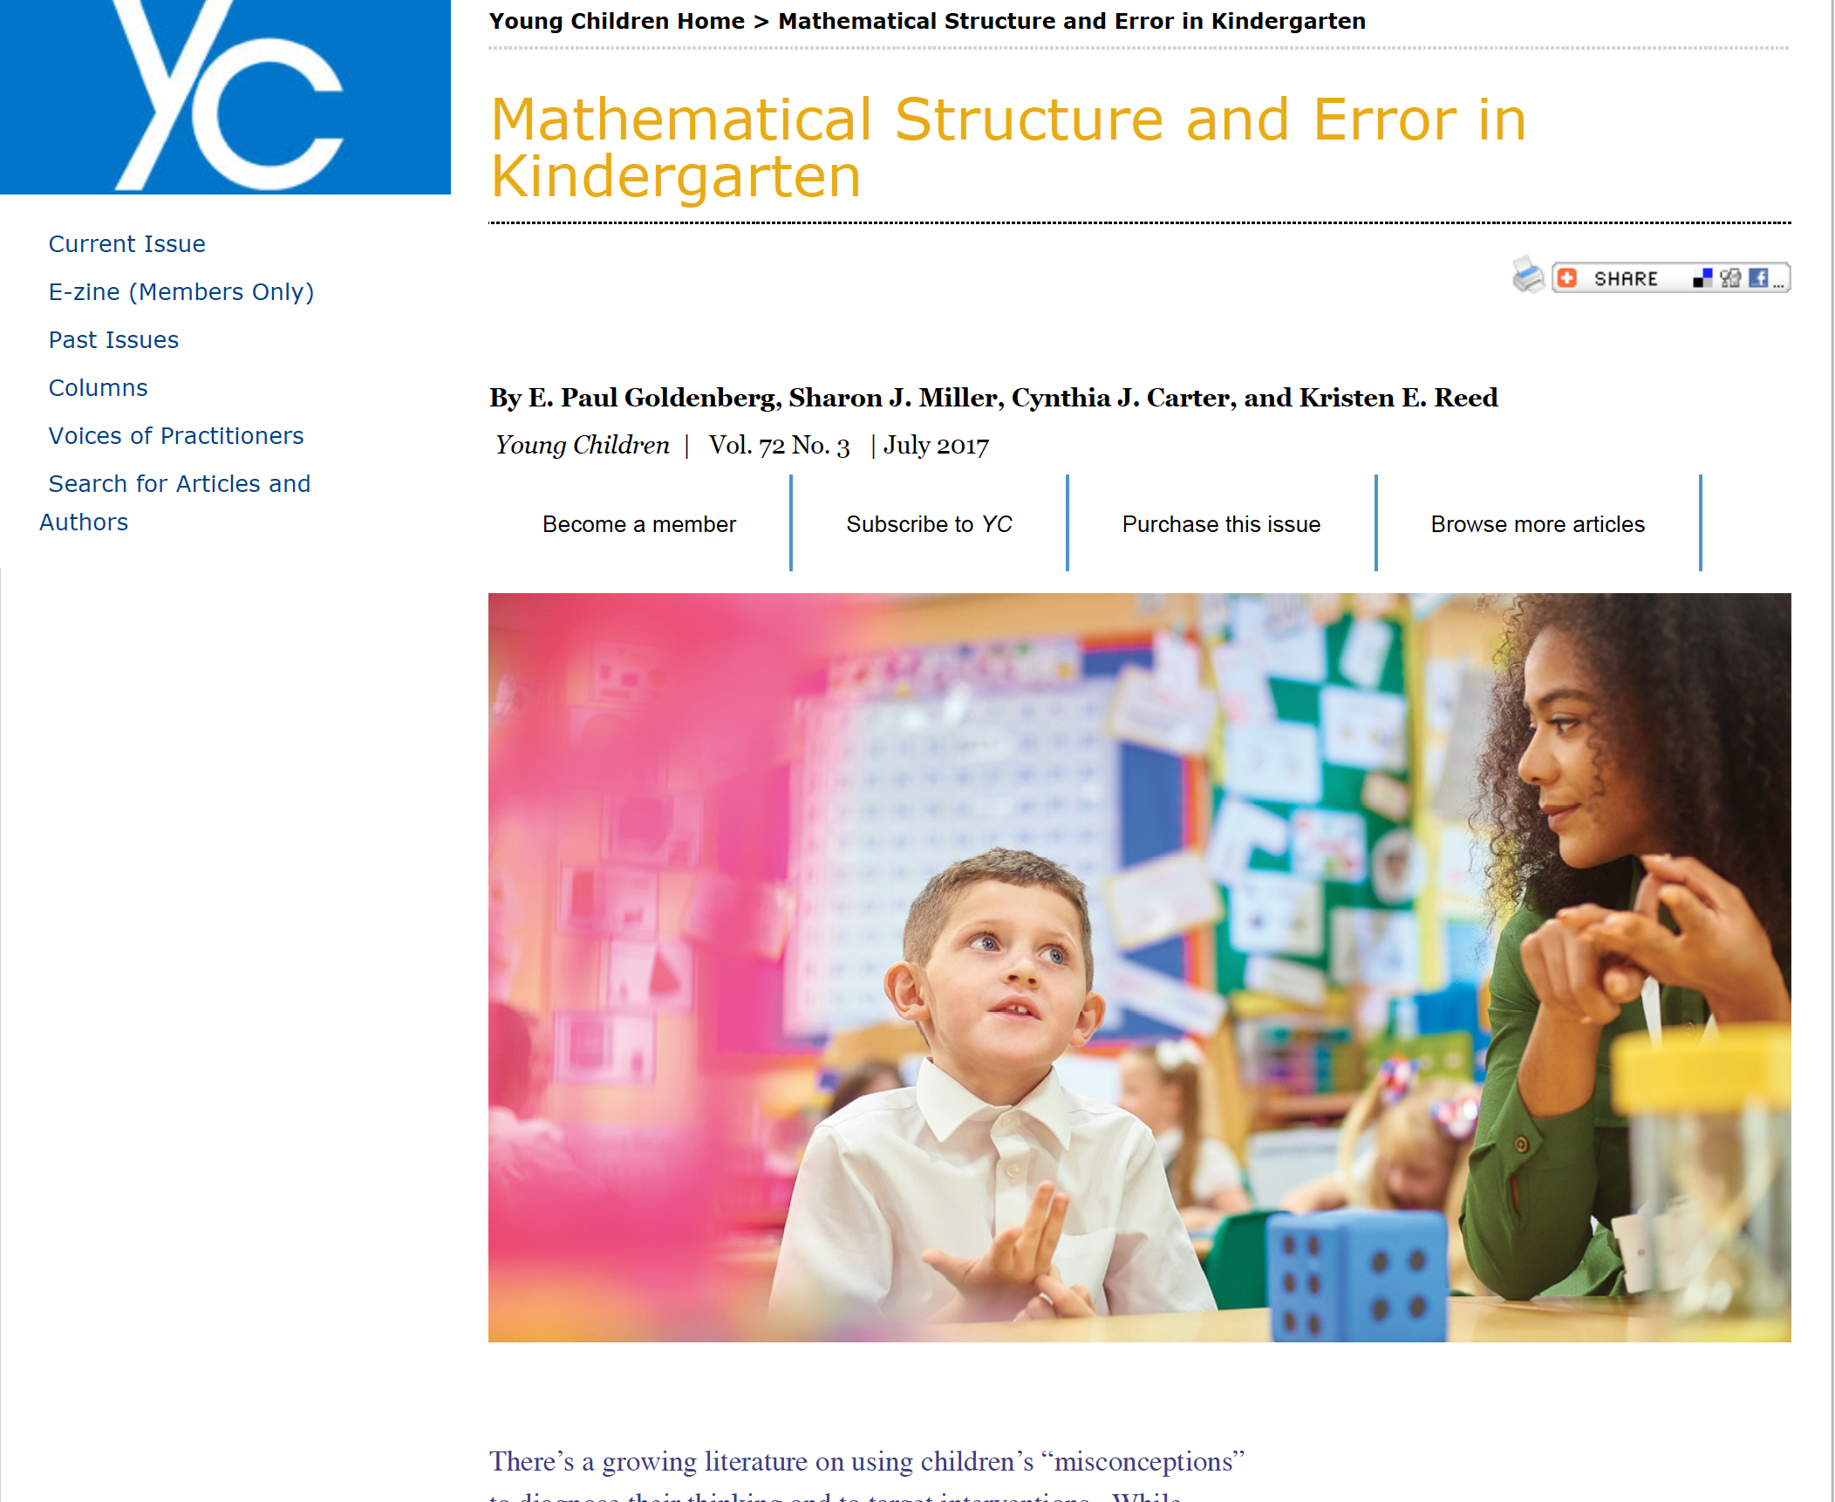
See…

Slide 27
Differentiation with Children Who Are
Dual Language Learners
Gather information on the children’s language history.
Embed differentiation assessments in playful, low-stress settings that are familiar to children.
Choose culturally meaningful and familiar materials.
Connect math terms to children’s home or Tribal language.
Use multiple representations.
Discern between emerging competence versus struggles with expressive vocabulary.
Use tiered levels of questions.

Slide 28
Dual Language and Tribal Language Learners
Teach critical words or phrases from the “big ideas” of mathematics.
Provide ongoing, special, focused experiences, often with visuals and home language support (which benefit all children).
Be aware of common phrases, idioms, and colloquialisms.
Learn and use Spanish cognates—words or roots that are similar in English.
Good curricula should provide these!

Slide 29
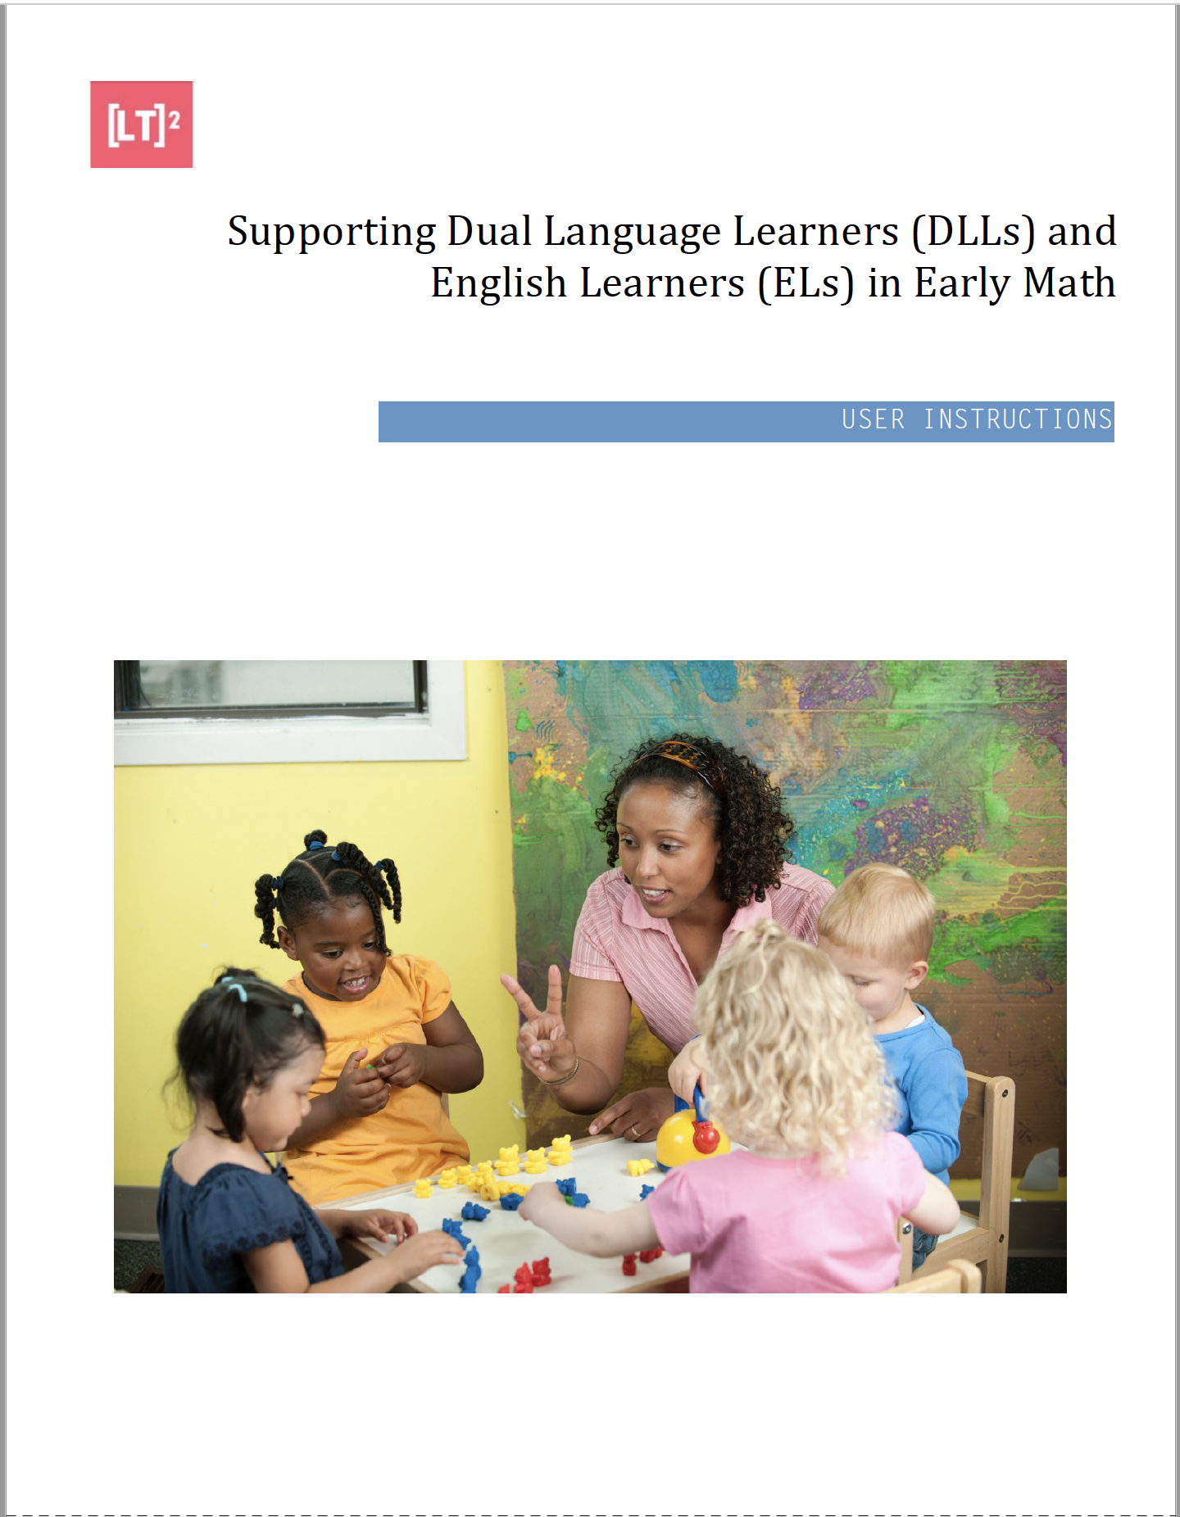
Supporting Dual Language Learners & English Learners in Early Math

Slide 30
Differentiated Instruction Benefits All Children
Create strong visual components
Provide collaborative activities where there are opportunities for peer learning
Consider a multi-sensory approach
Construct formative assessment formats that build on children’s strengths

Slide 31
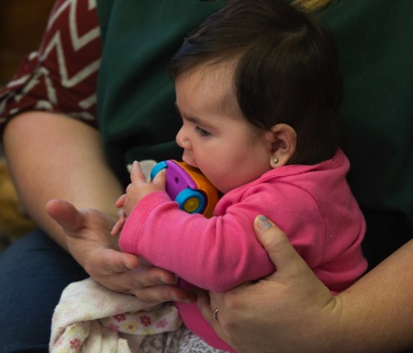

Review

Slide 32

LT²: Learning and Teaching with Learning Trajectories
See the Learning and Teaching with Learning Trajectories website for more trajectories, videos, and instructional math activities!
LearningTrajectories.org
ECLKC LT² Video Library https://eclkc.ohs.acf.hhs.gov/school-readiness/article/math-learning-trajectories

