Slide 1


Slide 2

Every Individual is Rooted in Culture
Notes:
Slide 2
Graphic is from Multicultural Principles https://eclkc.ohs.acf.hhs.gov/sites/default/files/pdf/multicultural-principles-learning-extensions-principle-01.pdf

Slide 3
Two-Eyed Seeing
“Two-Eyed Seeing asks us to see our strengths, the best in our ways of knowing, while also asking us to respect and celebrate our differences. Two-Eyed Seeing acknowledges the necessity of formal structure yet that it must be permeable to and receptive of new understandings and opportunities, i.e., understandings associated with ‘Spirit of the East’ which brings the ‘gift of newness, of transformation.’”

Slide 4
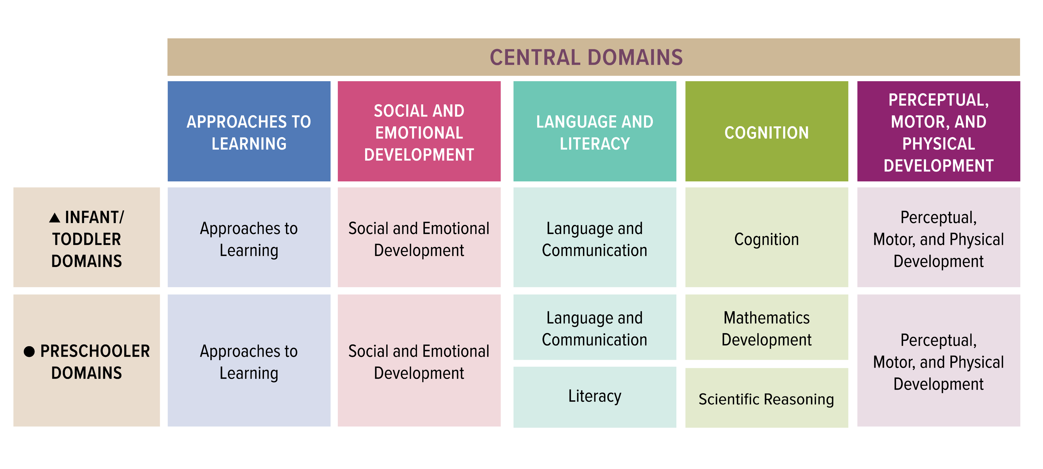
Emergent Writing Stretches Across ELOF Domains

Slide 5
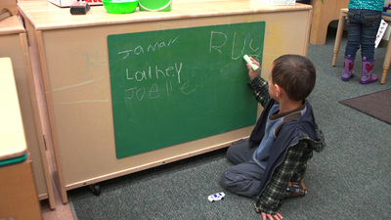
Writing Stretches Across ELOF Domains
Approaches to Learning
  Initiative and Curiosity (Infant)
  Creativity (Infant/Toddler & Preschool)
Language and Literacy
  Language and Communication (Infant/Toddler)
  Literacy (Preschool)
Cognition
  Imitation and Symbolic Representation and Play (Infant/Toddler)
  Counting and Cardinality (Preschool)
Perceptual Motor and Physical Development
  Fine Motor (Infant/Toddler & Preschool)

Slide 6
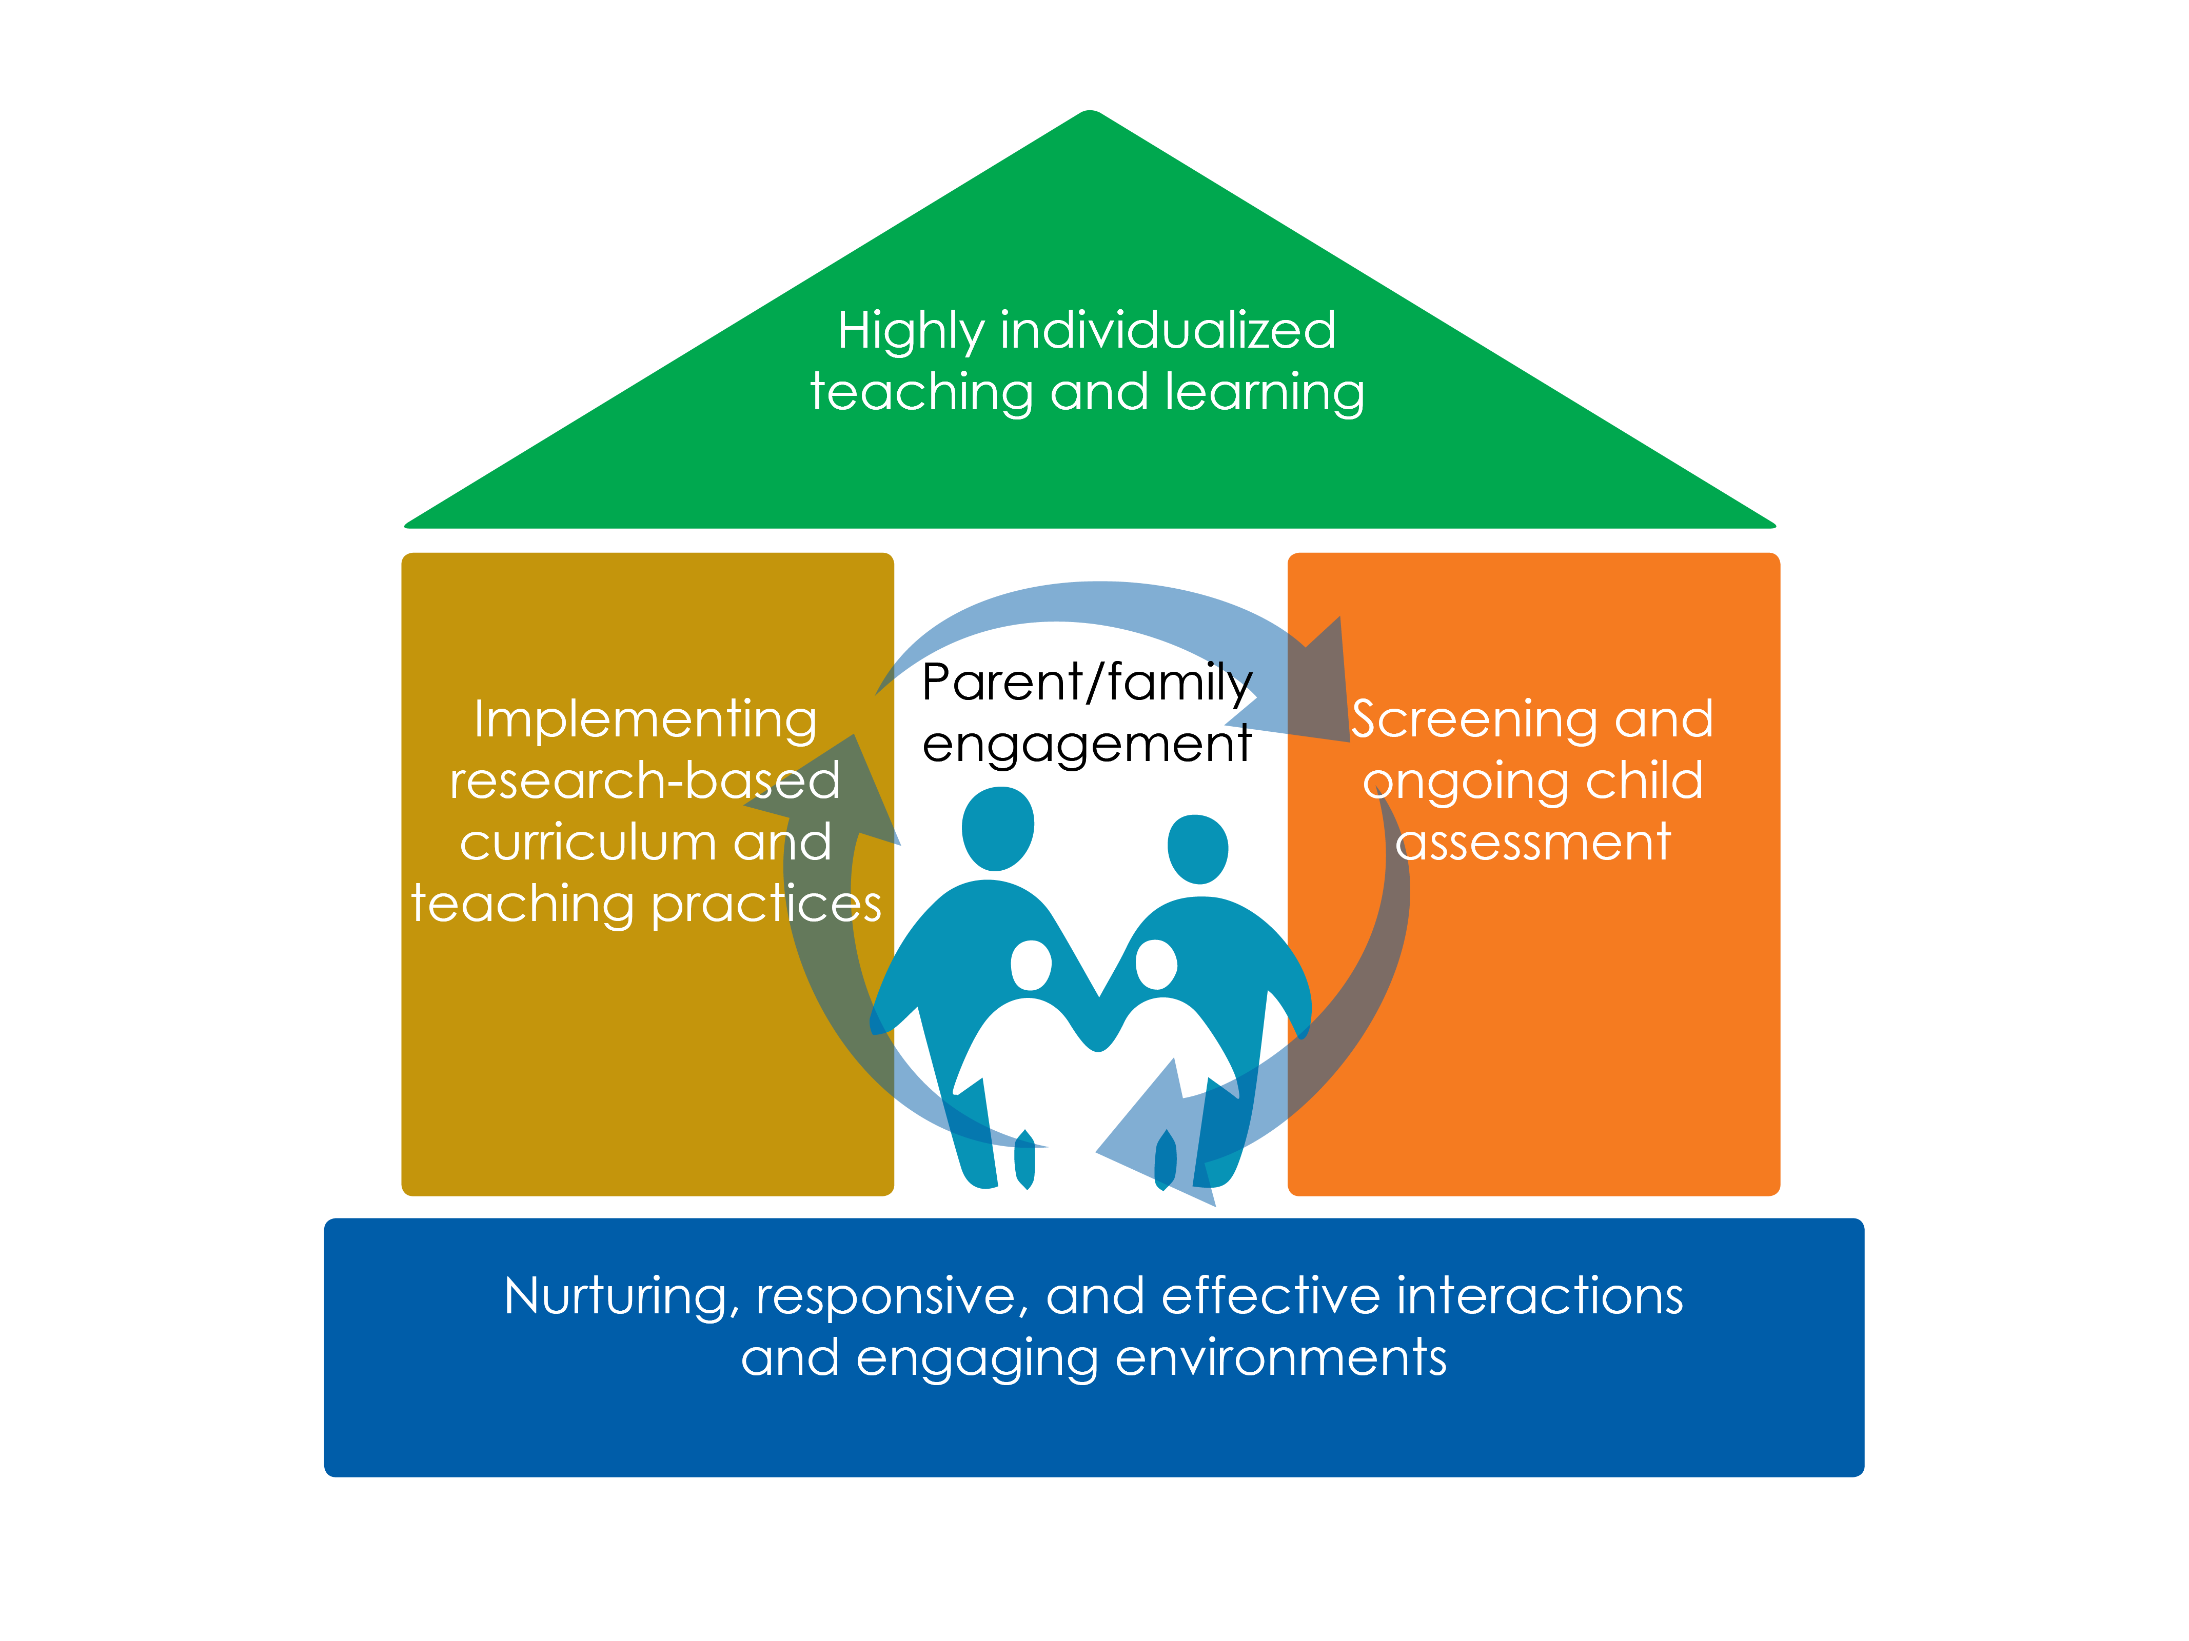
Framework for Effective Practice

Slide 7

Framework for Effective Practice

Slide 8
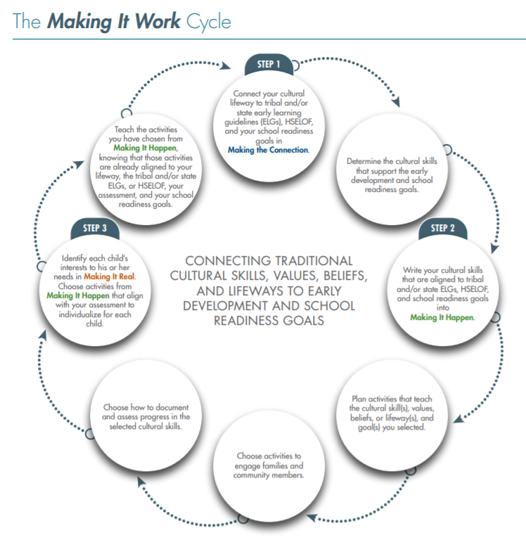
Making It Work
We were always trying to integrate culture into the curriculum—the science domain, the math domain, etc. Then we realized that culture should be at the base, serving as the foundation, the building block for curriculum development. It was an amazing paradigm shift! We are now making huge gains in integrating language and culture into our early childhood programming.
—The Red Cliff Early Childhood Center

Slide 9
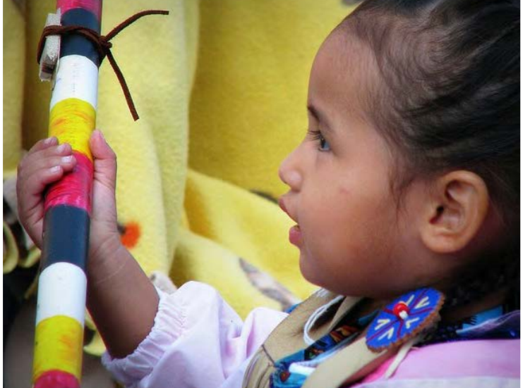
Language and Culture Matter
Without language, the canoe, paddle, water, seat, the birds you hear are different than what our ancestors experienced. If you know the language, then you know what our ancestors heard, saw, felt, and experienced.
—Zalmai “Zeke” Zahir, University of Oregon

Slide 10
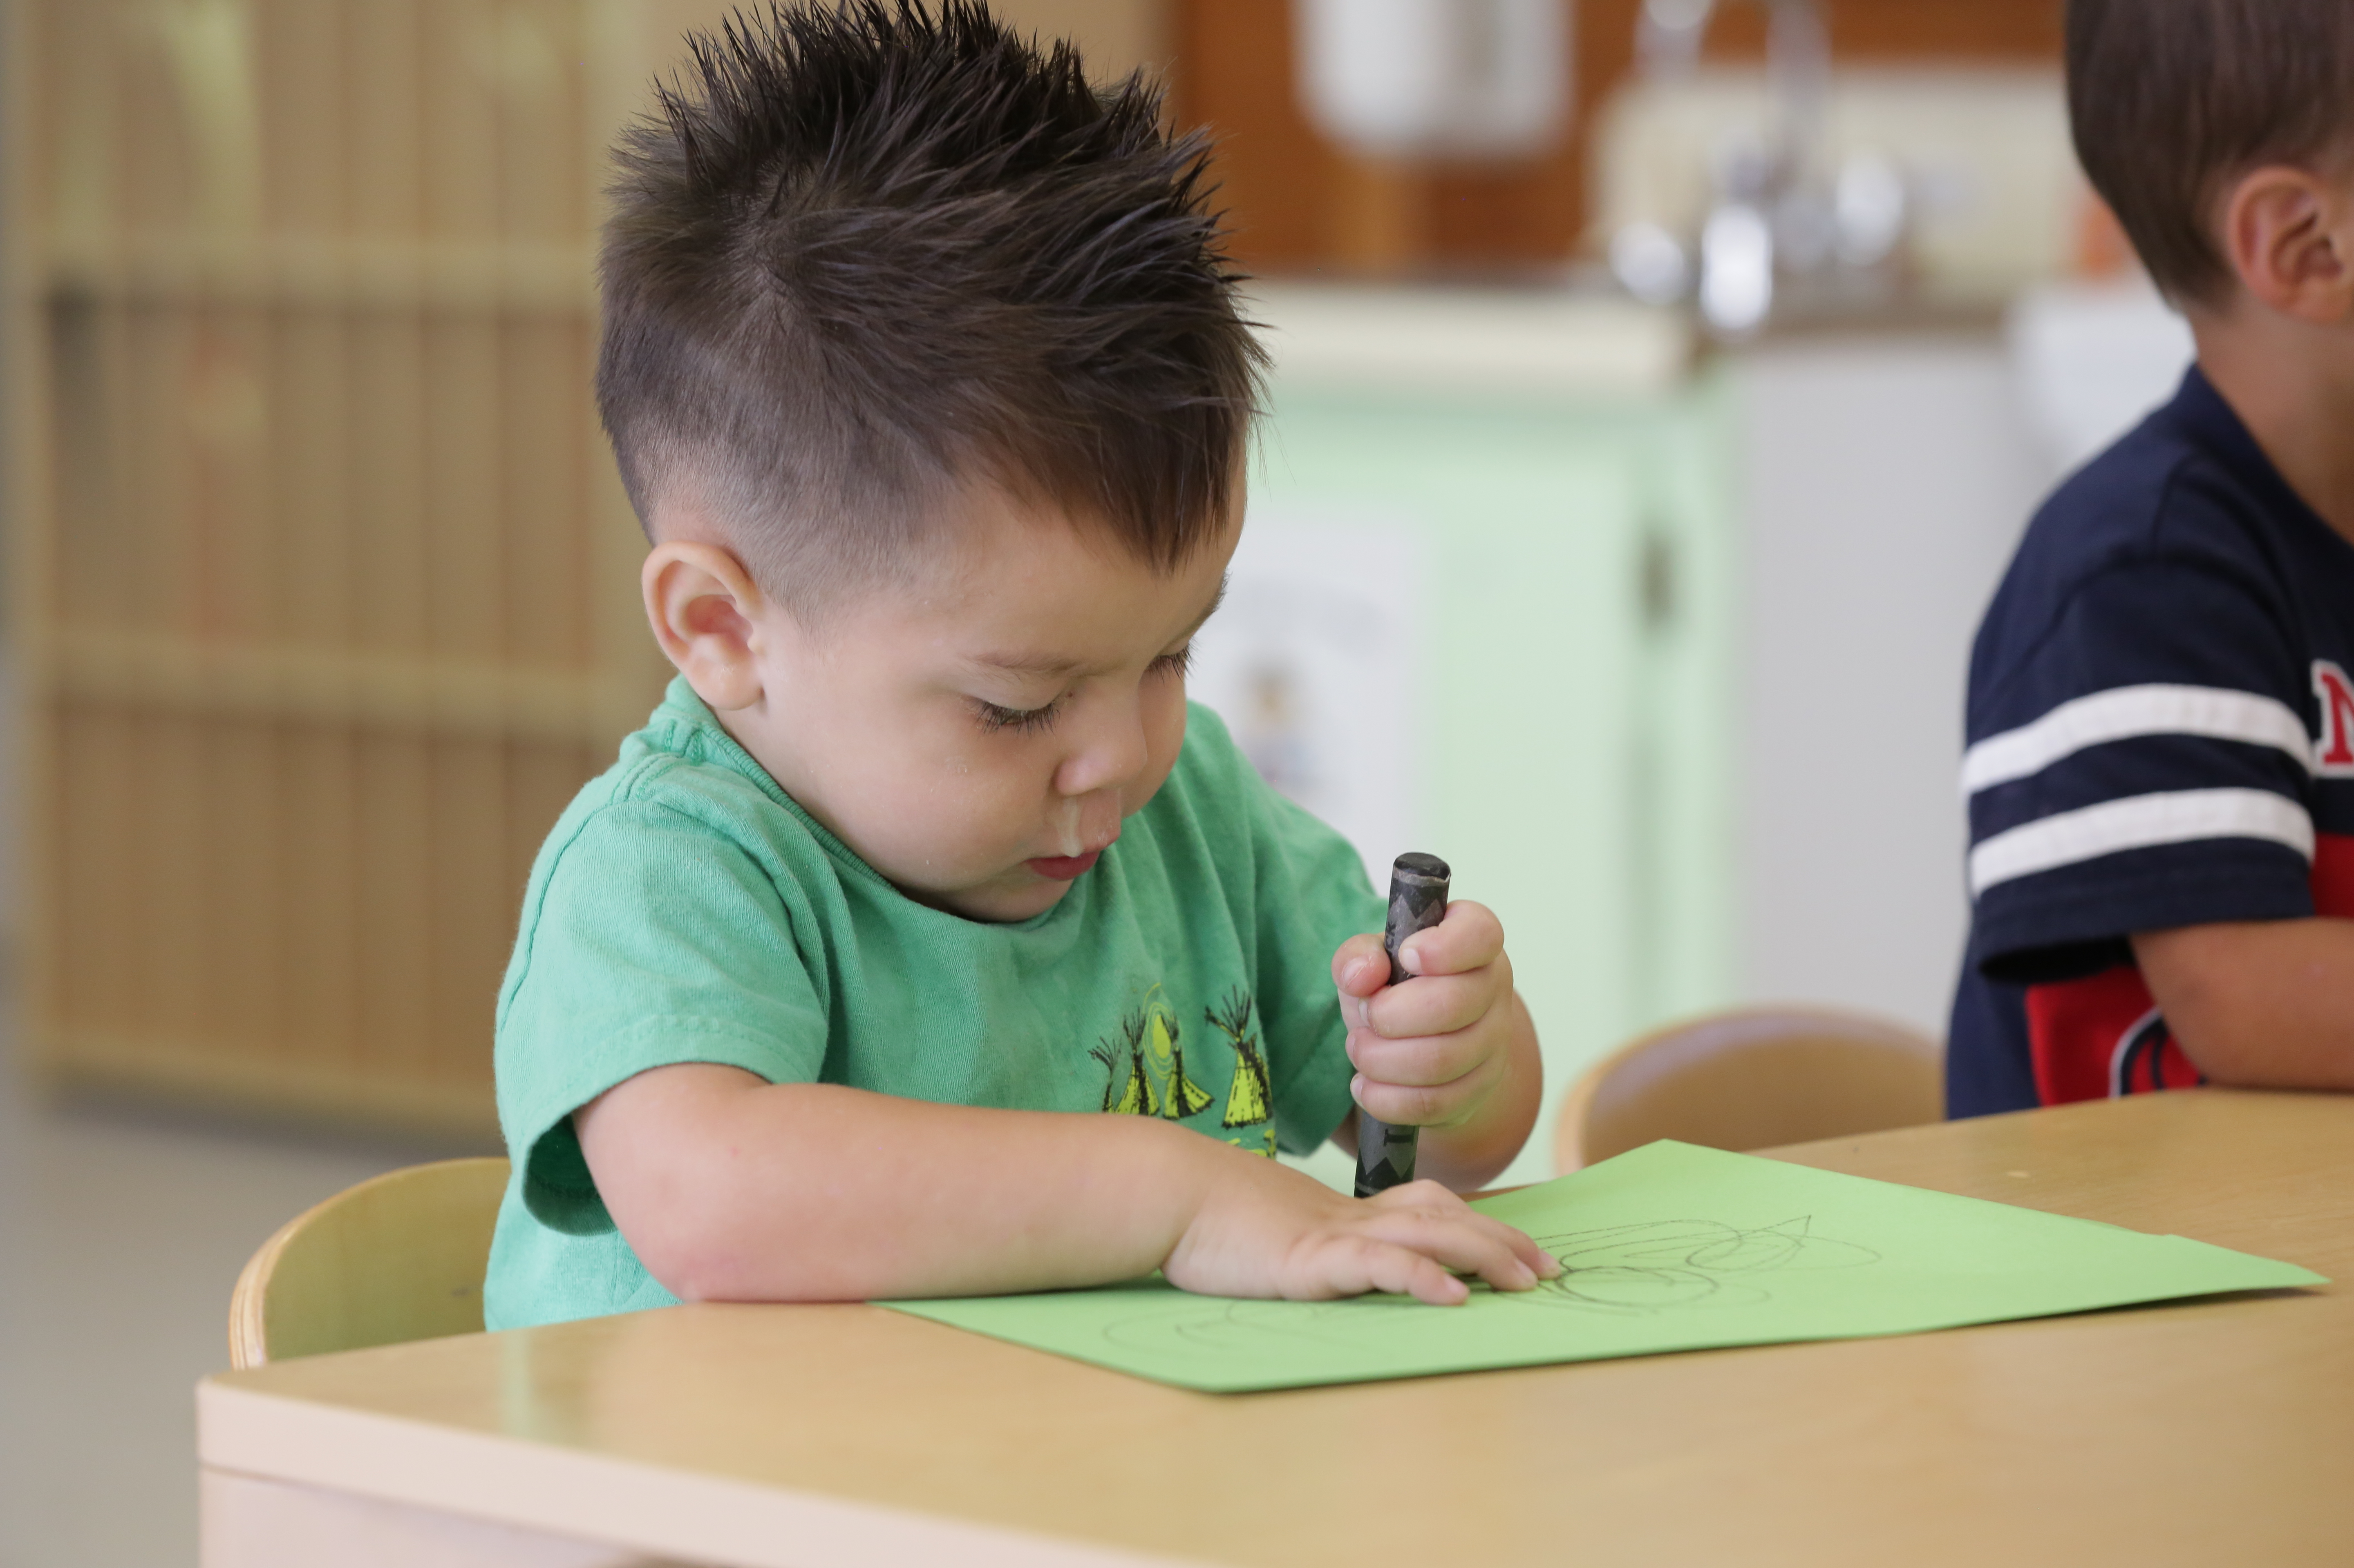
Not All Languages Are Written!
Not all Native American languages have a standard writing system
The importance of oral language for the preservation of cultural knowledge
Tribal Language Revitalization in Head Start and Early Head Start

Slide 11
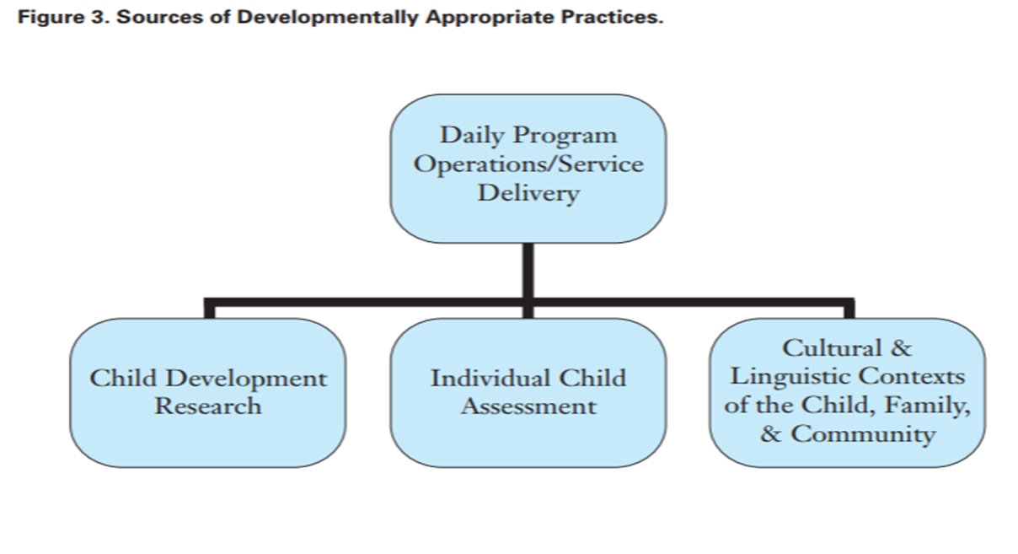
Culturally and Linguistic Responsive Practices
Sources of Developmentally Appropriate Practices

Slide 12
Session Objectives
Identify the significance of young children’s emergent writing for school readiness
Describe what emergent writing looks like in young children
Implement practical ways to begin to support emergent writing in your care setting
Learn strategies to use the Steps and Introduction to Making It Work Guide to integrate culture and language in lesson plans to assist with integration of culture and language in lesson plans for writing

Slide 13

Emergent Writing
Overview & Development

Slide 14

Definition of Emergent Writing
Children’s early attempts at writing begin with random marks and drawings and advances to invented and conventional spelling
Children as young as 2 years understand that writing has meaning and communicates ideas

Slide 15
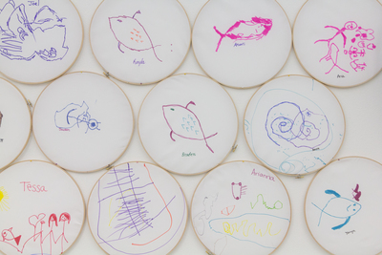
Early Stages of Emergent Writing
Children often write in drawings or scribbles without using letters.

Slide 16
Early Stages of Emergent Writing
Drawings that represent writing
2. Scribbling
Marks or scribbles the child intends to be writing
Wavy scribbles that have left-to-right progression; child pretends to write words
0. Pre-drawing
Random marks without meaning attached to them
1. Drawing
3. Wavy Scribbles/Mock Handwriting

Slide 17
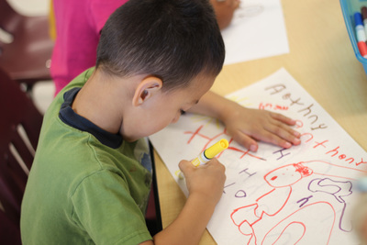
Middle Stages of Emergent Writing Development
Children begin to understand that writing includes specific symbols (letters) and follow certain patterns, but they do not yet understand or have letter-sound correspondence.

Slide 18
Middle Stages of Emergent Writing
4. Letter-like Forms/Mock Letters
Letters and marks that resemble letter-like shapes
5. Letter Strings
Strings of letters that do not create words, written left to right, including uppercase and lowercase letters
6. Transitional Writing
Letters with spaces in between to resemble words; letters or words copied from environmental print; letters often reversed

Slide 19
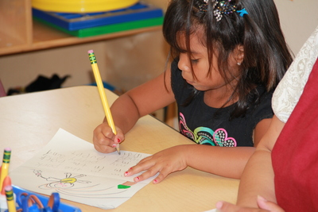
Late Stages of Emergent Writing Development
Children begin to understand and intentionally use letters to represent sounds, often starting with representing beginning sounds, then moving to ending sounds, middle sounds, and invented and more conventional spelling.

Slide 20
Late Stages of Emergent Writing
7. Invented Spelling
Invented or phonetic spelling; different ways to represent the sounds in words; often, the first letter of the word or beginning and ending sounds represent the entire word
8. Beginning Word and Phrase Writing
Words with beginning, middle, and ending letter sounds; short phrases
9. Conventional Spelling and Sentence Writing
Correct spelling, generally the child’s name and simpler or familiar words; sentences with punctuation and correct use of uppercase and lowercase letters

Slide 21
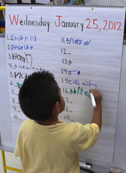
Supporting Emergent Writing
Practical Tips and Tools

Slide 22
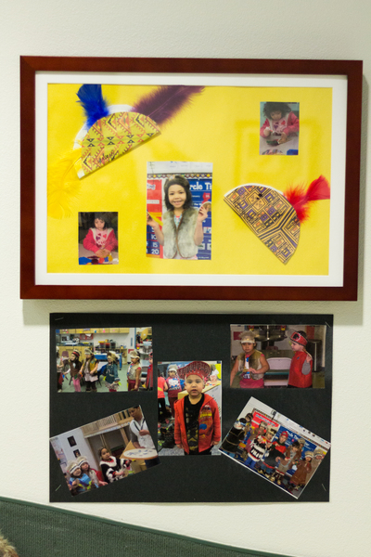
Parent, Family, and Community Engagement
Culturally and linguistically responsive environments can only be created by engaging and partnering with families, Elders, and the community. Establishing a partnership with families and the community is crucial for children’s learning and later success in life.

Slide 23
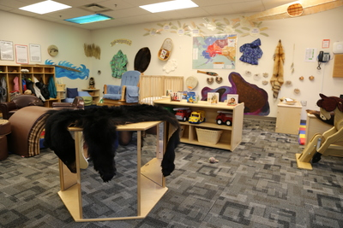
Creating A Learning Environment
To ensure that you are fully supporting children’s learning, you must understand what is valued, honored, and expected in each child’s home culture and be able to explain exactly how and what you are doing to support and take advantage of each child’s optimal ways of learning.

Slide 24
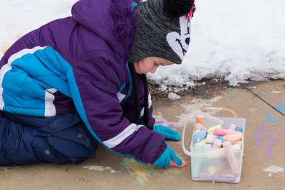
Supporting the Earliest Stages of Writing
To support pre-drawing, early drawing, and scribbling:
  Provide writing materials for children and encourage their use
  If children can talk, ask them to tell you about their drawing
  Revisit children’s drawing the next day and have children again tell you what it is or says

Slide 25
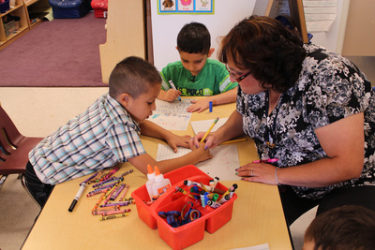
Supporting Middle and Later Stages of Writing
Start with name writing
Model writing throughout the day and in different contexts
Engage in shared and independent writing with children
Include authentic opportunities for writing throughout the day
Encourage peer scaffolding
Remember… you are supporting a process, not an outcome.

Slide 26
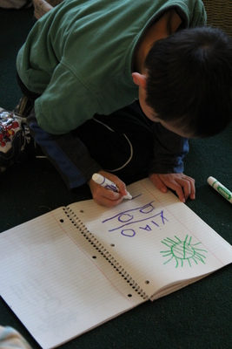
Supporting the Emergent Writing of All Children
Accept all levels of children’s writing
Accept children’s writing errors as learning or teaching opportunities
Be mindful of children’s physical abilities to write
Allow children to write in whatever language they are most comfortable
  Be aware of general differences between writing in English and writing in children’s tribal language

Slide 27
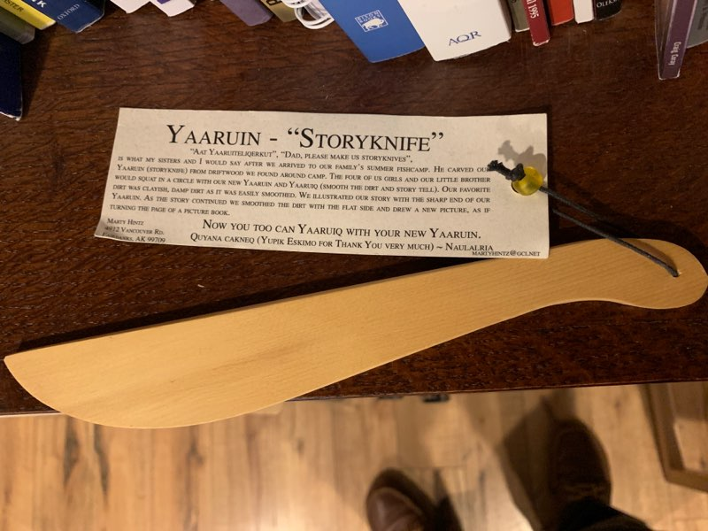
Prewriting Strategy: Story Knife
What is story knifing?
Drawing while storytelling
Peer-to-peer interaction
Drawing as a prewriting strategy
Tamaa-i-tamakut yaaruitni pencil-aaqelqaqut wangkuta.
(The story knives were our pencils.)- Neva Rivers, 2002

Slide 28
Activity: Writing in Your Setting
Select samples of children’s writing from your care setting, and review their drawing and writing
In which stage(s) of emergent writing are children?
  Don’t forget to consider whether the sample shows children’s teacher-supported or independent writing
What supports can you put in place during writing for children to help them develop in this area?
What learning opportunities can you put in place to encourage children to practice writing in a fun and meaningful way?

Slide 29
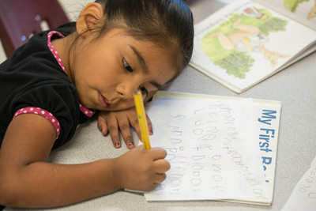
Review

