Slide 1


Slide 2
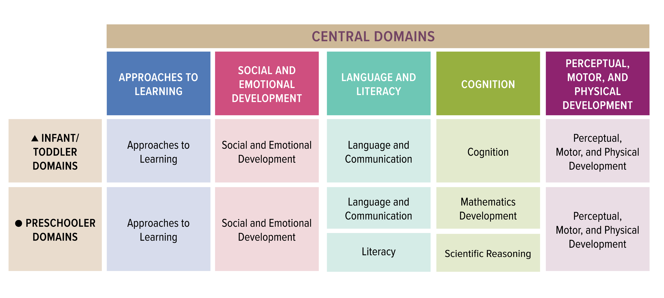
Emergent Writing Stretches Across ELOF Domains

Slide 3
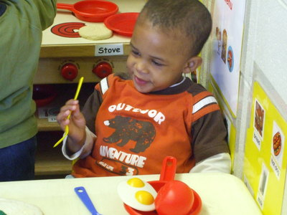
Emergent Writing Stretches Across ELOF Domains
Approaches to Learning
  Initiative and Curiosity (Infant)
  Creativity (Infant/Toddler & Preschool)
Language and Literacy
  Language and communication (Infant/Toddler)
  Literacy (Preschool)
Cognition
  Imitation and symbolic representation and play (Infant/Toddler)
  Counting and Cardinality (Preschool)
Perceptual Motor and Physical Development
  Fine motor (Infant/Toddler & Preschool)

Slide 4

Framework for Effective Practice

Slide 5

Framework for Effective Practice

Slide 6
Session Objectives
Identify the significance of young children’s emergent writing for school readiness
Describe what emergent writing looks like in young children
Implement practical ways to begin to support emergent writing in your care setting

Slide 7
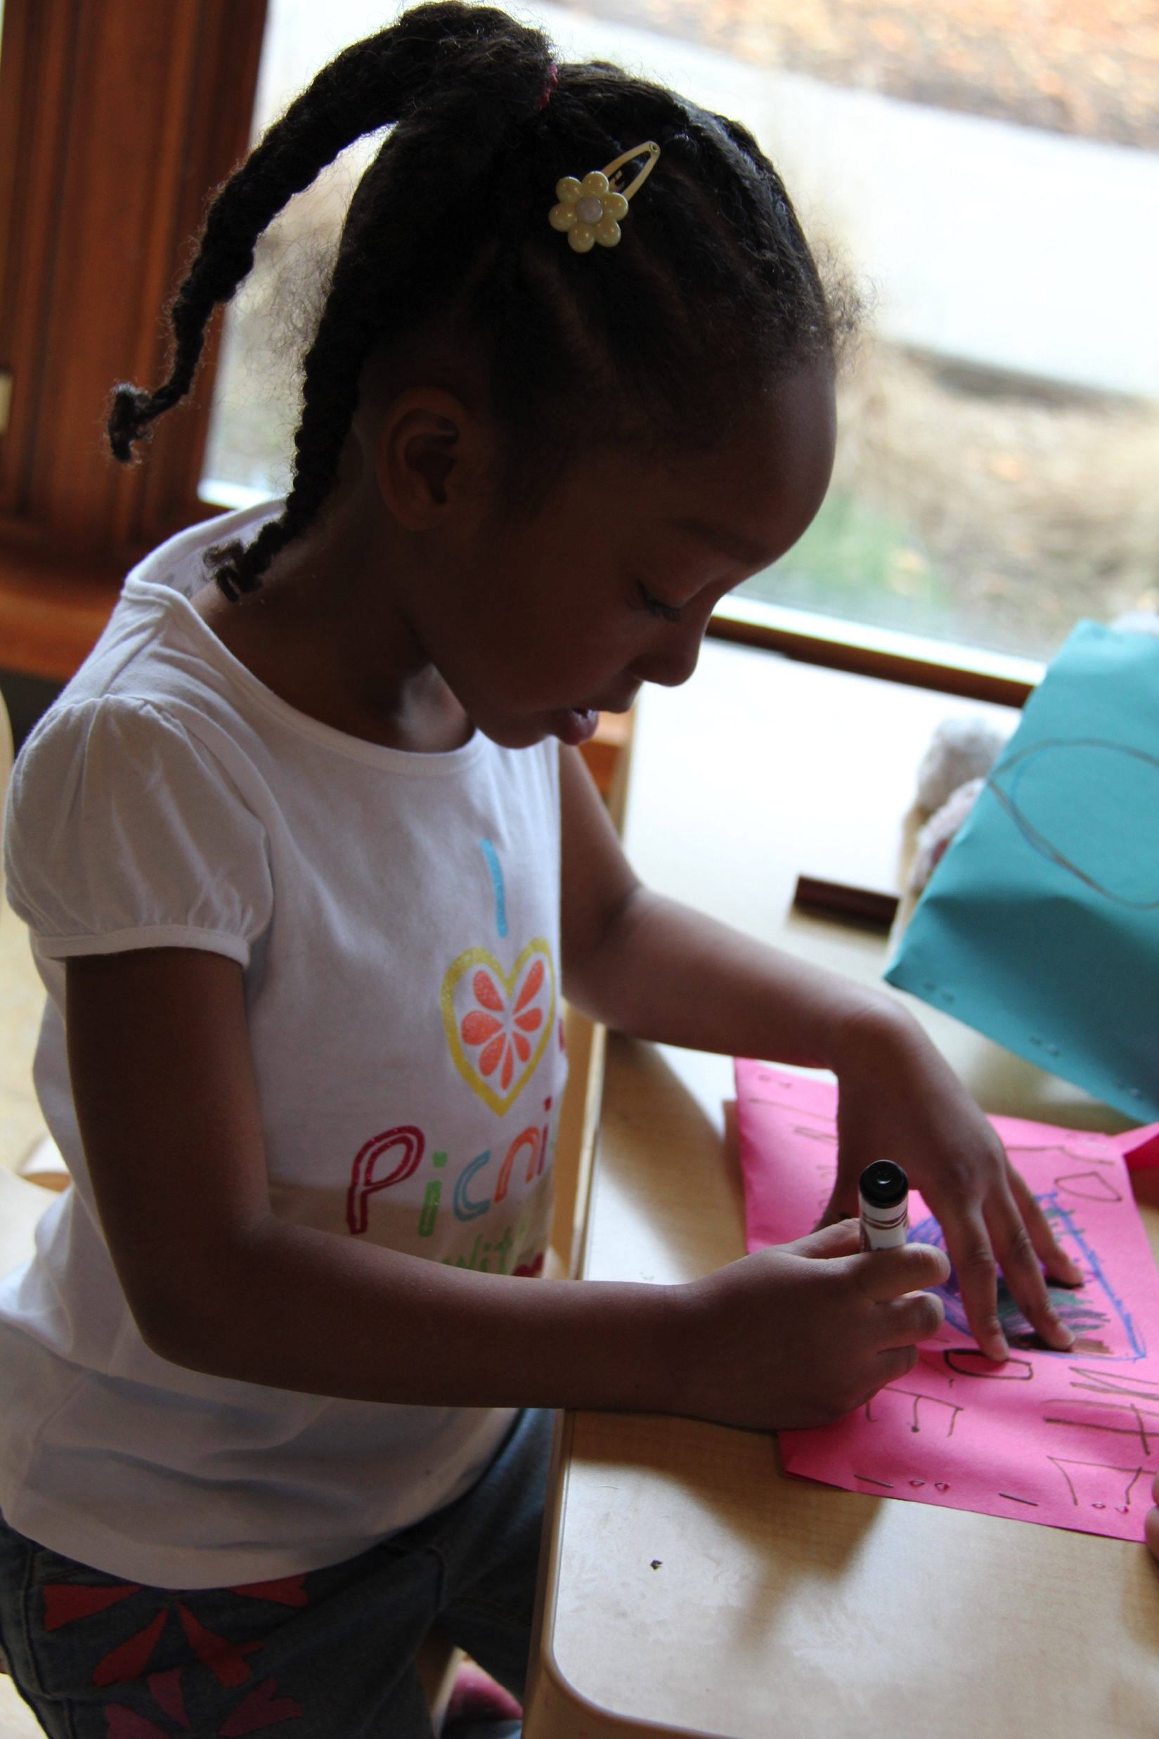
Emergent Writing
Overview & Development

Slide 8

Definition of Emergent Writing
Children’s early attempts writing begins with random marks and drawings and advances to invented and conventional spelling
Children as young as 2 years understand that writing has meaning and communicates ideas

Slide 9
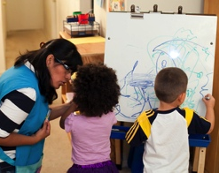
Early Stages of Emergent Writing
Children often write in drawings or scribbles without using letters

Slide 10
Early Stages of Emergent Writing
Drawings that represent writing
2. Scribbling
Marks or scribbles the child intends to be writing
Wavy scribbles that have left-to-right progression; child pretends to write words
0. Pre-drawing
Random marks without meaning attached to them
1. Drawing
3. Wavy Scribbles/Mock Handwriting

Slide 11
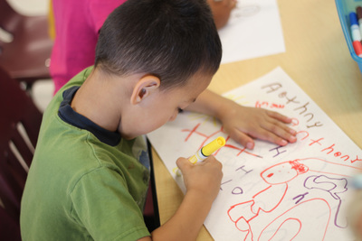
Middle Stages of Emergent Writing Development
Children begin to understand that writing includes specific symbols (letters) and follow certain patterns, but they do not yet understand or have letter-sound correspondence.

Slide 12
Middle Stages of Emergent Writing
4. Letter-like Forms/Mock Letters
Letters and marks that resemble letter-like shapes
5. Letter Strings
Strings of letters that do not create words, written left to right, including uppercase and lowercase letters
6. Transitional Writing
Letters with spaces in between to resemble words; letters or words copied from environmental print; letters often reversed

Slide 13

Late Stages of Emergent Writing Development
Children begin to understand and intentionally use letters to represent sounds, often starting with representing beginning sounds, then moving to ending sounds, middle sounds, and invented and more conventional spelling.

Slide 14
Late Stages of Emergent Writing
7. Invented Spelling
Invented or phonetic spelling; different ways to represent the sounds in words; often, the first letter of the word or beginning and ending sounds represent the entire word
8. Beginning Word and Phrase Writing
Words with beginning, middle, and ending letter sounds; short phrases
9. Conventional Spelling and Sentence Writing
Correct spelling, generally the child’s name and simpler or familiar words; sentences with punctuation and correct use of uppercase and lowercase letters

Slide 15
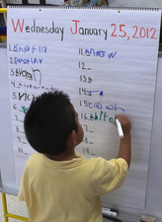
Supporting Emergent Writing
Practical Tips and Tools

Slide 16
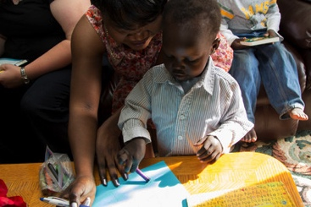
Supporting the Earliest Stages of Writing
To support pre-drawing, early drawing, and scribbling:
  Provide writing materials for children and encourage their use
  If children can talk, ask them to tell you about their drawing
  Revisit children’s drawing the next day and have children again tell you what it is or says

Slide 17
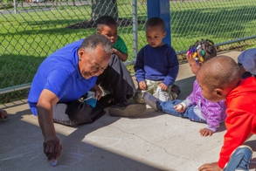
Supporting Middle and Later Stages of Writing
Start with name writing
Model writing throughout the day and in different contexts
Engage in shared and independent writing with children
Include authentic opportunities for writing throughout the day
Encourage peer scaffolding
Remember… You are supporting a process, not an outcome.

Slide 18
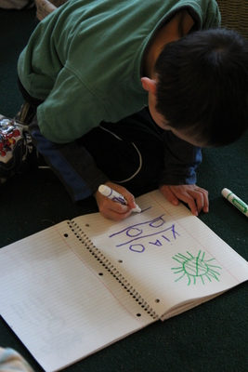
Supporting the Emergent Writing of All Children
Accept all levels of children’s writing
Accept children’s writing errors as learning or teaching opportunities
Be mindful of children’s physical abilities to write
Allow children to write in whatever language they are most comfortable
  Be aware of general differences between writing in English and writing in children’s home language

Slide 19
Learning Activity: Writing in Your Setting
Select samples of children’s writing from your care setting, and review their drawing and writing
In which stage(s) of emergent writing are children?
  Don’t forget to consider whether the sample shows children’s teacher-supported or independent writing
What supports can you put in place during writing for children to help them develop in this area?
What learning opportunities can you put in place to encourage children to practice writing in a fun and meaningful way?

Slide 20

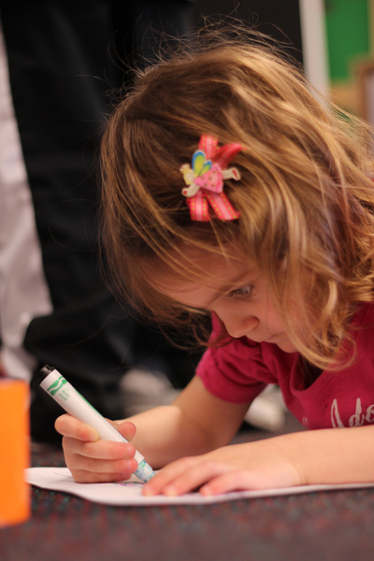
Review

