Slide 1
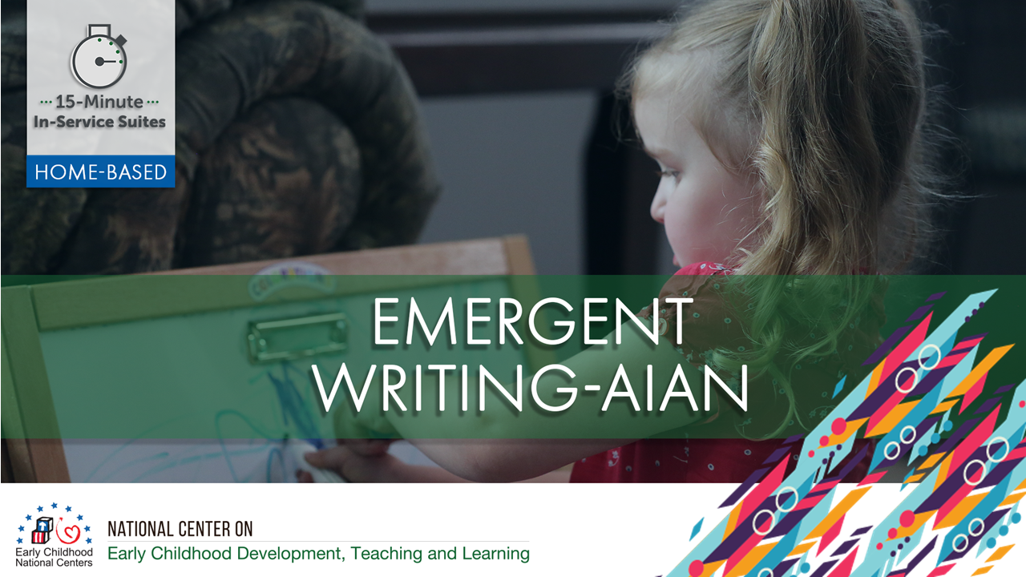

Slide 2
HSPPS Support Writing
Subpart C - Education and Child Development Program Services
1302.30 Purpose
All programs must provide high-quality early education and child development services, including for children with disabilities, that promote children’s cognitive, social, and emotional growth for later success in school…

Slide 3
HSPPS Support Language and Culture
Subpart C – Education and Child Development Program Services
1302.36 Tribal language preservation and revitalization
A program that serves American Indian and Alaska Native children may integrate efforts to preserve, revitalize, restore, or maintain the tribal language for these children into program services. Such language preservation and revitalization efforts may include full immersion in the tribal language for the majority of the hours of planned class operations.
Notes:
Optional Slide 2

Slide 4
HSPPS Support Language and Culture
ACF-IM-HS-15-02 Native Language Preservation, Revitalization, Restoration, and Maintenance in Head Start and Early Head Start Programs
“OHS strongly supports the full integration of AIAN languages and culture in their Head Start and Early Head Start programs, including the use of language immersion, dual language, and other proven approaches…”
Notes:
Optional Slide 4

Slide 5
HSPPS Support Writing
Subpart C - Education and Child Development Program Services
    1302.35 Education in Home-Based Programs
    A home-based program must provide home visits and group socialization activities that promote secure parent-child relationships and help parents provide high-quality early learning experiences in language, literacy, mathematics, social and emotional functioning, approaches to learning, science, physical skills, and creative arts. A program must implement a research-based curriculum…

Slide 6
Center-Based and Family Child Care Practices
Effective Teaching Practices
Child Development

Slide 7
Home Visiting Practices
Effective Home Visiting & Socialization
Positive Parenting
Child Development

Slide 8
What’s Different for a Home Visitor?
Effective Home Visiting
Positive Parenting
Child Development

Slide 9
Theory of Change for Home-Based
THEORY OF CHANGE FOR INFANT-TODDLER PROGRAMS
HOME-BASED AND CLASSROOM
Source: Roggman et al, 2016

Slide 10
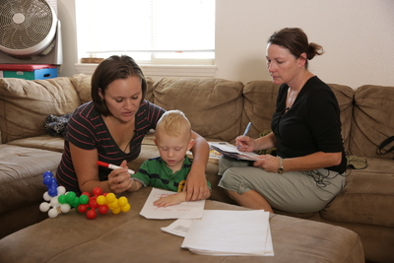
Parents Can Support Early Writing
Help parents foster their child’s pre-drawing, early drawing, and scribbling. Have them:
  Provide writing materials for children and encourage their use
  Ask children to talk about their drawings (when possible)
  Revisit children’s drawings between home visits and explain what it is or says

Slide 11
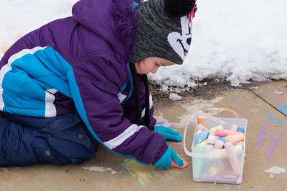
Parents Can Support Later Writing
Support parents in:
Starting with name writing with their child
Modeling writing throughout the day and in different contexts
Engaging in shared and independent writing with children
Including authentic opportunities for writing throughout the day
Finding opportunities to practice writing with peers

Slide 12
Activity: Writing in Your Setting
Have parents select samples of their child’s writing or drawing, and review with them.
Work with parents to identify which stage(s) of emergent writing their child is in.
  Do the sample shows children’s parent-supported or independent writing?
How can you support this parent during writing activities with their child?
What activities can you offer parents to provide additional opportunities to practice writing?

