Slide 1

on Your Learning

Slide 2
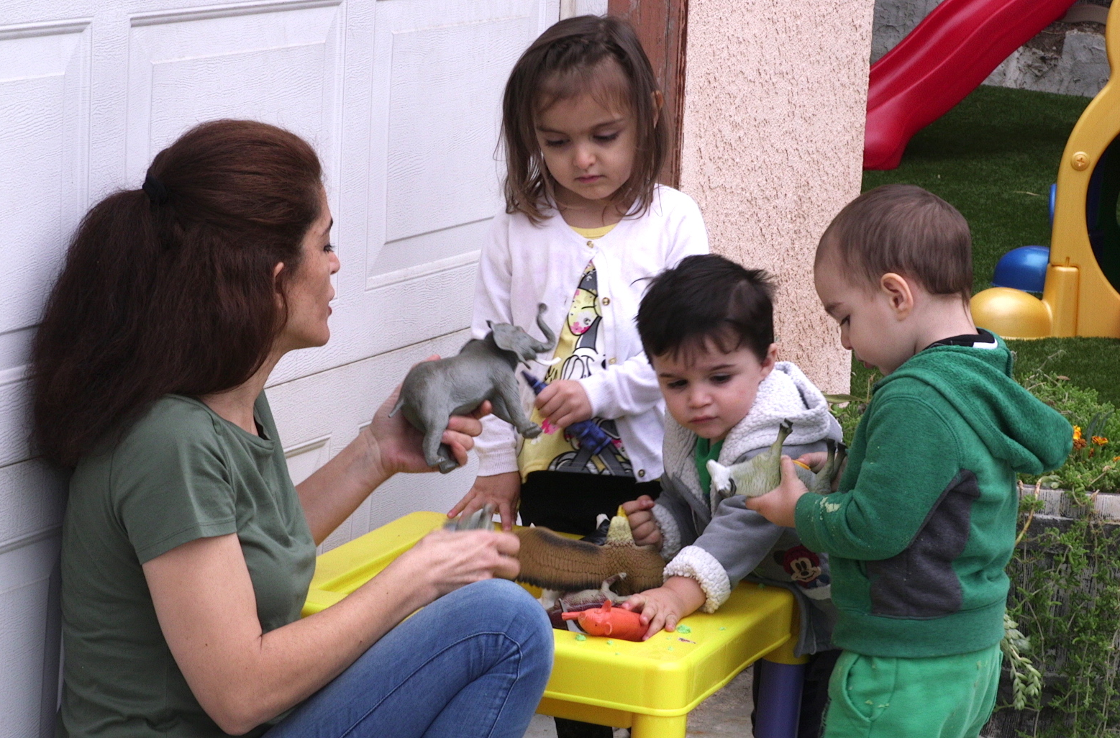
Learning Activity:
Planning to Build on Children’s Interests
How can you implement your curriculum and be responsive to children’s interests?

