Slide 1
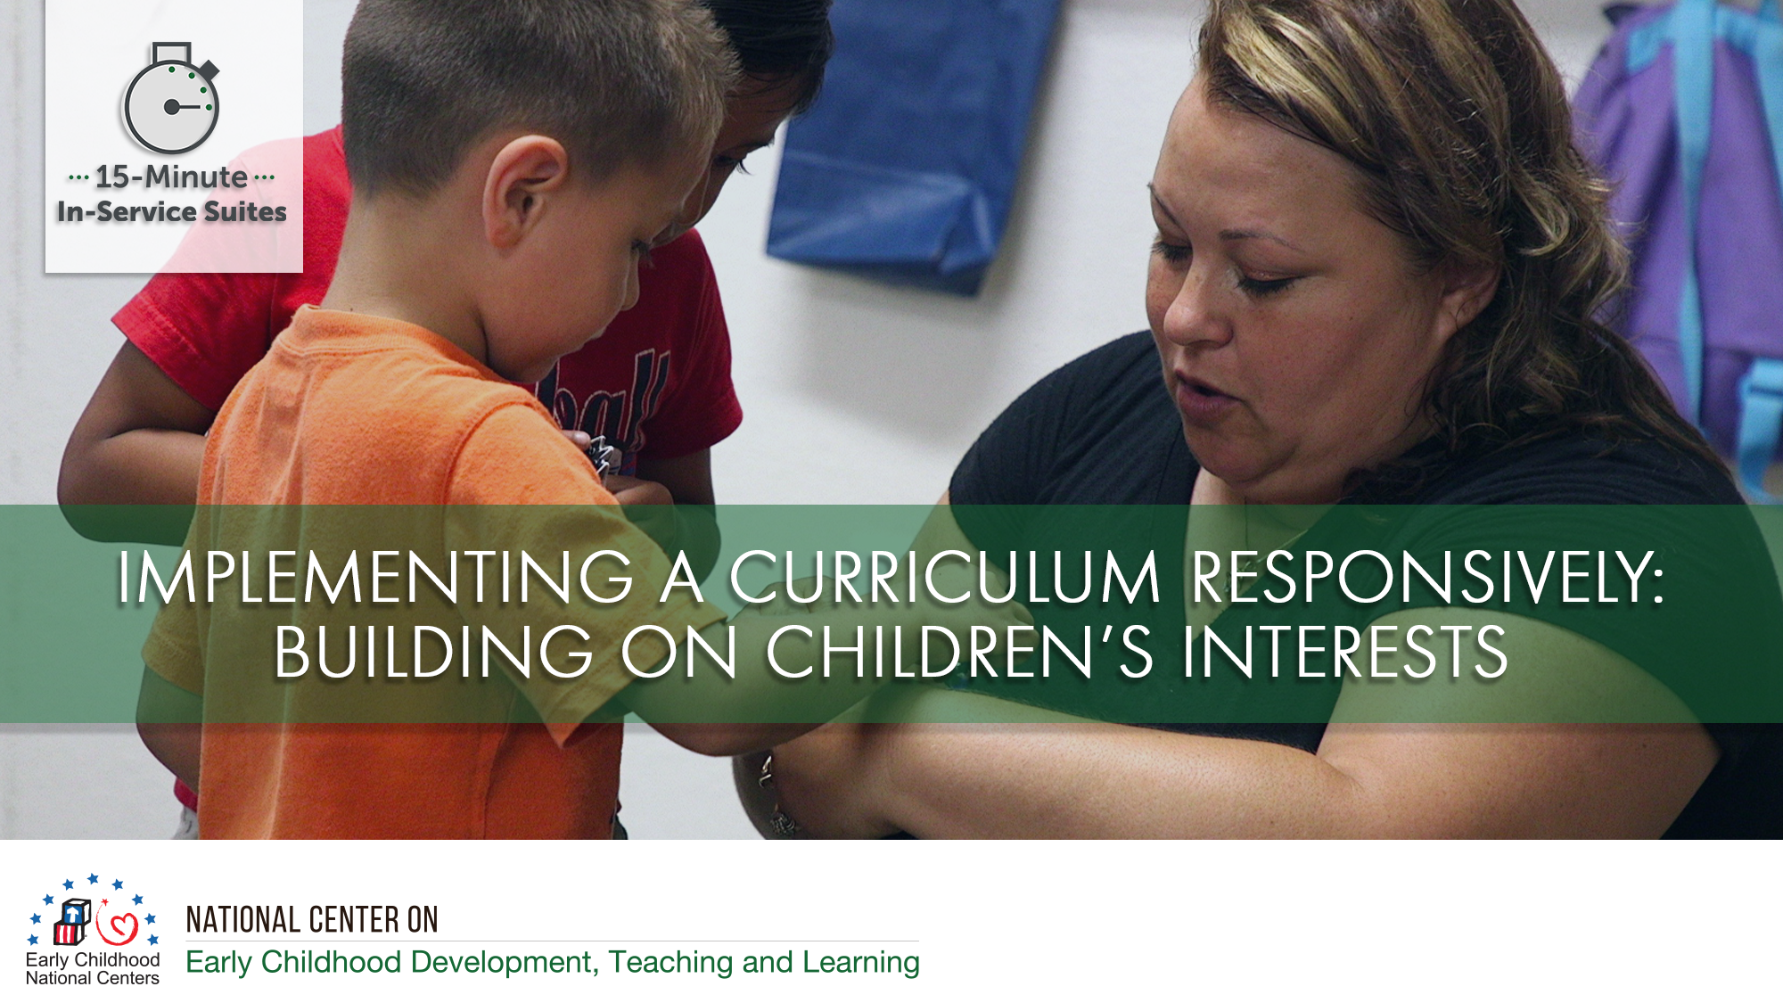

Slide 2
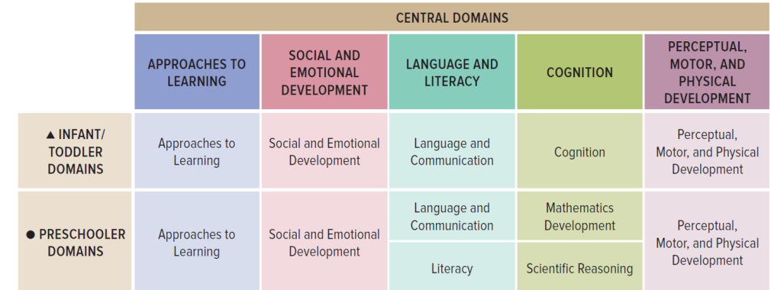
Connections to the ELOF

Slide 3
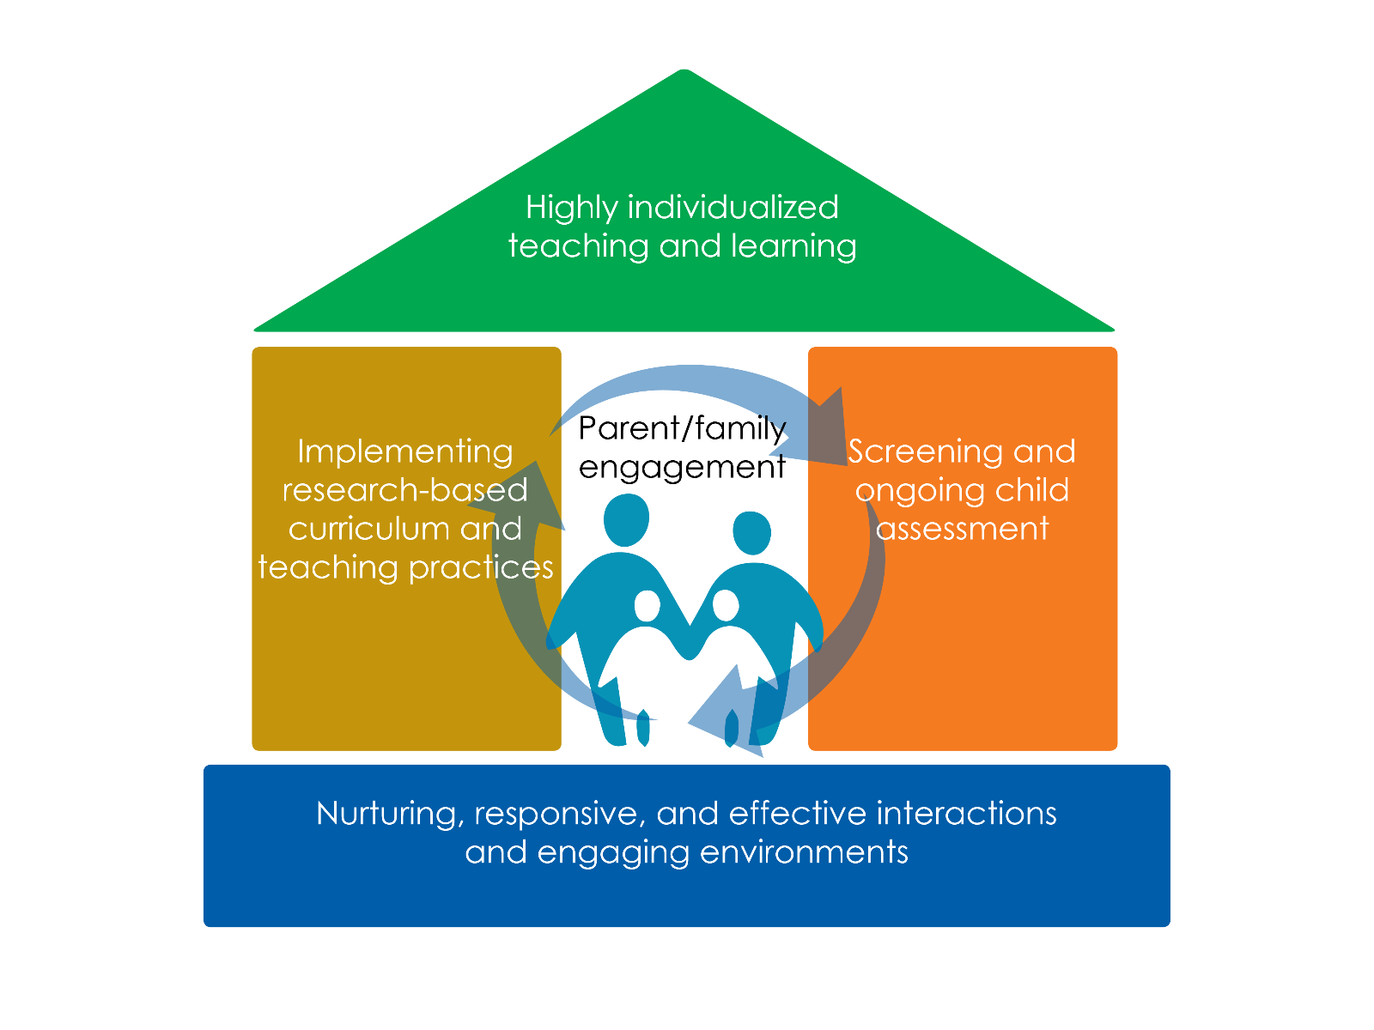

Slide 4
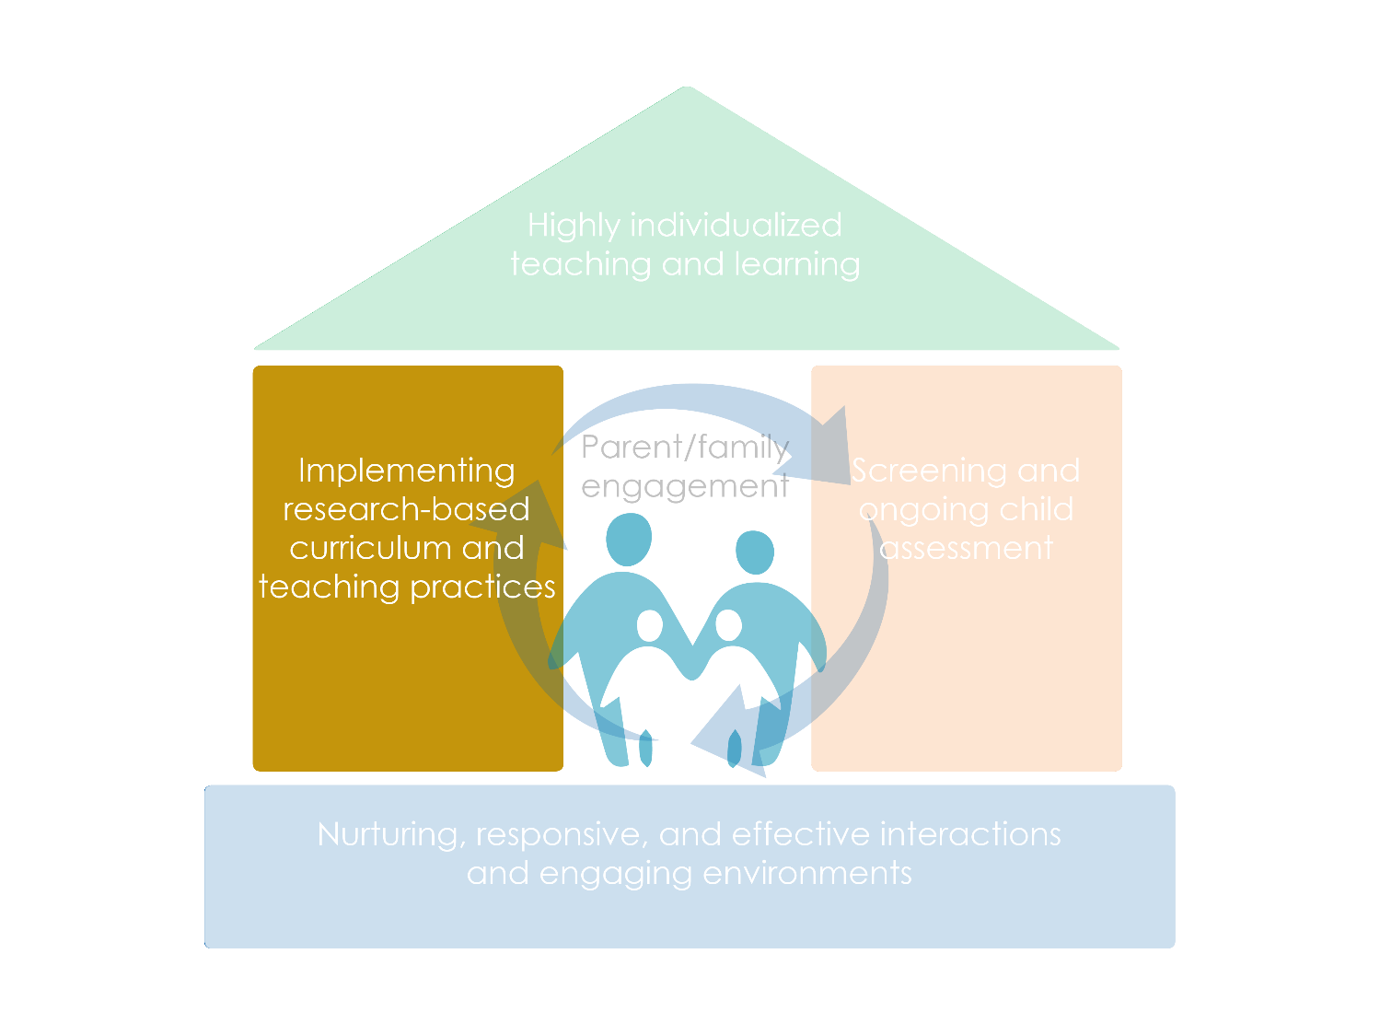

Slide 5
Objectives
Discuss the importance of learning about children’s interests.
Explore ways curricula provide guidance on the learning environment, learning experiences, and adult-child interactions.
Consider ways to implement a curriculum responsively by building on children’s interests.
Notes:
.

Slide 6
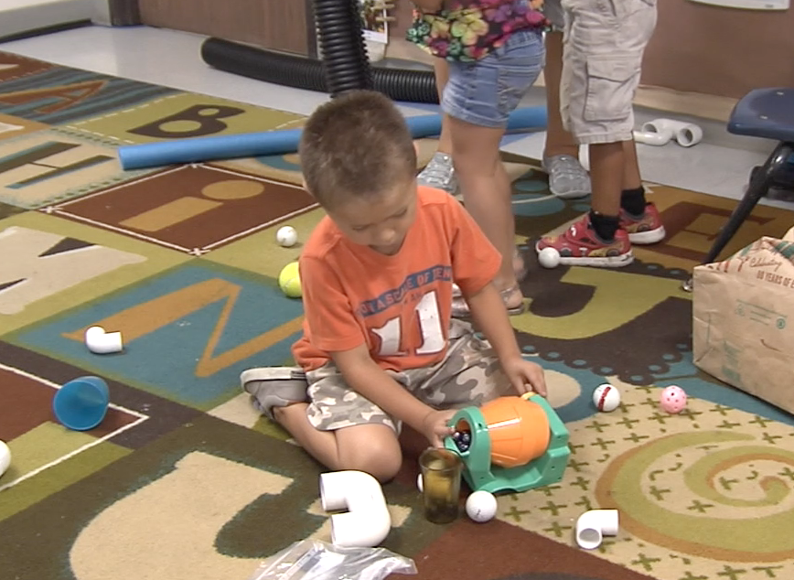
Why Care About Children’s Interests?
Notes:
.
.

Slide 7
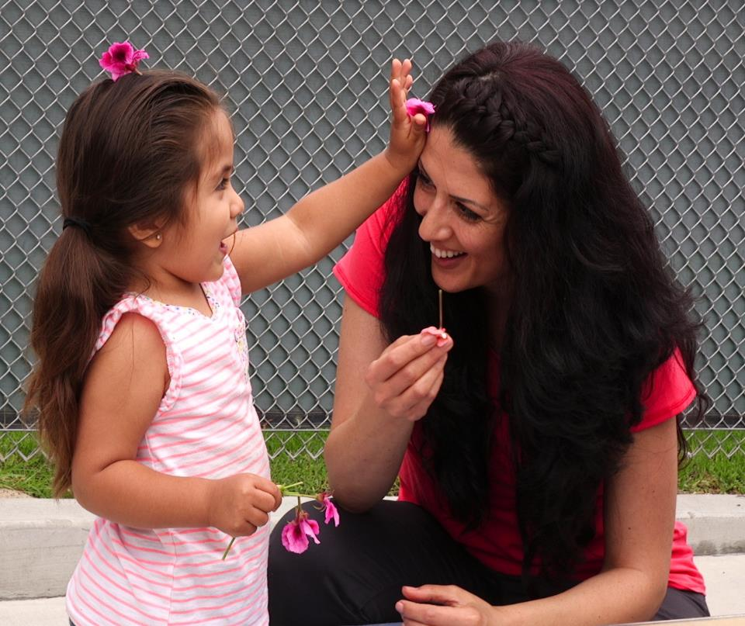
Relationships: The Heart of Responsiveness

Slide 8
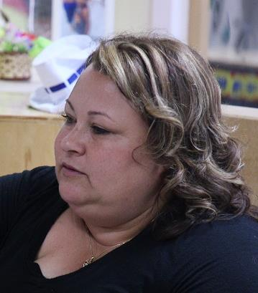
Implementing a Curriculum Responsively
What do I know about children’s interests? | What does my program’s curriculum offer? | How do I implement the curriculum responsively?

Slide 9
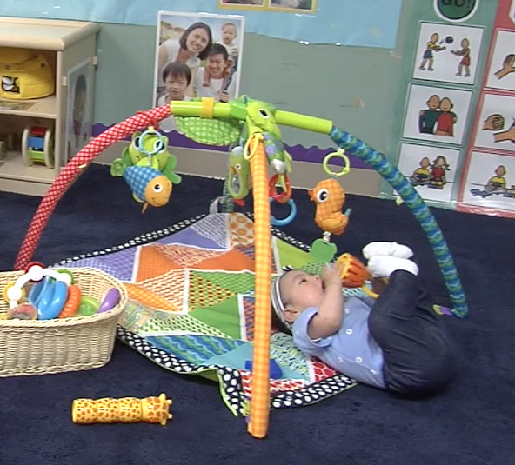
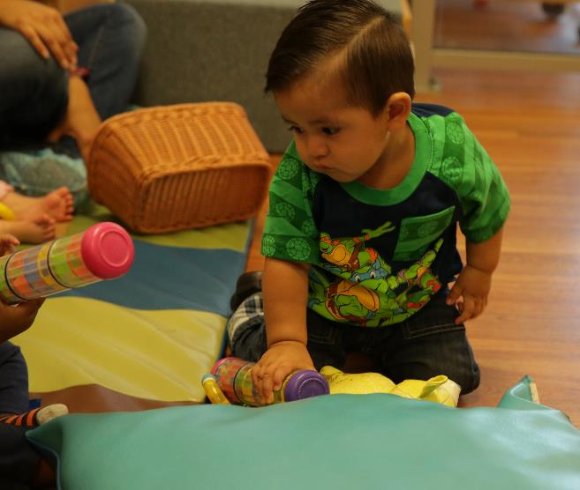
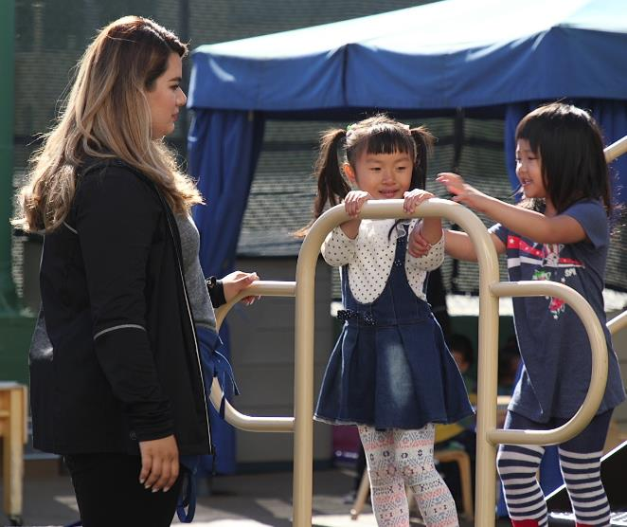
Observing and Learning About Children’s Interests

Slide 10
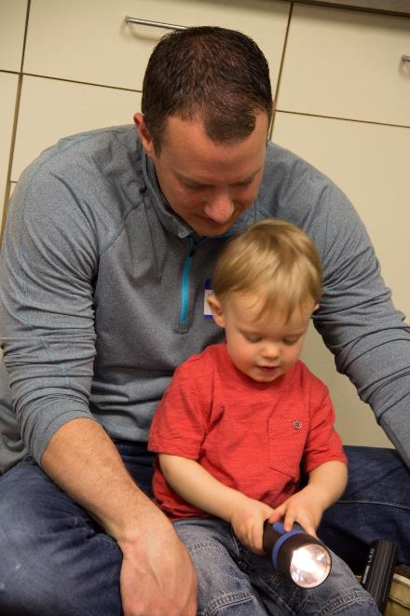
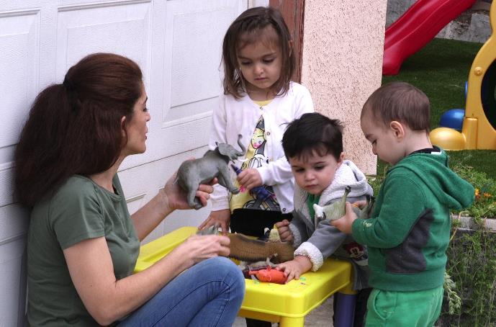
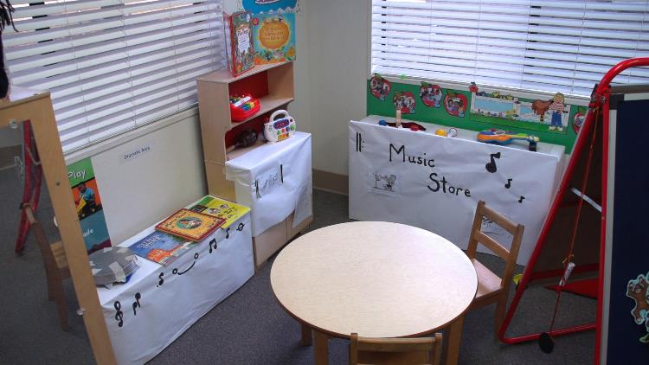
Learning About Children’s Interests:
Personal Interests

Slide 11
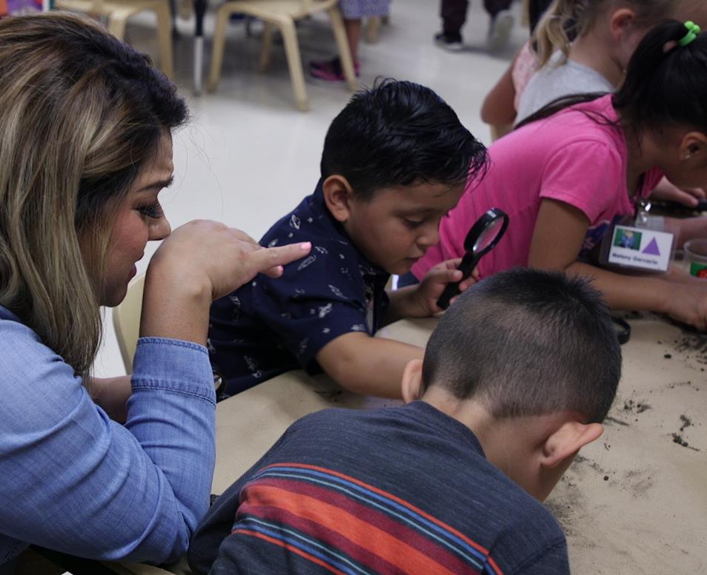
Learning About Children’s Interests:
Situational Interests

Slide 12
Curricula Offer Guidance On
Learning experiences
Learning environments
Interactions

Slide 13


Learning Environments
Setting Up Learning Centers
Dramatic Play
In the dramatic play area, follow children’s interests and reflect the community where children live
Set out a wide variety of materials so children can discover and explore what’s most interesting to them
Extend or change dramatic play materials to best reflect children’s interests, strengths, and needs
Getting Started
Daily Routines and Schedules
Setting Up Learning Centers and Selecting Materials
This Photo by Unknown Author is licensed under CC BY-SA-NC
This Photo by Unknown Author is licensed under CC BY

Slide 14
Learning Experiences
Building a Tree House
Skills and Concepts: counting with one-to-one correspondence, measurement, cause and effect, persistence and sustained attention
Materials: Wooden unit blocks, rulers, ”Build a Tree House” poster
Post and review the directions on the “Build a Tree House” poster. Place several wooden unit blocks in the center of the table. Ask the children ”Do you remember when we read Squirrel Builds a Tree House?”
Have children share what they remember about the book and the steps for building the tree house. Tell the children that today they will work in pairs to build a tree house using unit blocks. Show the poster and review the steps with them.
As they build together, narrate their actions, encourage them to count aloud, and ask open-ended questions about their process (e.g., What do you think will happen if you…?”). Encourage children to measure their tree houses to check if they are the same or different than the tree house on the poster.
MONDAY: Small Groups
This Photo by Unknown Author is licensed under CC BY-ND

Slide 15
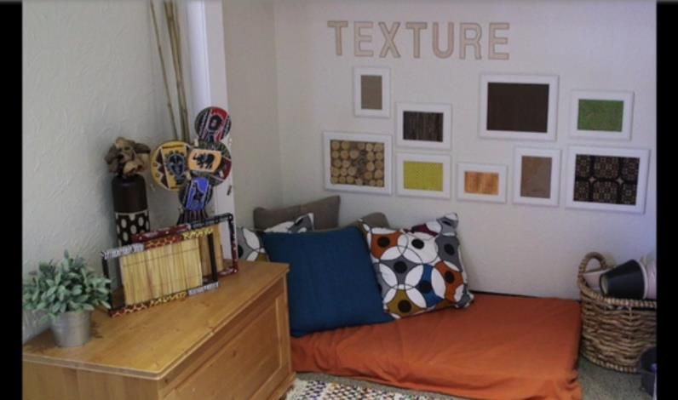

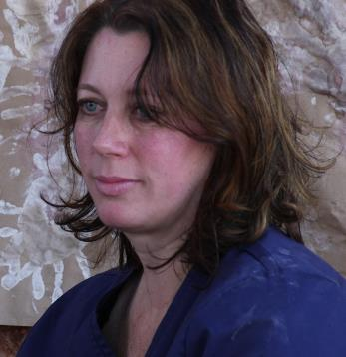
Activity: Teacher Sara Builds on Toddlers’ Personal Interests
How do I implement my program’s curriculum responsively?

Slide 16
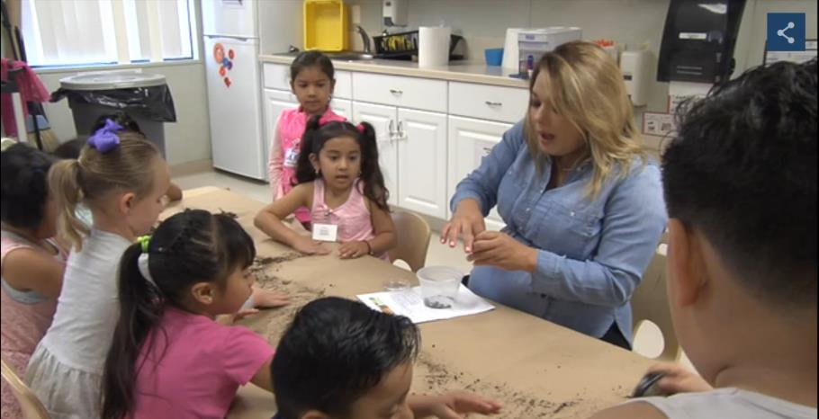


Activity: Teacher Jessica Follows Children’s Situational Interests
How do I implement my program’s curriculum responsively?

Slide 17
Review
What do I know about children’s interests?
What does my program’s curriculum offer?
How do I implement the curriculum responsively?

