Slide 1
Notes:
Directions for Presenter:
Welcome and Introductions:
Begin the training by giving participants background information about yourself.
Provide an opportunity for participants to introduce themselves.

Slide 2
Make-Believe Play Stretches Across ELOF Domains

Slide 3
Make-Believe Play Stretches Across ELOF Domains
Approaches to Learning
Creativity (Infant/Toddler & Preschool)
Social and Emotional Development
Relationships with Other Children (Preschool)
Language and Literacy
Emergent Literacy (Infant/Toddler)
Communicating and Speaking (Preschool)
Cognition
Imitation and Symbolic Representation & Play
(Infant/Toddler)
Notes:
Directions for Presenter:
The preschool ELOF Approaches to Learning domain, as part of the Creativity subdomain, includes a goal that focuses on pretend play (review Goal P-ATL 13 on the slide).
There are individual goals that are about play, but note that under Infant/toddler cognition, there is an entire sub-domain devoted to play. This is how important play is to development and learning. (I’m adding this comment because a sub-domain is broader than a goal).
Note to Presenter:
Information about the development of play in infants, along with the relevant ELOF goal, can be found in the supplemental slides for this In-Service Suite.

Slide 4
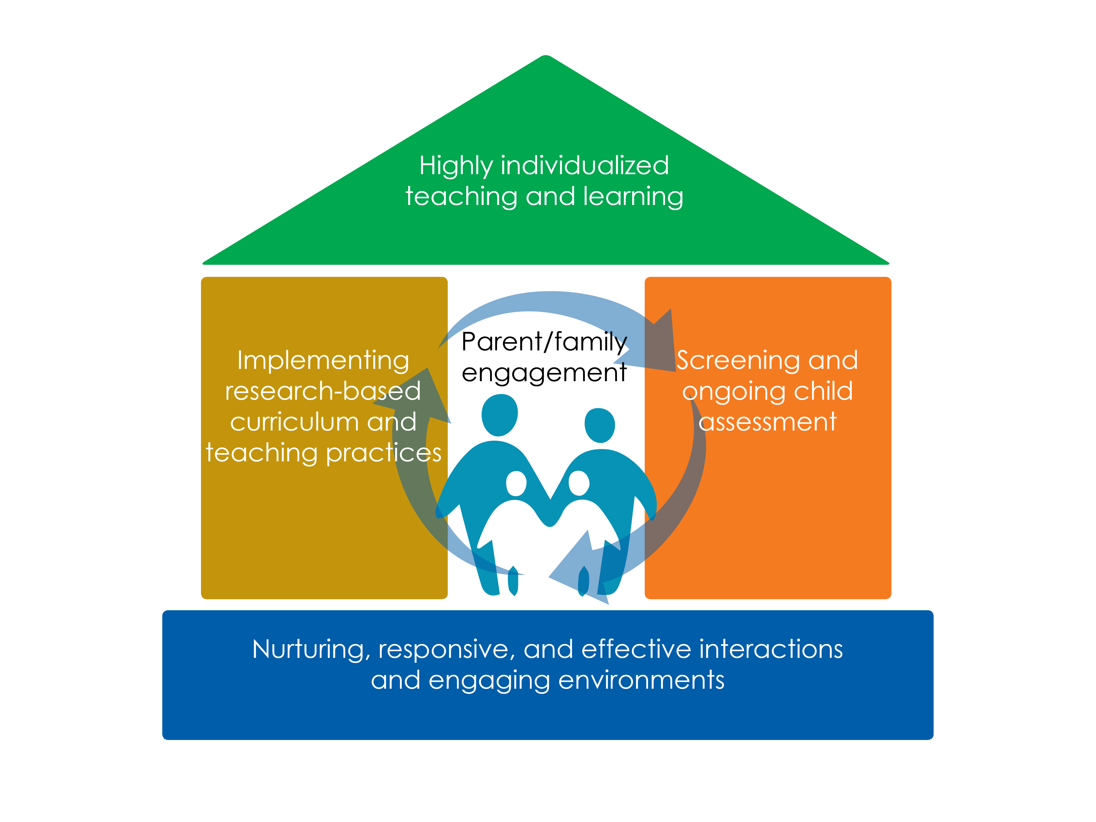
Framework for Effective Practice

Slide 5
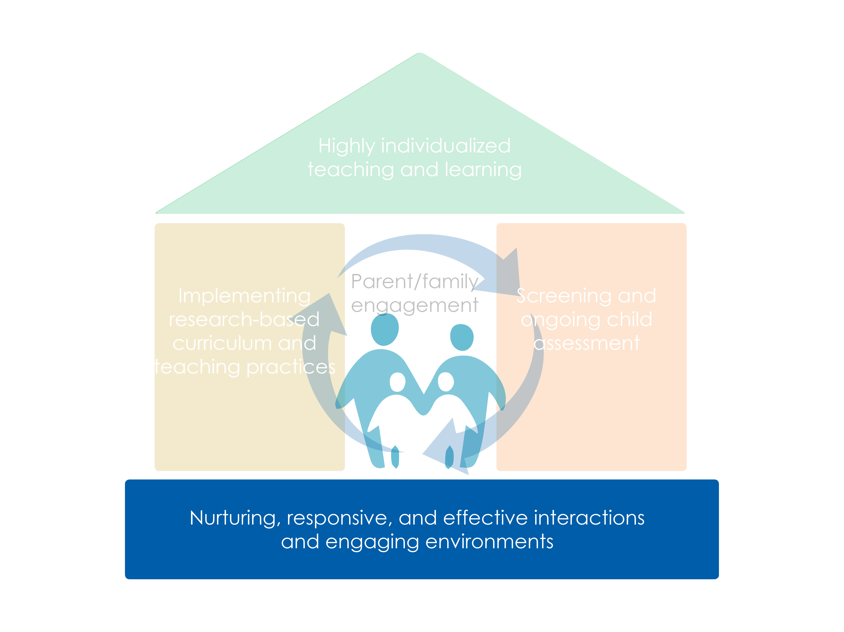
Framework for Effective Practice

Slide 6
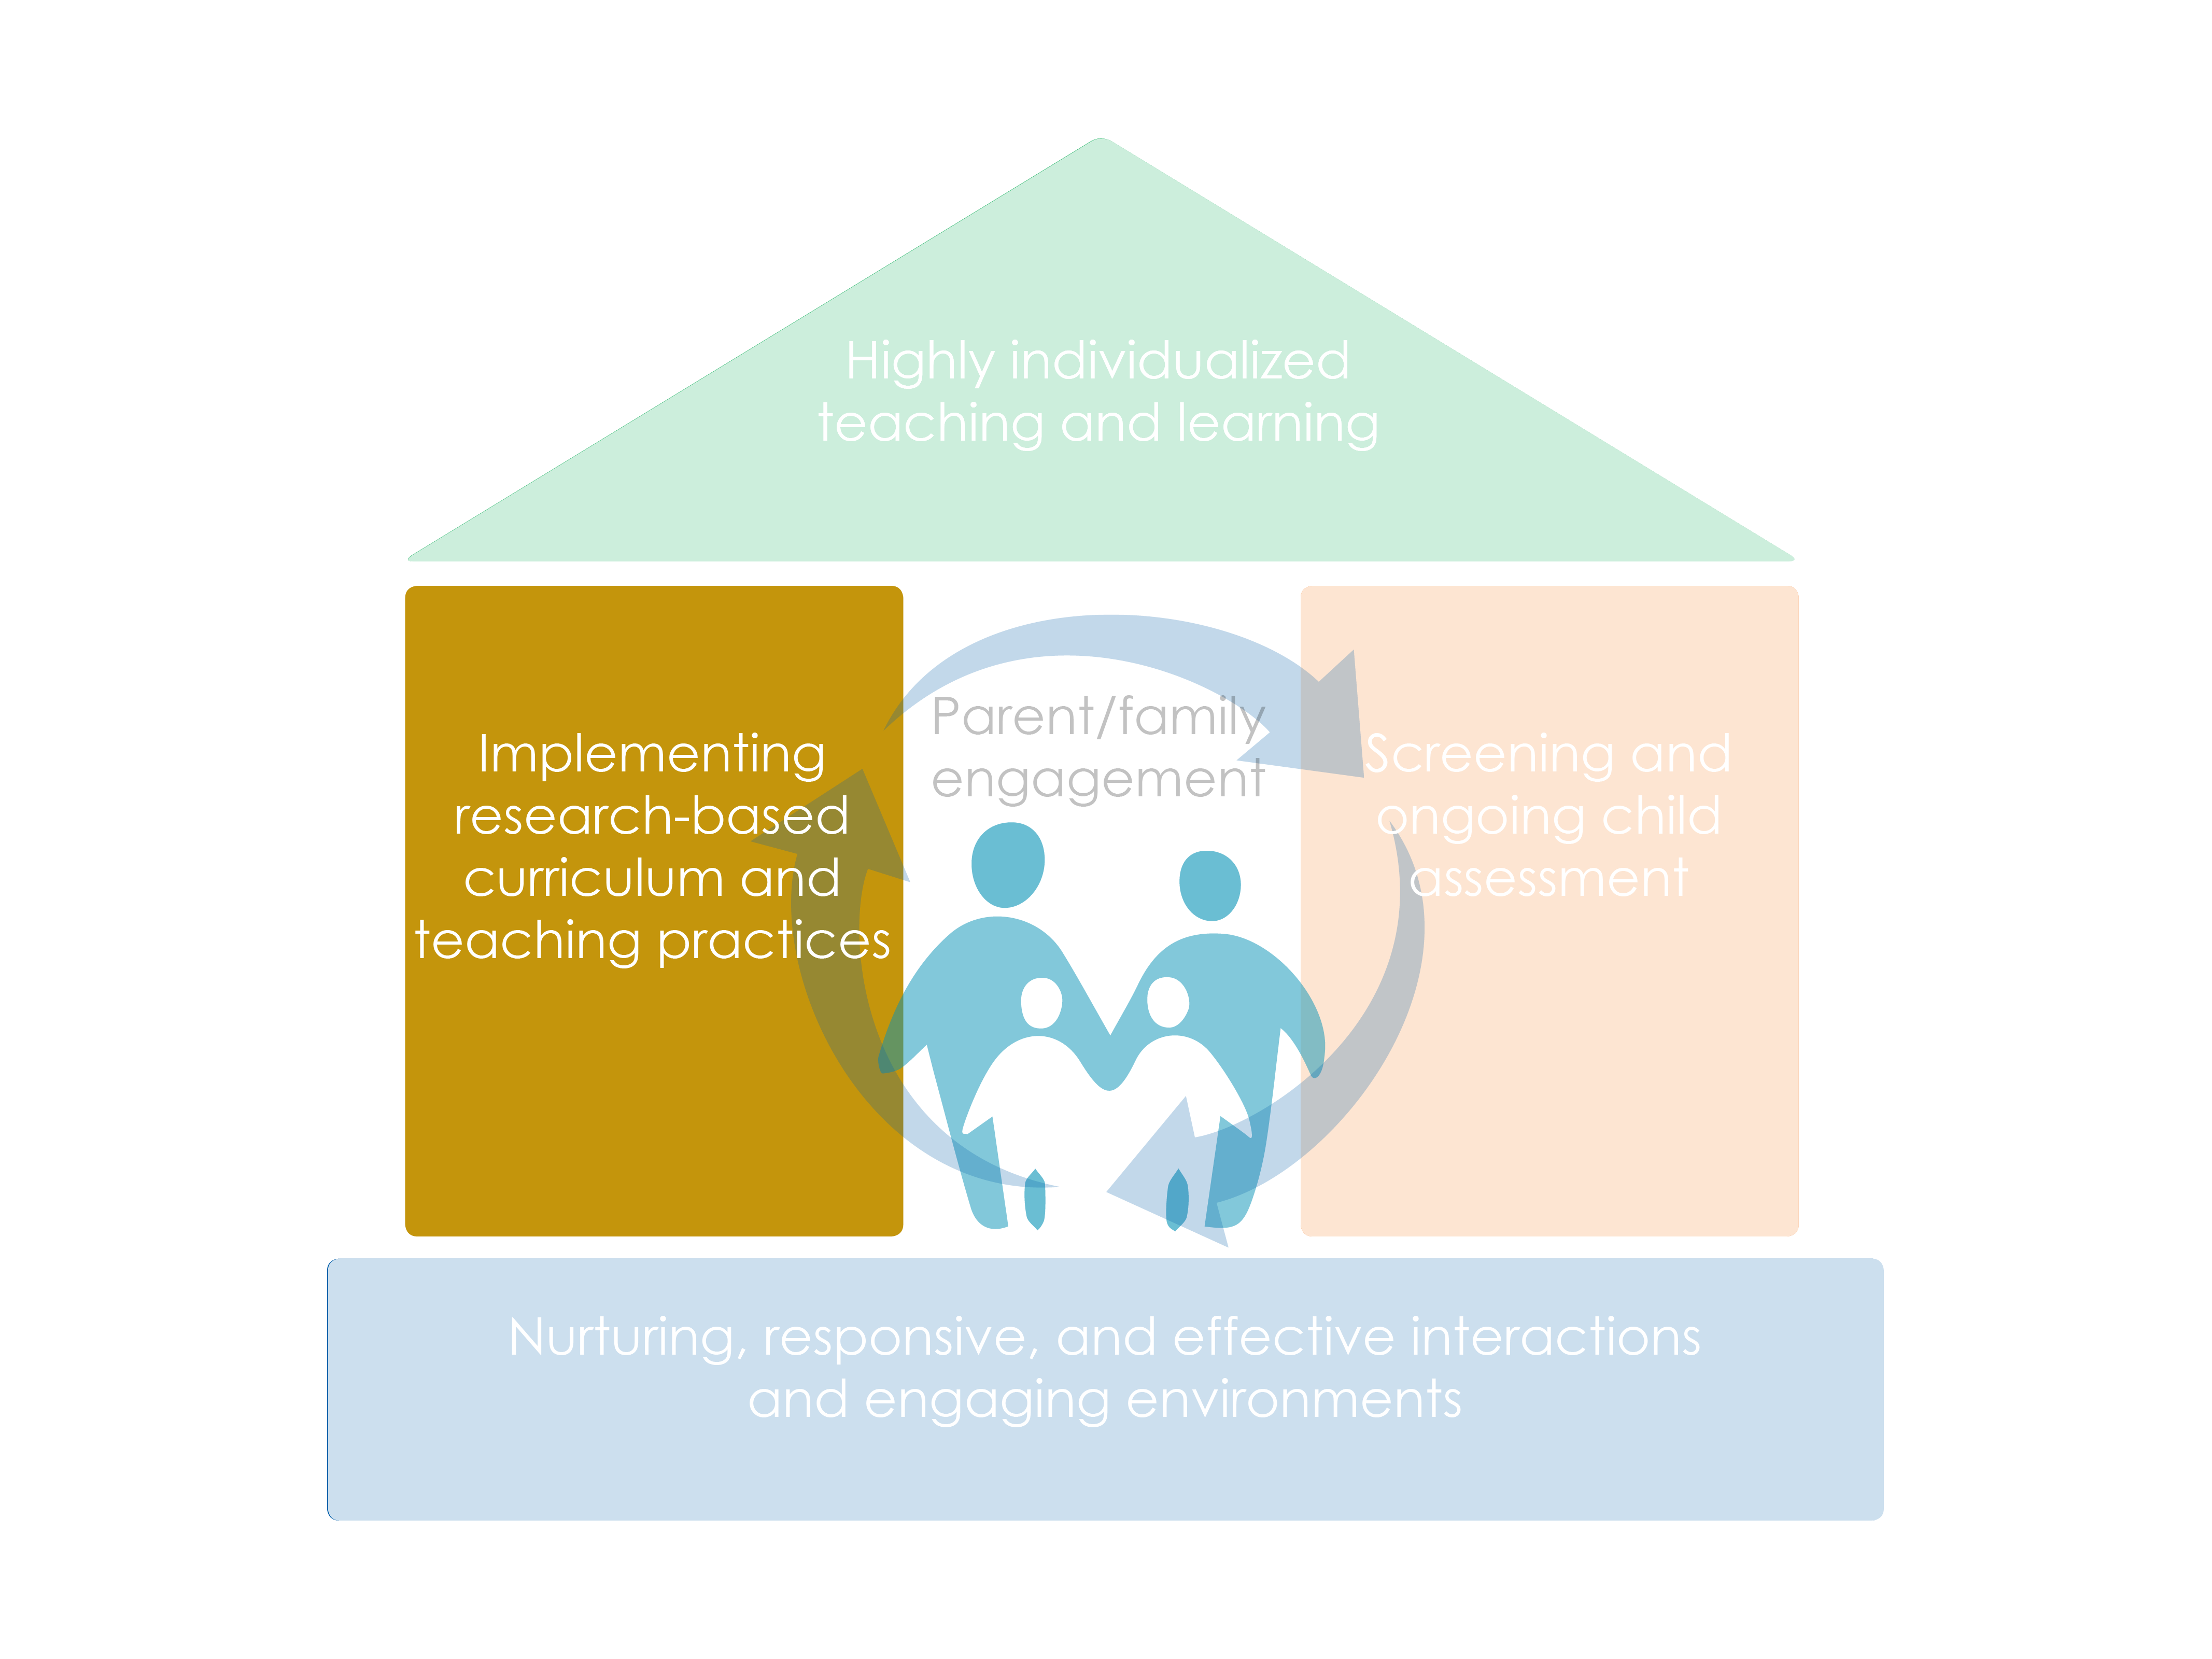
Framework for Effective Practice

Slide 7
Session Objectives
Identify the unique key components of make-believe play
Describe what make-believe play looks like
Implement practical ways to support make-believe play in your early learning setting
Notes:
Directions for Presenter:
By the end of this presentation you should be able to: (Read the objectives.)
Ask if anyone has further for suggestions for what they will like to be able to do by the end of this session

Slide 8
Foundations of Play Infants & Toddlers

Slide 9
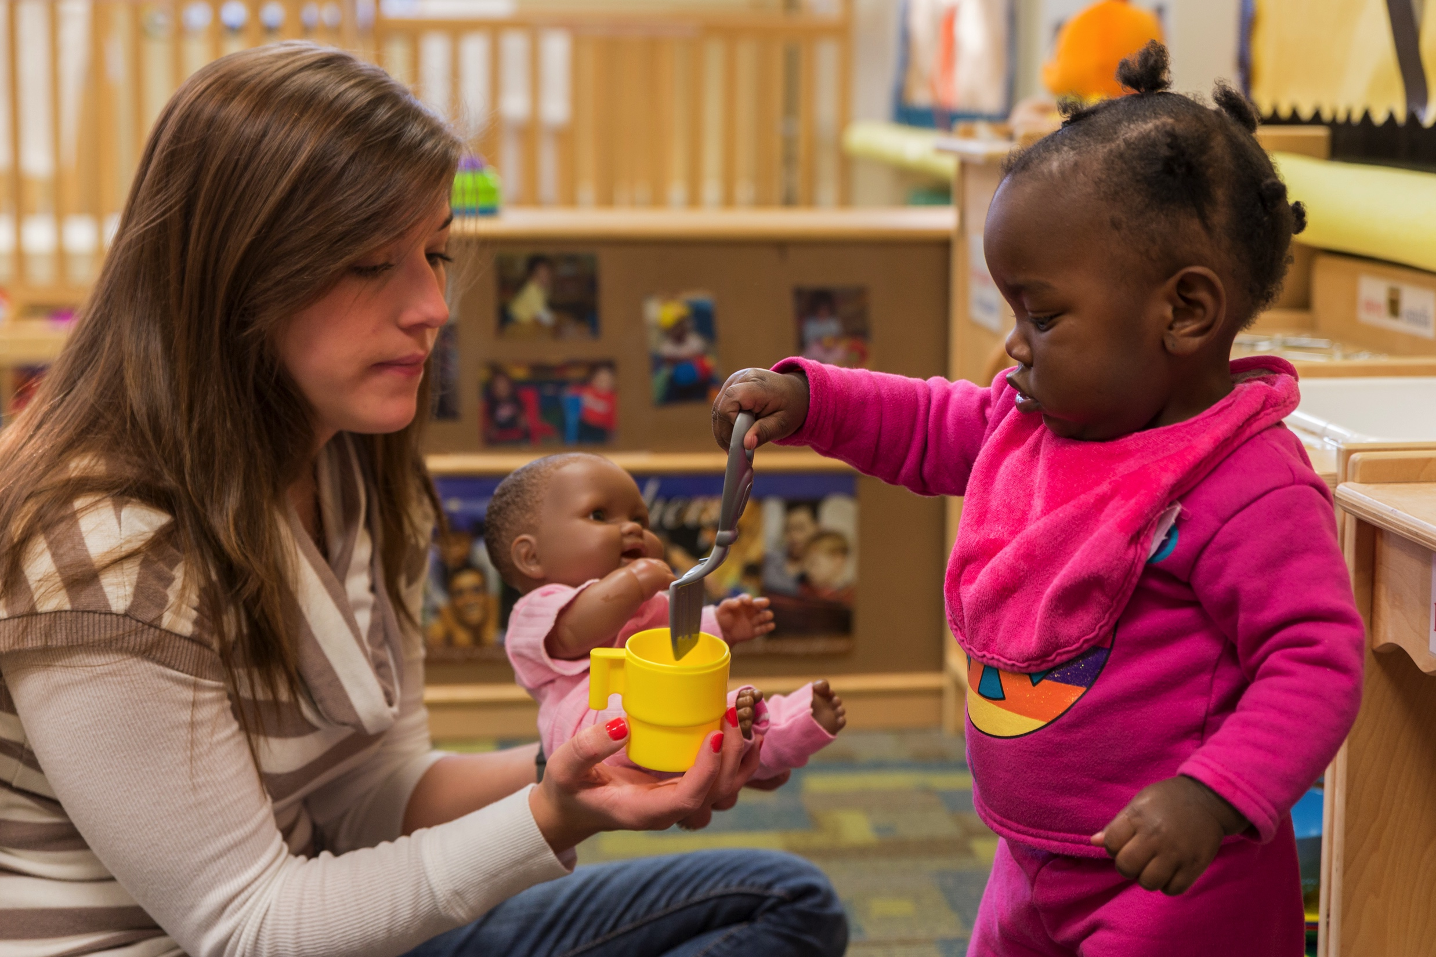
Foundations of Play
Play begins with exploration
Infants explore new objects to discover what they are and what they do
Exploration looks different, depending on a child’s understanding of an object or situation
Exploratory play includes more and more social play (and even the beginnings of pretend play)

Slide 10
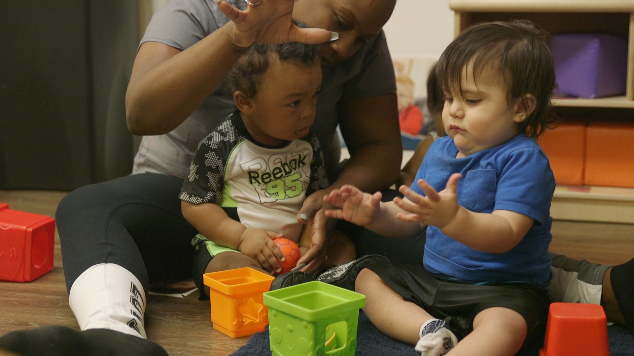
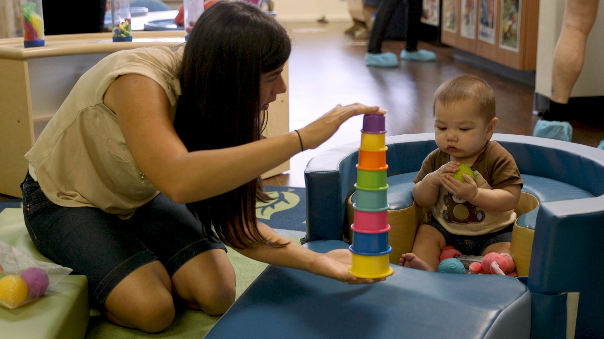
Benefits of Infant and Toddler Play
According to the American Academy of Pediatrics, play:
Supports healthy brain development
Is one way infants and toddlers interact with their environment
Allows children to safely explore their fears and practice adult roles and familiar routines (at home or in the learning environment)
Builds relationships between children and their peers and caregivers

Slide 11
Make-Believe Play Overview & Development

Slide 12
The Path to Make-Believe Play
Object-Oriented or Instrumental Play
Beginnings of Make-Believe Play
Make-Believe Play
Object-Oriented Sensorimotor Actions

Slide 13
Requirements for Make-Believe Play
Children engage in high-quality make-believe play when they:
Create an imaginary situation
Take on and act out roles
Follow a set of rules determined by roles

Slide 14
Turn and Talk
Think of instances in your own learning environments when you’ve seen make-believe play contribute to children’s learning and development, and share with your partner.

Slide 15
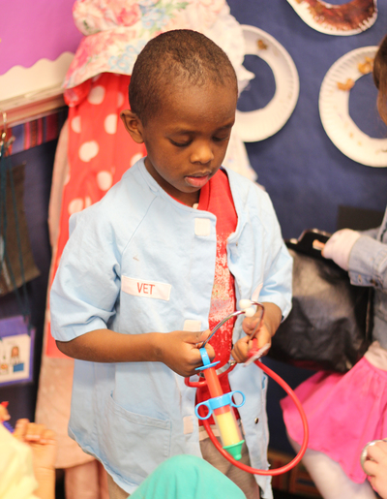
Benefits of Make-Believe Play
Make-believe play provides opportunities to practice many skills:
Symbolic thinking
Self-regulation
Oral language
Social and emotional skills
Literacy, math, and science skills

Slide 16
Supporting Make-Believe Play Practical Tips and Tools

Slide 17
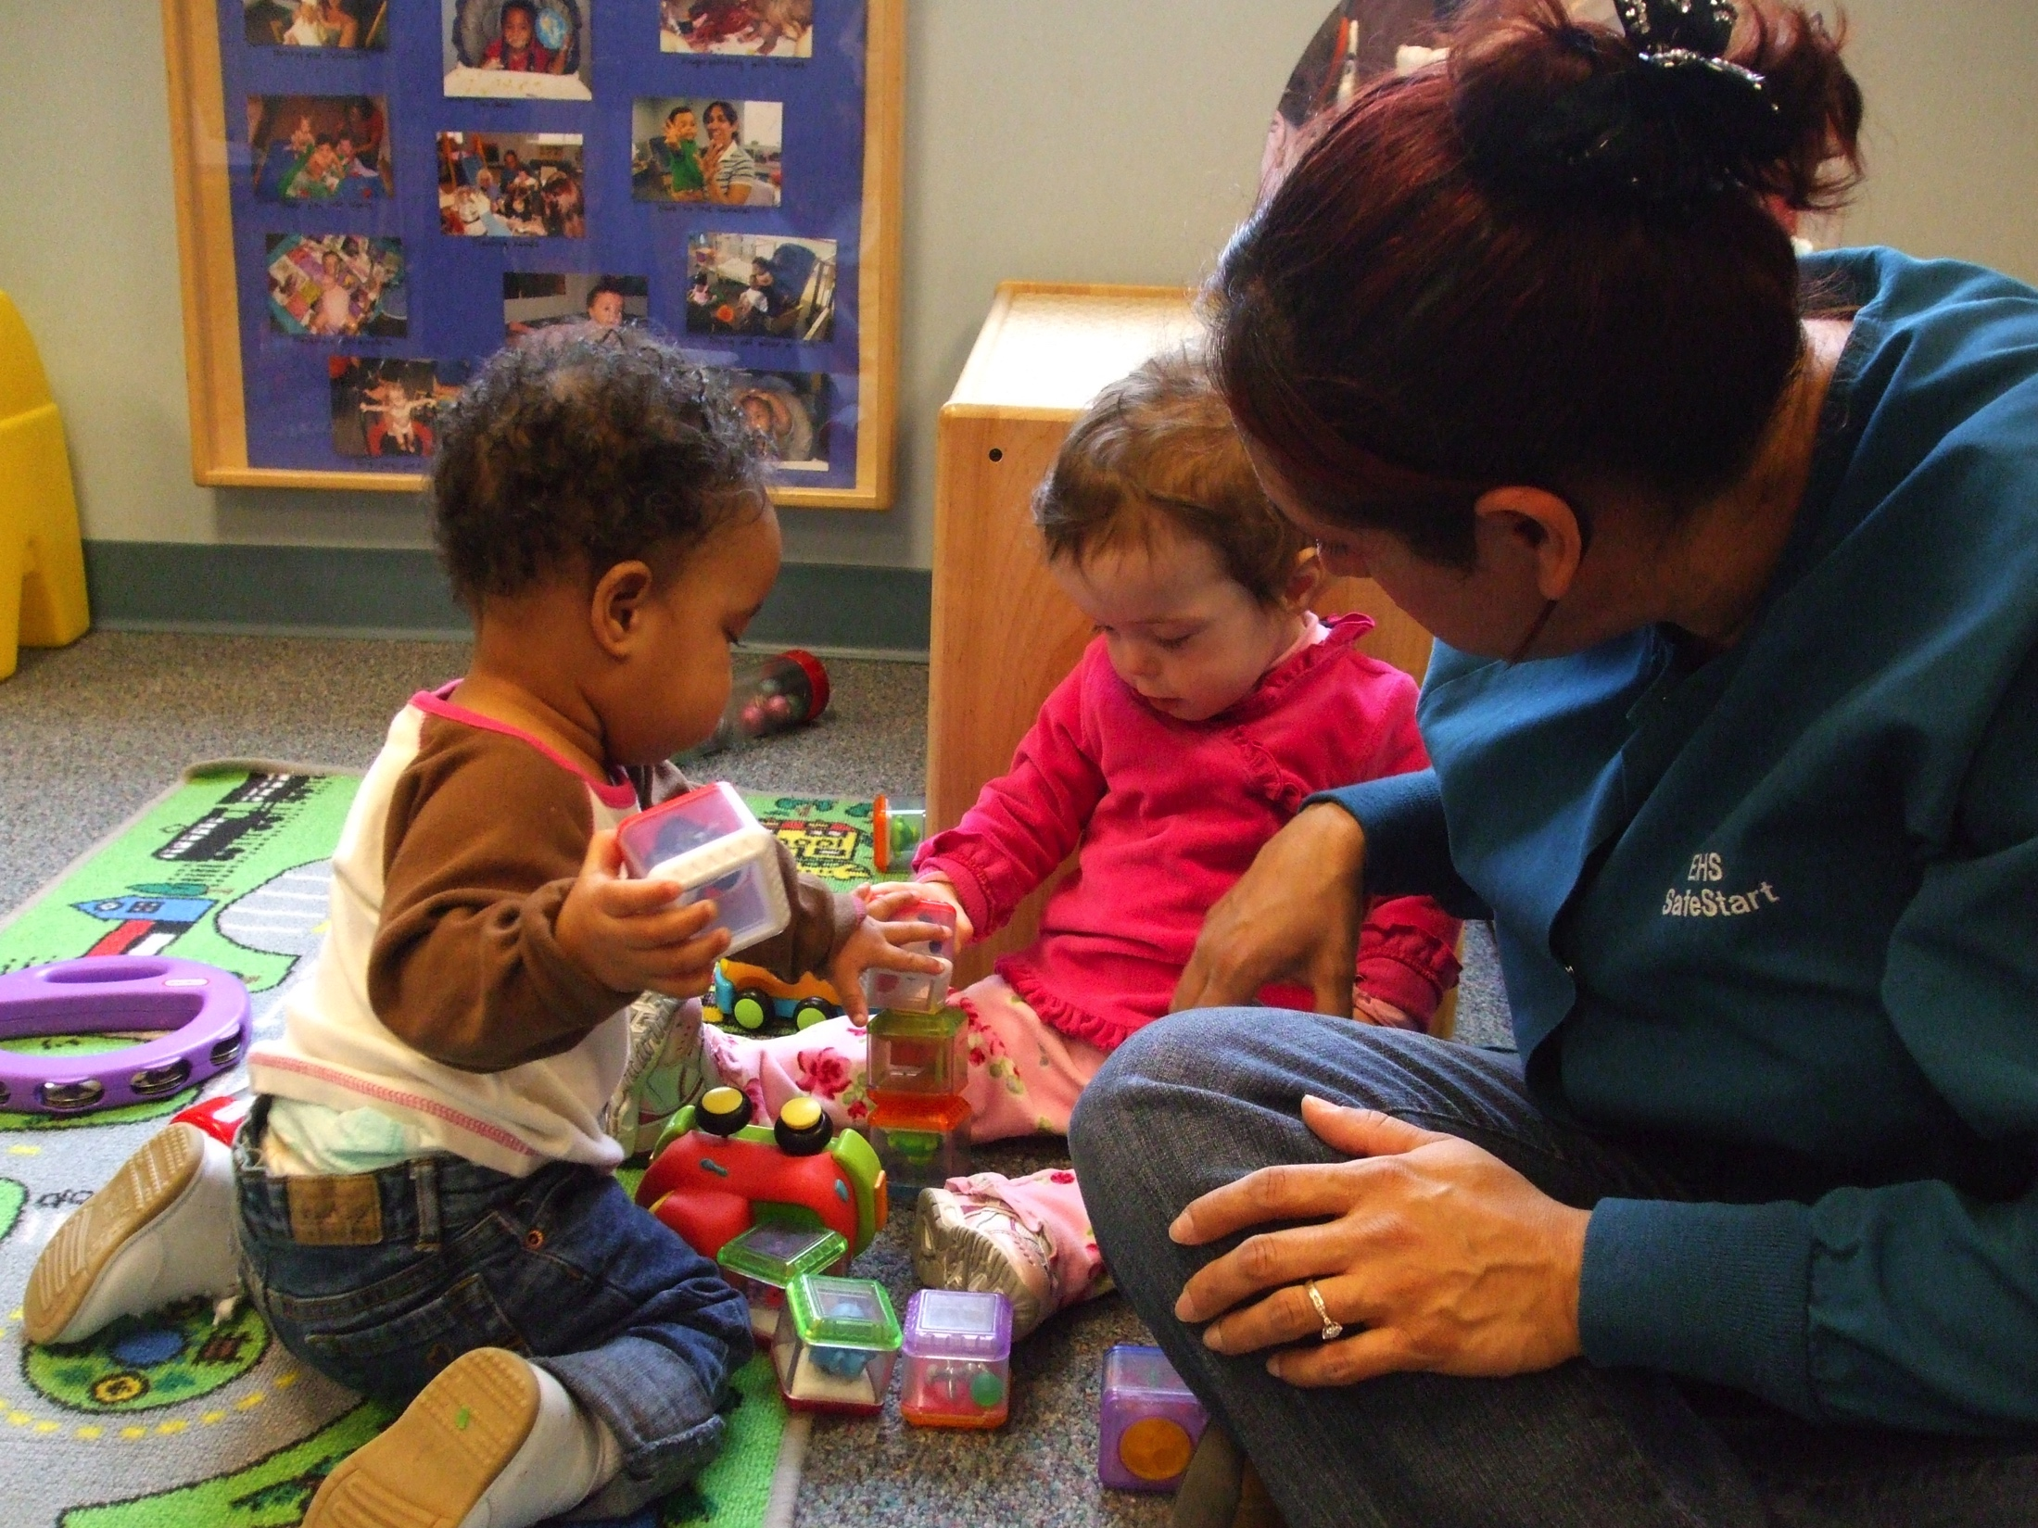
Creating an Environment to Support Social Play
Provide open-ended cooperative-use toys and materials that increase opportunities for social interaction
Create a physical space that encourages children to share space with other children

Slide 18
Play Themes vs. Curriculum Unit
A unit, or study, is often dictated by a curriculum, and focuses on a concept or general event
A play theme involves the creation of pretend scenarios, pretend roles, and relationships between roles

Slide 19
Play Themes Inspired by Units
Play themes are often inspired by curriculum units or studies, though it’s not a requirement.
You can also choose your play theme based on children’s interests!
Unit/Study Example | Theme Examples Inspired by Unit/Study
Transportation | Airport, train station, car dealership, cruise ship
Animals | Zoo, farm, vet’s office, pet store
Health and Nutrition | Restaurant, farmer’s market, fitness center (with foods from different cultures represented by children)
Reduce, Reuse, Recycle | Garden center, farm, recycling center

Slide 20
Cycle of Supporting Make-Believe Play
Build Background Knowledge
Brainstorm Theme Development
High-Level Make-Believe Play
Build Props & Create Play Areas
Start Here
Once you determine a play theme, you begin the cycle of supporting make-believe play

Slide 21
Supporting All Children in Make-Believe Play
With the appropriate supports, make-believe play can be a fun and engaging experience for all children.

Slide 22
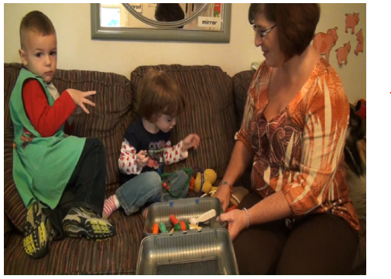
Make-Believe Play: Video

Slide 23
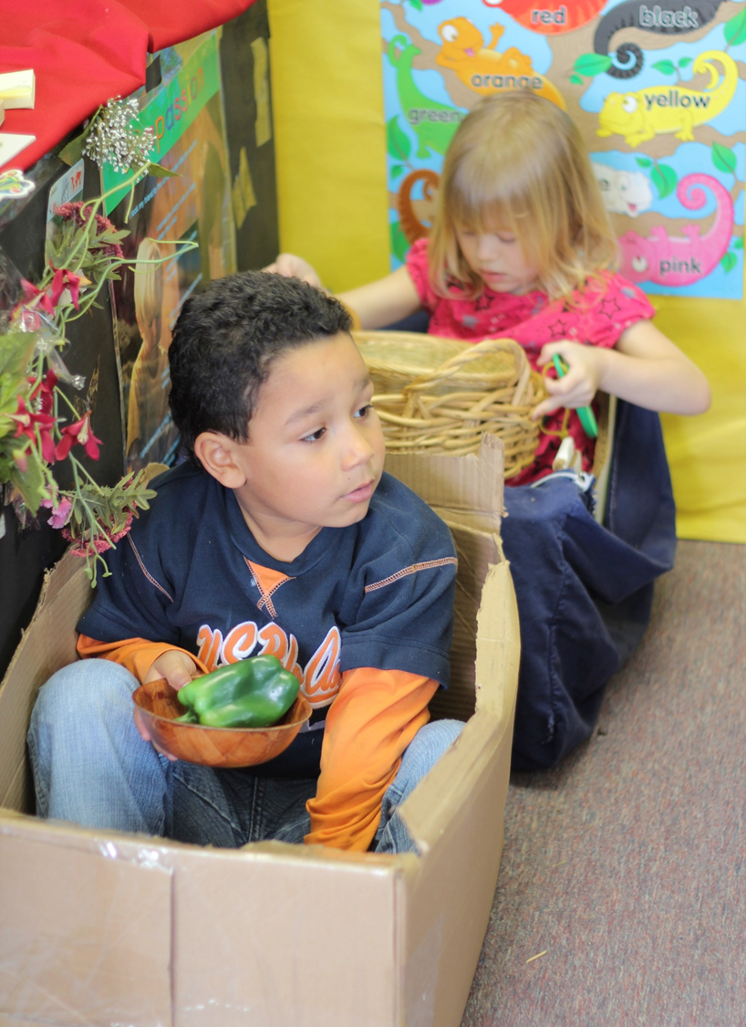
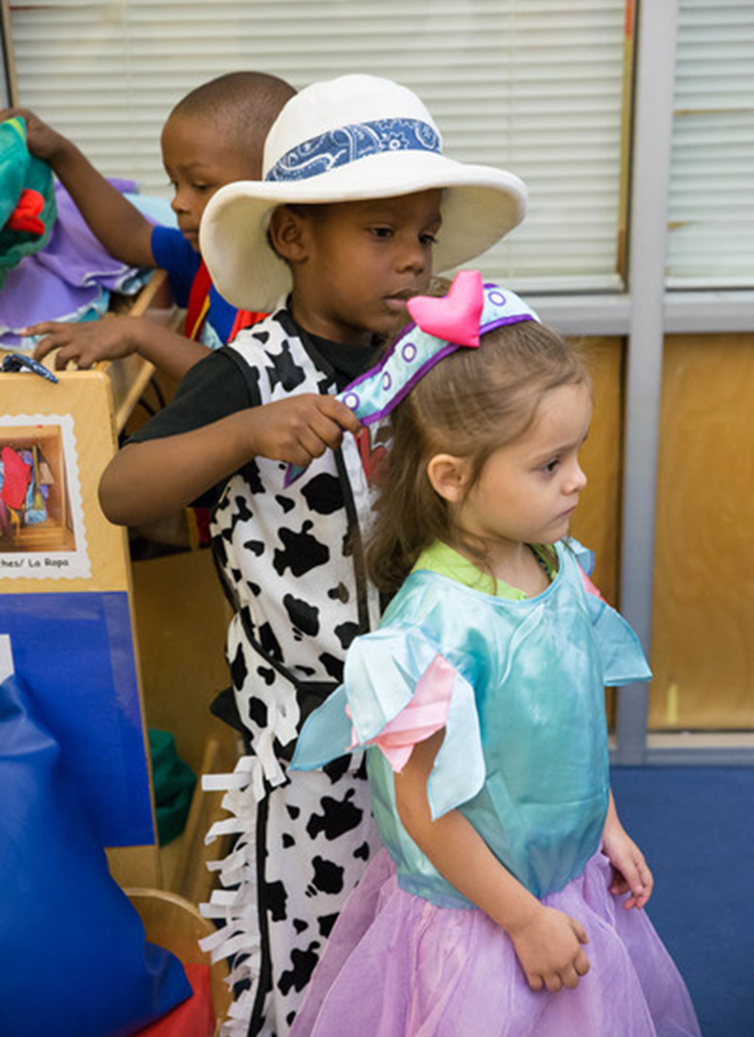
Review

