Slide 1
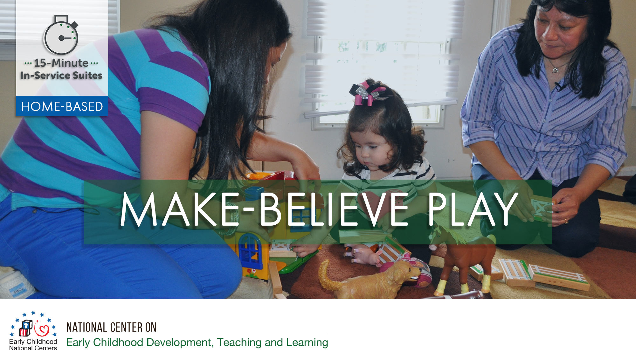

Slide 2
HSPPS Support Make-Believe Play
Subpart C - Education and Child Development Program Services
1302.30 Purpose
All programs must provide high-quality early education and child development services, including for children with disabilities, that promote children’s cognitive, social, and emotional growth for later success in school….
Notes:
OPTIONAL

Slide 3
HSPPS Support Make-Believe Play
Subpart C - Education and Child Development Program Services
    1302.35 Education in home-based programs
    (a) Purpose. A home-based program must provide home visits and group socialization activities that promote secure parent-child relationships and help parents provide high-quality early learning experiences in language, literacy, mathematics, social and emotional functioning, approaches to learning, science, physical skills, and creative arts. A program must implement a research-based curriculum…
Notes:
OPTIONAL

Slide 4
Center-Based and Family Child Care Practices
Effective Teaching Practices
Child Development

Slide 5
Home Visitor Practices
Effective Home Visiting and Socialization Practices
Positive Parenting Practices
Child Development

Slide 6
What’s Different for a Home Visitor?
Effective Home Visiting and Socialization Practices
Positive Parenting Practices
Child Development

Slide 7
Theory of Change for Home-Based
Theory of change model for infant/toddler home visiting vs. classroom.
Source: Roggman et al, 2016

Slide 8
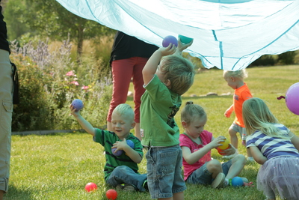
Creating an Environment to Support Social Play
With parents:
  Discuss open-ended, cooperative use toys and materials that encourage social interaction
  Discuss play dates to increase opportunities for social play
At group socializations:
  Create a physical space that encourages children to be in the same area as other children

Slide 9
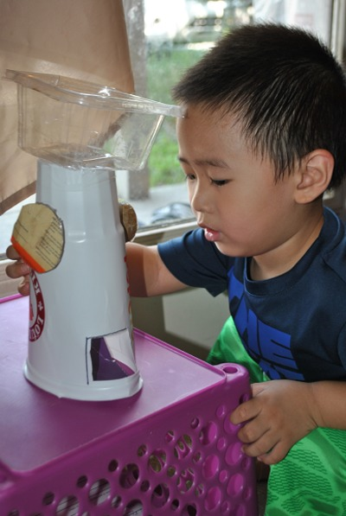
Play Themes
A play theme lends itself to the creation of pretend scenarios, pretend roles, and relationships between roles

Slide 10
Play Themes Inspired by Everyday Activities
Play themes are often inspired by everyday experiences or may be found in some home-based curricula
Everyday Experience | Play Activities
Grocery shopping | Making a grocery list, shop around the house. Pretend the child is the cashier and the adult is the shopper. .
Baking cookies | Pretend to be bakers and make a recipe. Add ingredients and use real cookie cutters to pretend to make the cookies.
Taking care of a baby doll | Parent and child can pretend to be the baby’s caregiver. Change her diaper, feed her, or rock her to sleep.
Taking a bus ride | Line up chairs to ride on the “bus”, being the bus driver, making each stop for the passengers.

