Slide 1
HSPPS Support Make-Believe Play
Subpart C - Education and Child Development Program Services
1302.30 Purpose
All programs must provide high-quality early education and child development services, including for children with disabilities, that promote children’s cognitive, social, and emotional growth for later success in school….
Notes:
OPTIONAL

Slide 2
HSPPS Support Make-Believe Play
Subpart C - Education and Child Development Program Services
1302.31 (c) Learning environment.
A program must ensure teachers implement well-organized learning environments with developmentally appropriate schedules, lesson plans, and indoor and outdoor learning experiences that provide adequate opportunities for choice, play, exploration, and experimentation among a variety of learning, sensory, and motor experiences…
Notes:
OPTIONAL

Slide 3
Building Background Knowledge
Books
Videos
Field Trips (real or virtual)
Guest Speakers
The deeper children’s background knowledge, the more engaged they will be in play
Start by finding out what children already know

Slide 4
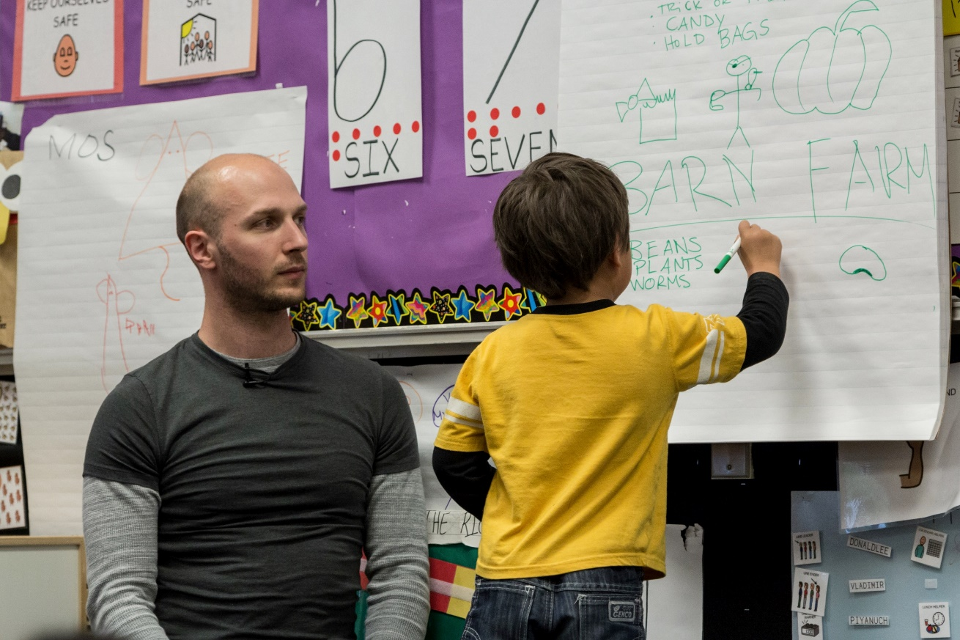
Brainstorm Theme
Brainstorm with children to determine the “what, who, and how”
  What scenarios can children act out in the dramatic play area?
  Who will children pretend to be in the dramatic play area—what roles can they play?
  How will children pretend in the scenario—what kind of language will they use and what are the “rules” of the different roles?

Slide 5
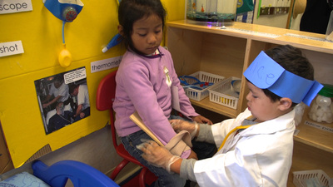
Build Props and Create Make-Believe Play Areas
Props help children stay in their roles and encourage role-specific language
Props can also encourage children to engage in different types of play scenarios

Slide 6
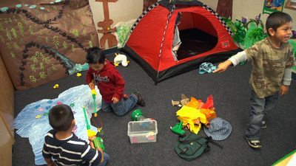
High-Level Make-Believe Play
Once you’ve selected an engaging play theme, provided children with rich background knowledge, brainstormed theme scenarios and roles with children, and made props, you are ready to support high-level make-believe play!

