Slide 1
Managing the classroom:
Designing Environments
FALL 2012

Slide 2
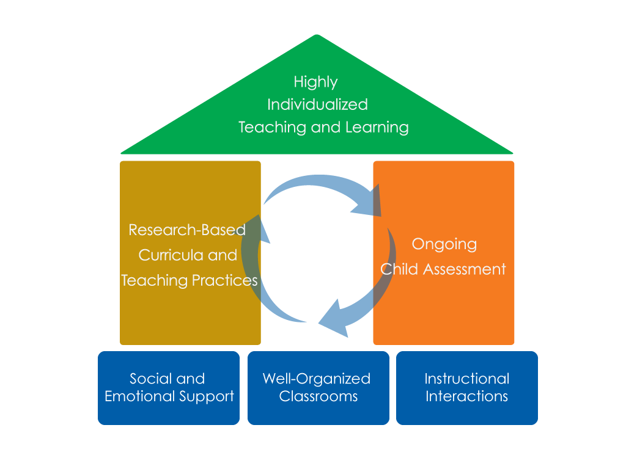
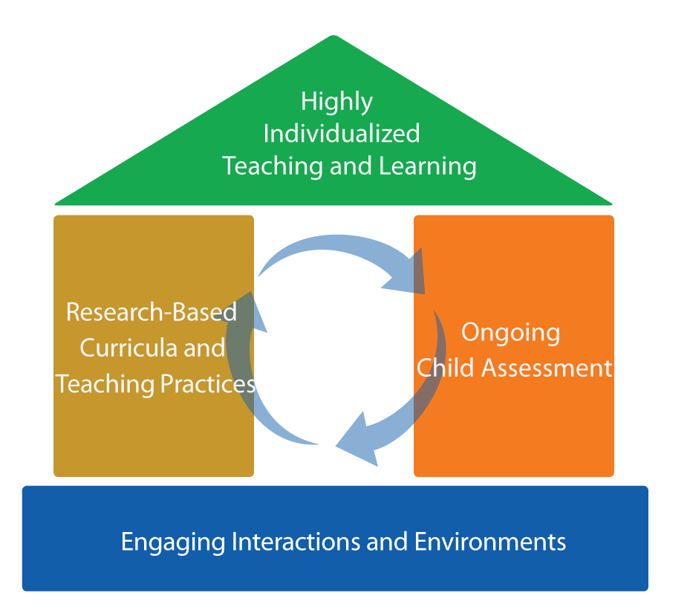
FRAMEWORK FOR EFFECTIVE PRACTICE
SUPPORTING SCHOOL READINESS FOR ALL CHILDREN
FOCUS ON
FOUNDATION

Slide 3
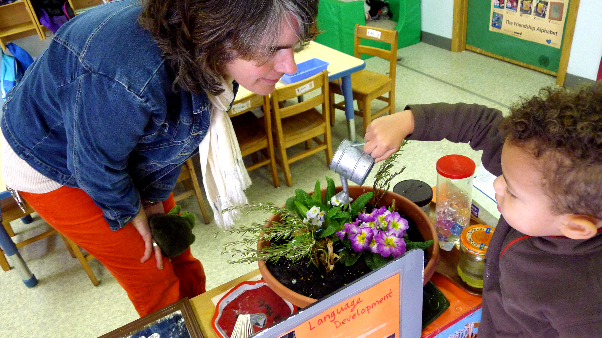
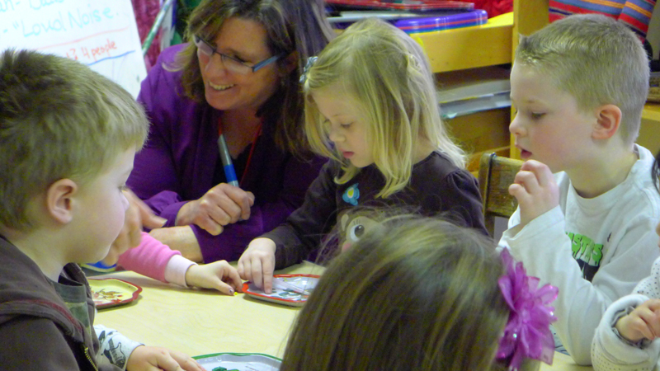
The focus
CLASSROOM ENVIRONMENTS THAT PROMOTE CHILDREN’S DEVELOPMENT AND LEARNING

Slide 4
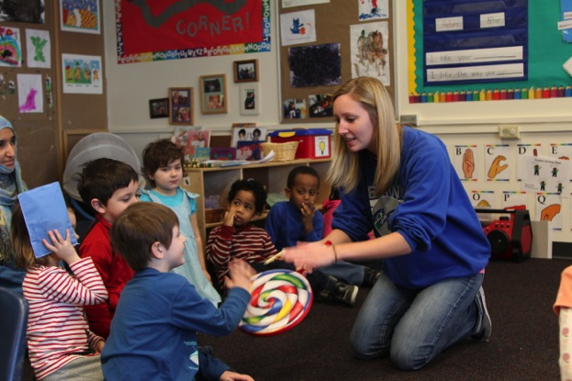
objectives
Describe the effects and identify components of effective environments.
Discuss approaches to designing
the physical space,
the contents,
and grouping
arrangements
in a well-organized
classroom.

Slide 5
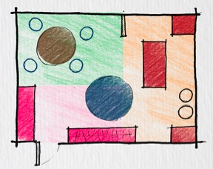
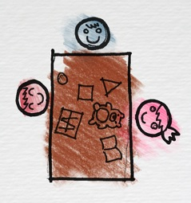
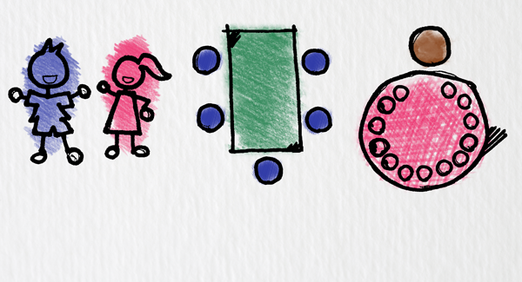
Effective environments
Support Children’s Engagement
  Well-Designed
  Physical Space
  Relevant
  Contents
  Intentional
  Groupings

Slide 6

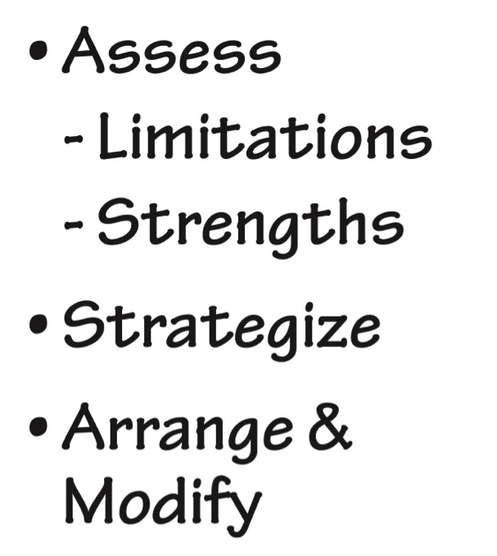
Design the physical spaces

Slide 7
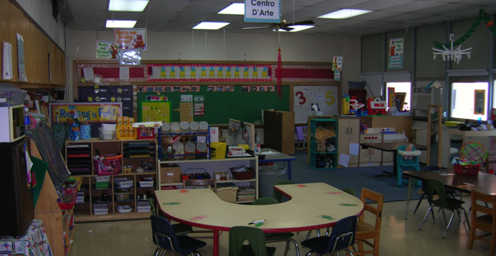
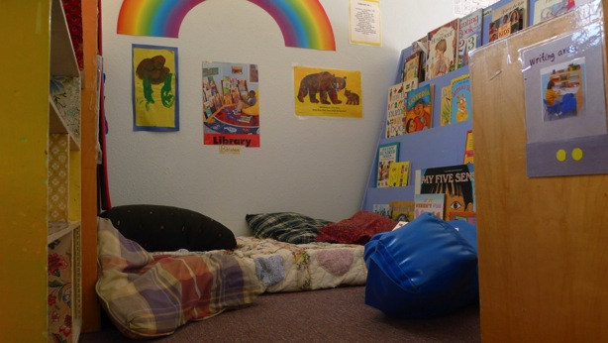
THE Child’s perspective
Welcoming?
Adequate Space?

Slide 8

Designing early childhood classroom
The rooms in this video are used everyday with children.
As you watch the video, reflect on both the strengths and limitations you see.

Slide 9
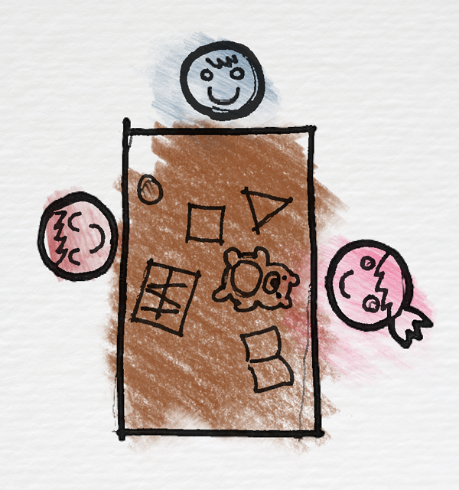
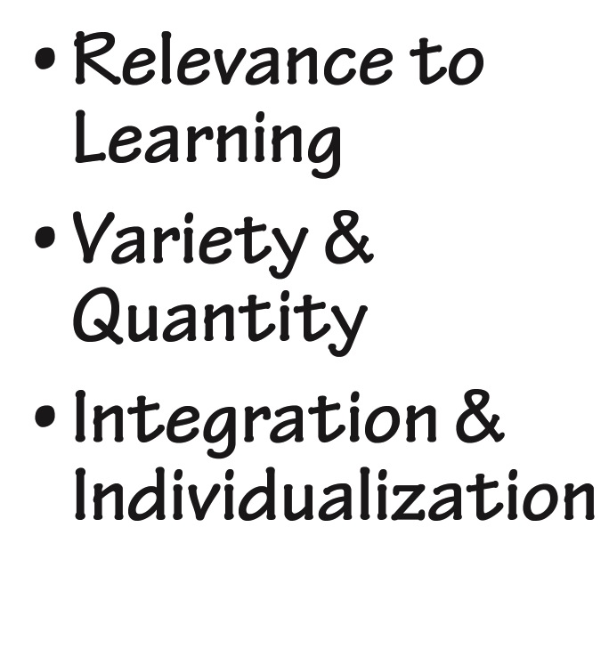
Design the classroom contents

Slide 10
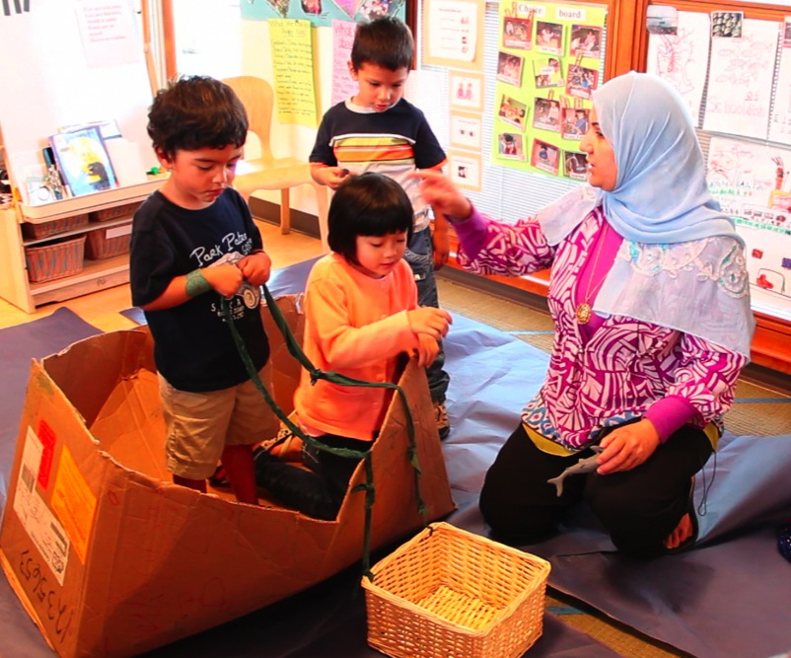
Guide learning
Visual Displays
Books & Music
Activities
Toys
Props
Materials

Slide 11
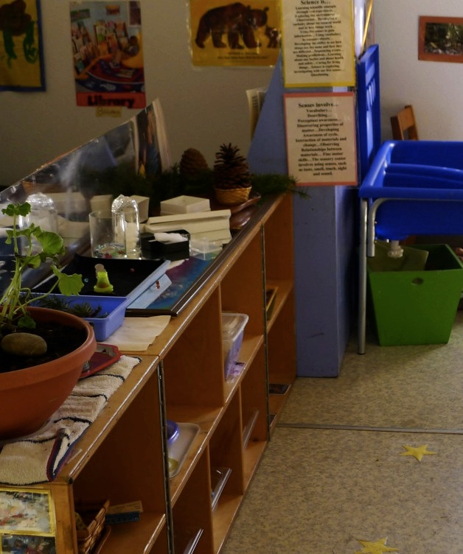
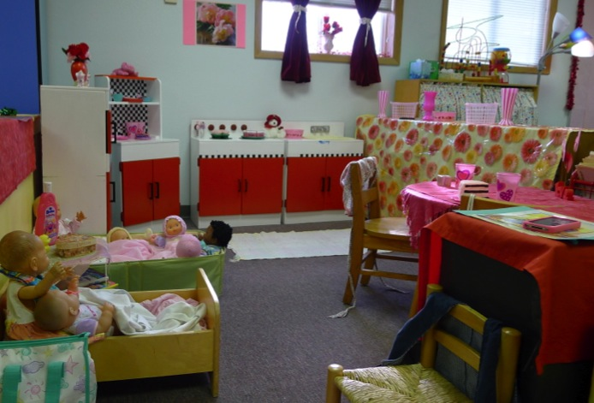
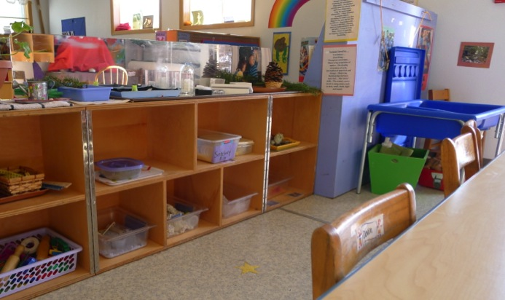
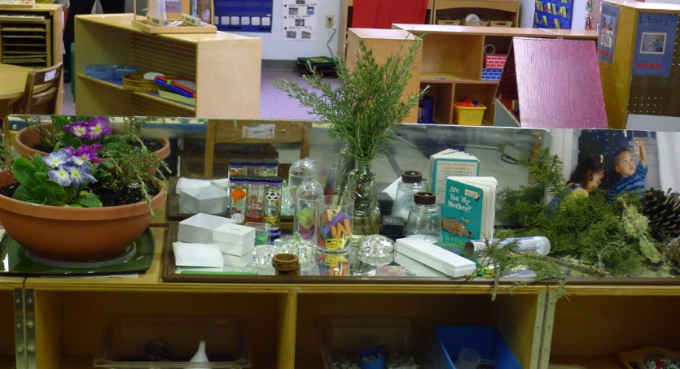
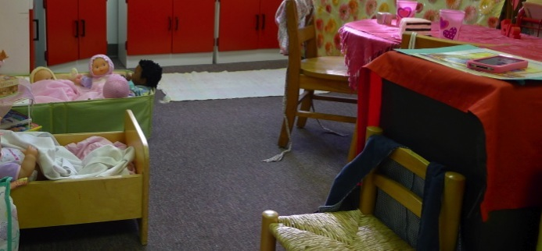
How is the learning being guided?

Slide 12
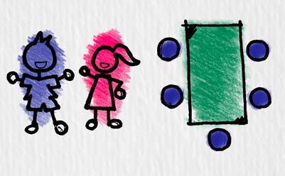
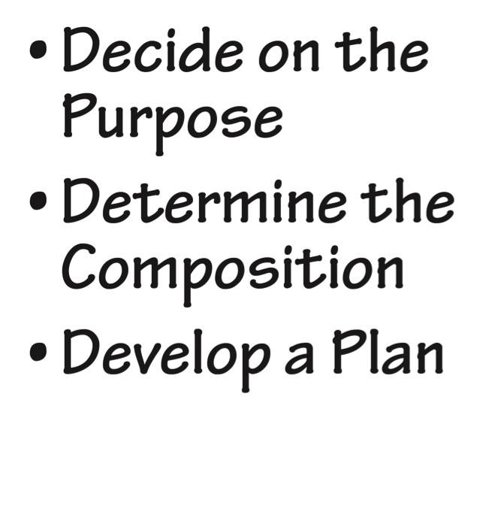
Design the groupings

Slide 13
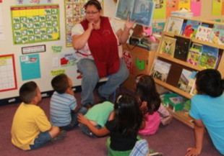


Maximize learning
  Large groups: Build community, do routine activities, and introduce concepts.
  Small groups: ↑opportunities for interactions and scaffolding.
  One-on-one: Provide individually
  focused instruction.

Slide 14
Other considerations
  Rotating Children & Toys
  Tailor Instruction in Small Groups
  Cooperative Toys & Activities
  Simple & Quick

Slide 15
review
What did you learn today about early childhood environments?
Reflect on the actions you will take in the coming weeks to increase the effectiveness of your classroom environment.

Slide 16
FALL 2012

