Slide 1
HSPPS Support Math
Subpart C - Education and Child Development Program Services
1302.30 Purpose
All programs must provide high-quality early education and child development services, including for children with disabilities, that promote children’s cognitive, social, and emotional growth for later success in school….
Notes:
OPTIONAL

Slide 2
HSPPS Support Math
Subpart C - Education and Child Development Program Services
    1302.31 Teaching and the Learning Environment
A center-based and family child care program must ensure teachers and other relevant staff provide responsive care, effective teaching, and an organized learning environment that promotes healthy development and children’s skill growth aligned with the Head Start Early Learning Outcomes Framework: Ages Birth to Five, including for children with disabilities….
Notes:
OPTIONAL

Slide 3
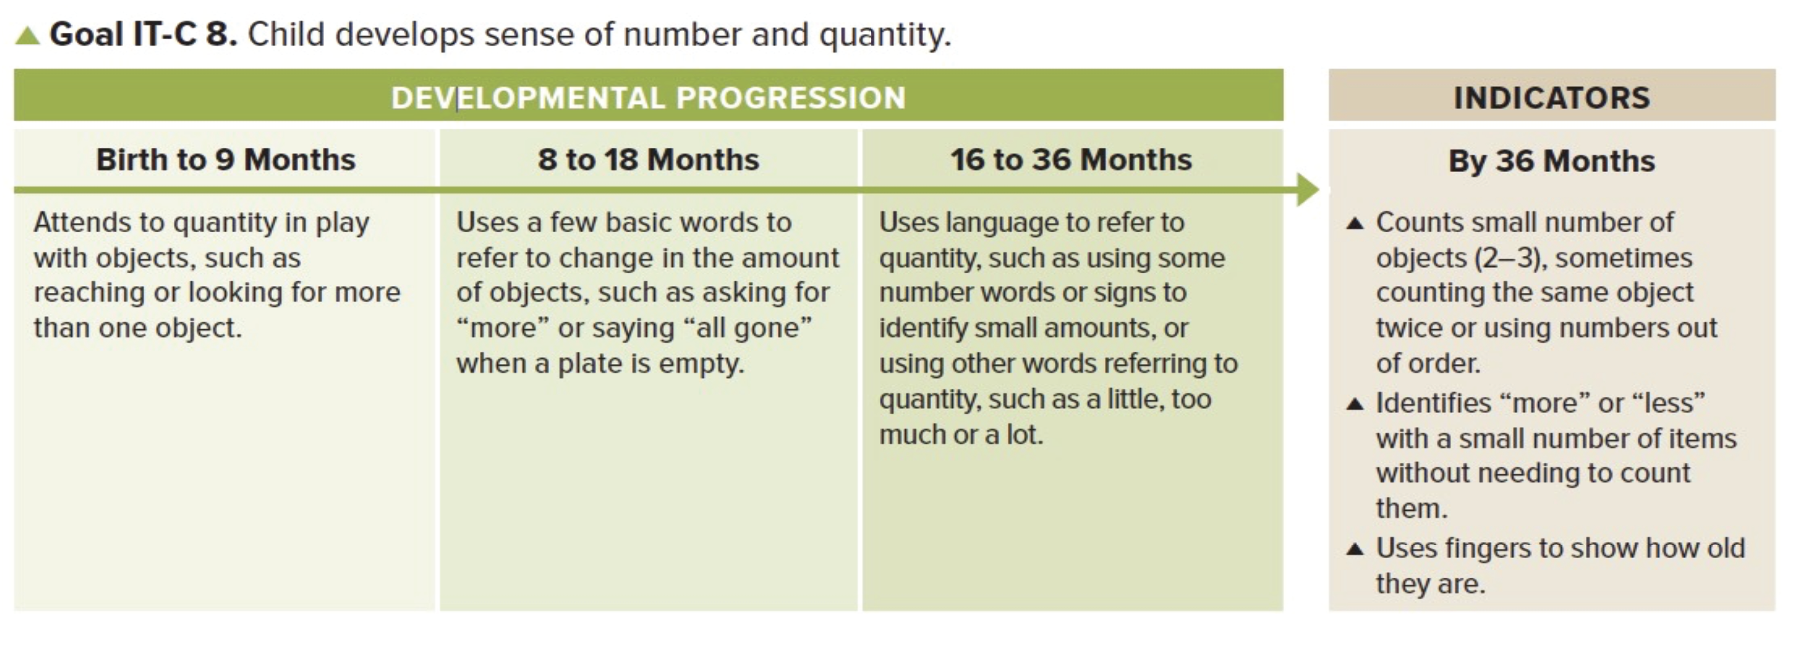
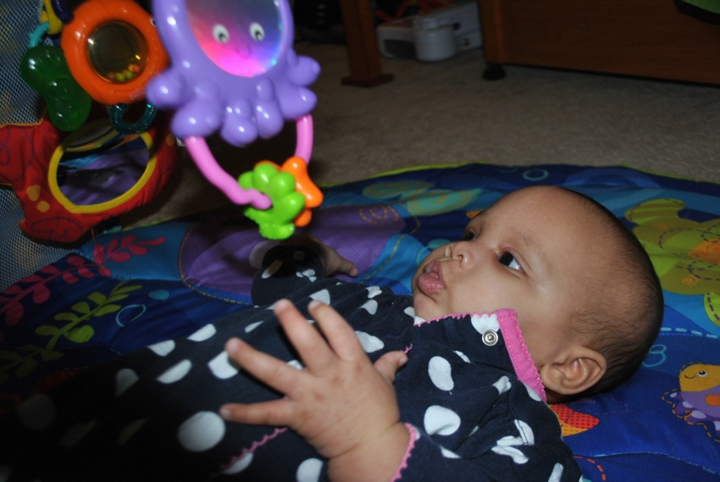
Sensitive to numbers small
and large.
Some use “two”….

Slide 4
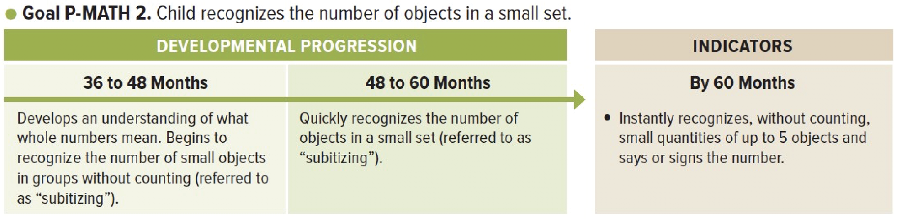


Slide 5

LT^{2:} Foundation
LearningTrajectories.org
Example

Slide 6
LT²: Small Collection Namer
LearningTrajectories.org
Example

Slide 7
LT²: Maker of Small Collections
LearningTrajectories.org
Example

Slide 8
LT²: Perceptual Subitizer to 4
LearningTrajectories.org
Example

Slide 9
LT²: Perceptual Subitizer to 5
LearningTrajectories.org
Example

Slide 10
LT²: Conceptual Subitizer to 5
LearningTrajectories.org
Example

Slide 11
LT²: Conceptual Subitizer to 10
LearningTrajectories.org
Example

Slide 12
LT²: Learning and Teaching with Learning Trajectories
See the Learning and Teaching with Learning Trajectories website for more trajectories, videos, and instructional math activities!
LearningTrajectories.org

