Slide 1

SOCIAL & EMOTIONAL DEVELOPMENT

Slide 2
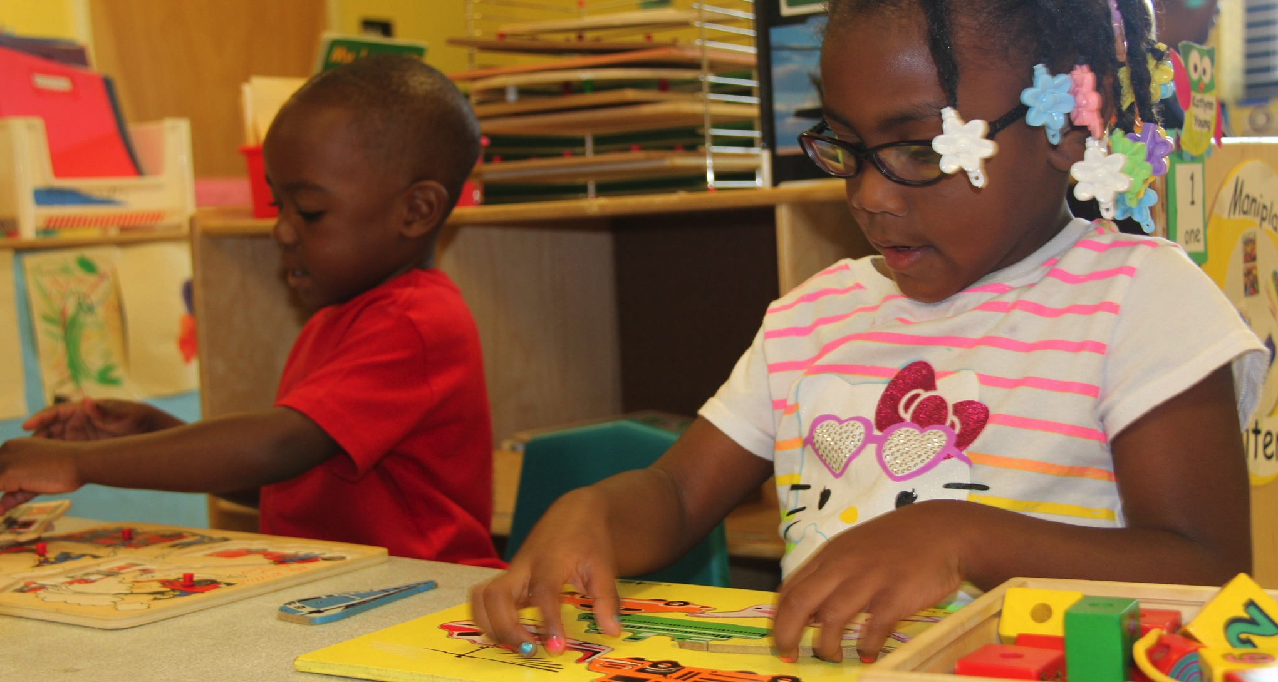
APPROACHES TO LEARNING

Slide 3
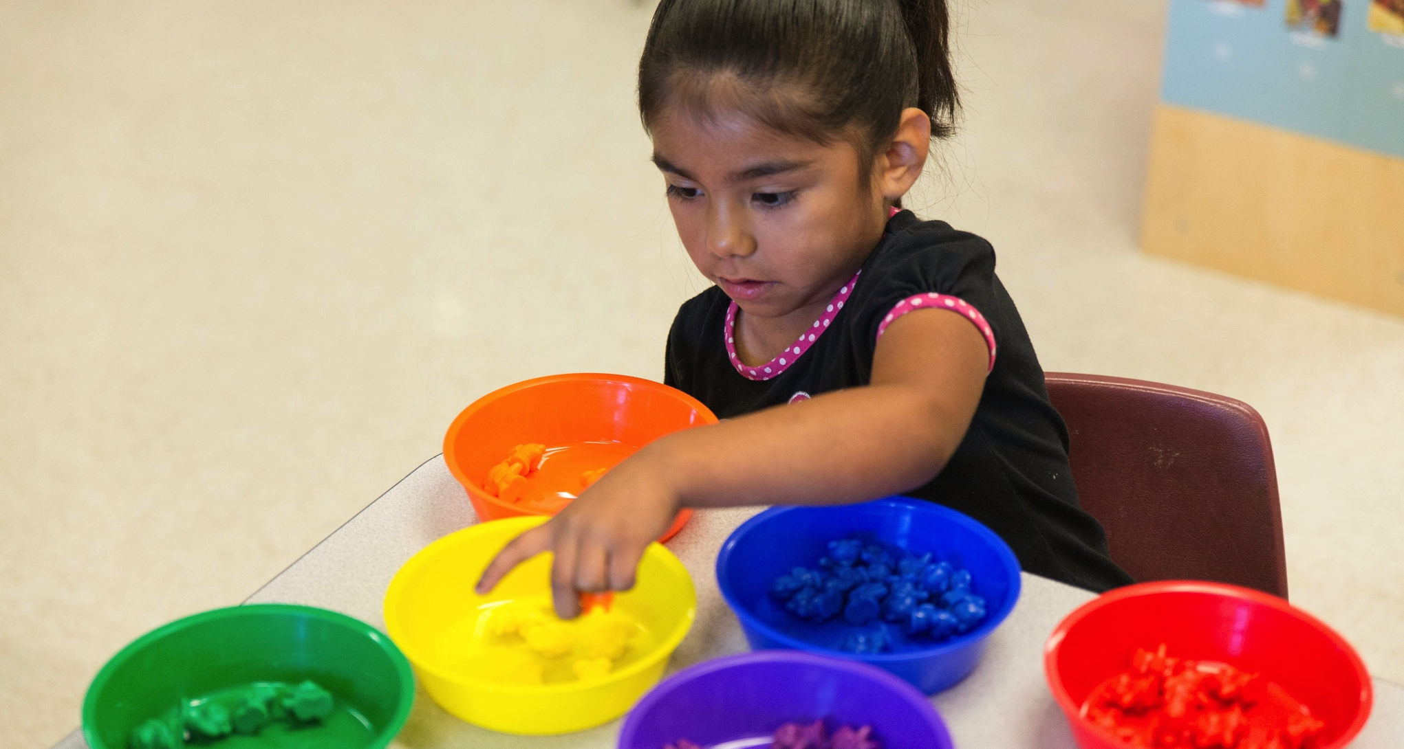
LOGIC & REASONING

Slide 4
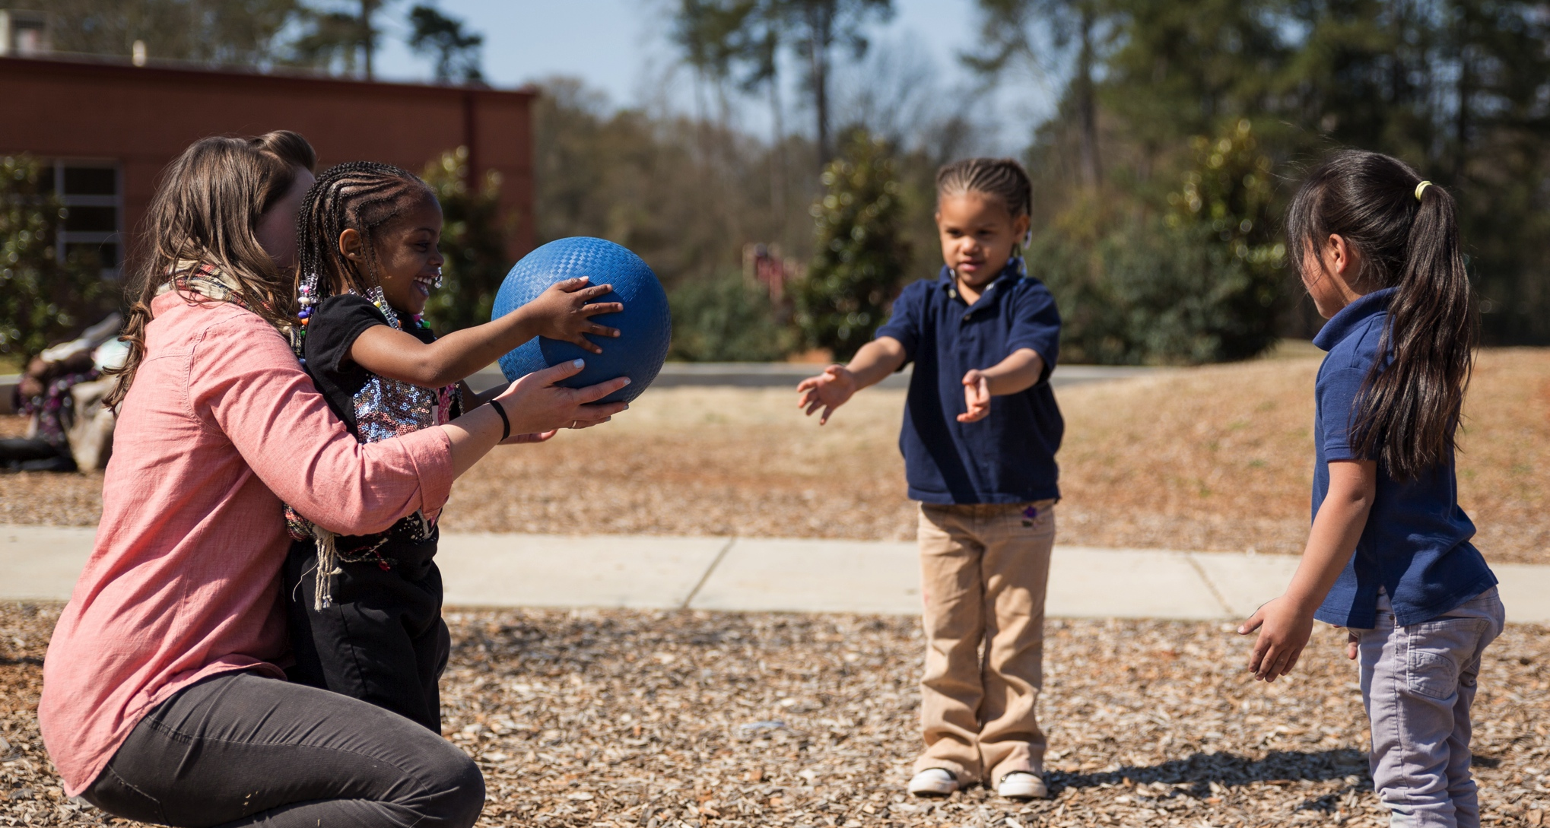
PHYSICAL DEVELOPMENT & HEALTH

Slide 5
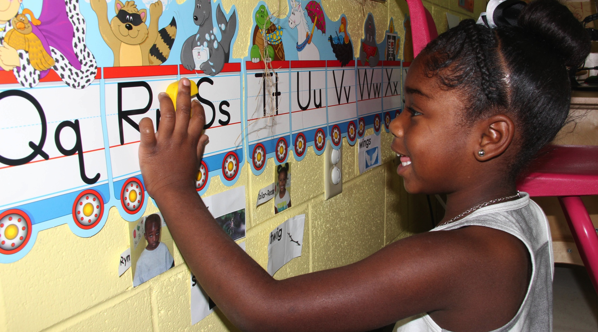
LITERACY KNOWLEDGE & SKILLS

Slide 6
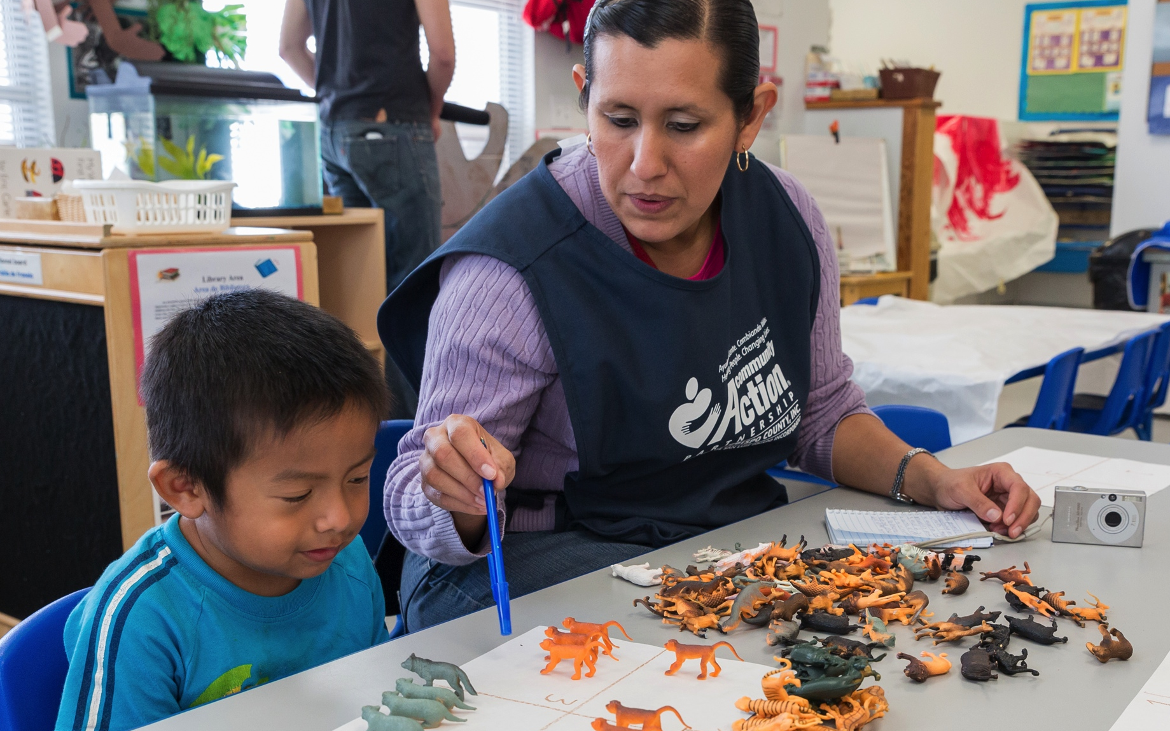
MATHEMATICS KNOWLEDGE & SKILLS

